Slide 1

STEM for inclusive schools
School Education
ERASMUS+
KA220-NW-23-30-151162
Cooperation partnerships in school education
Reference Number:
2023-1-DE03-KA220-SCH-000151162
Duration:
03.09.2023 to 02.03.2026
(30 months)
STEM for inclusive schools
Learning – Teaching – Training - Activity – LTTA 1
Inclusive Learning Models and Use of Digital Technologies in STEM
3rd - 7th of June 2024
Welcome to participants / Getting to know each other
3rd of June 2024
Presentation of the leading partner:
University of Paderborn
Chair of Business and Human Resource Education II
Prof. Dr. Marc Beutner

Slide 2

Welcome to the project
STEM for inclusive Schools

Slide 3


Welcome to the Project
STEM for inclusive schools
  A short information concerning:
Chair of Business, Human Resource Education and Evaluation Research Prof. Dr. Marc Beutner

Slide 4
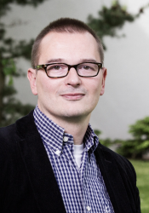
The department and the chair
Chair of Business, Human Resource Education and Evaluation Research Prof. Dr. Marc Beutner

Slide 5
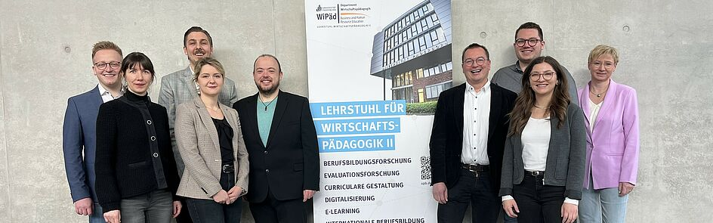
The Chair in portrait
Tim Eickels, Ilona Petsch, Sebastian Koppius, Jennifer Schneider, Elmar Janssen, Prof. Dr. Marc Beutner, Niclas Grüttner, Helene Lindenthal, Annette Steffens

Slide 6
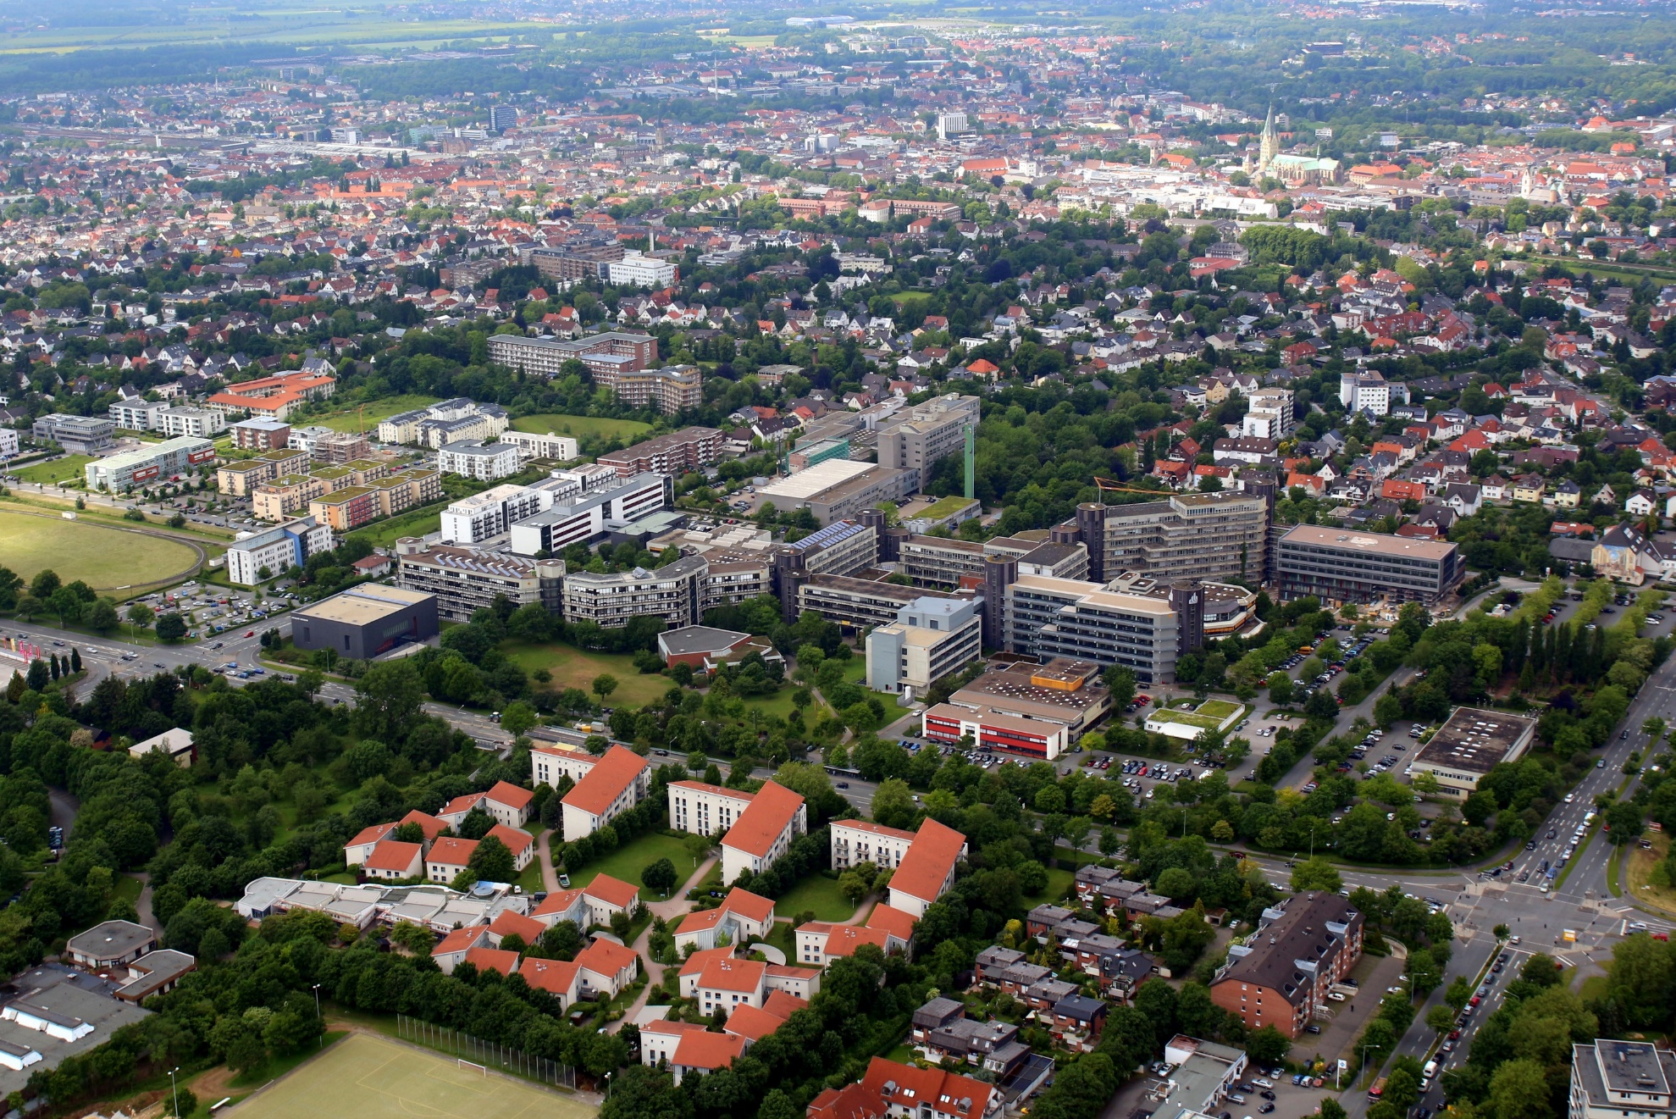
(University of Paderborn,
Picture from Patrick Kleibold, 14.06.2013)

Slide 7
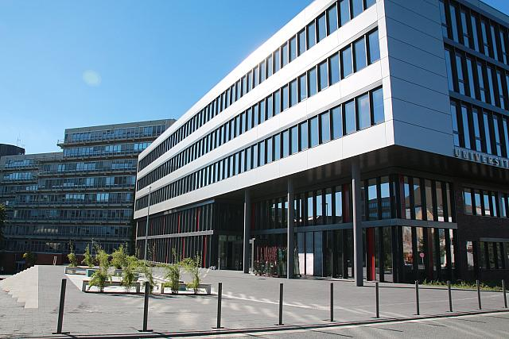

The University of Paderborn
Q-Building, University of Paderborn - Referat Presse und Kommunikation, 27.09.2013
5 faculties
About 65 different degree programmes
19.076 students 2022
2.646 staff members 2022

Slide 8
Research foci and fields of activity
  Youth education, Adult education, vocational education and
  vocational teacher education
  Education of students in the first phase (university phase) of teacher education in the field of adult education, vocational education and training
  Connection of teaching activities and research
  School education with focus on general and vocational schools
  European VET – Cultural differences and similarities
  Game-based-learning, Serious Games
  eLearning, mLearning
  Entrepreneurship Education and Career Orientation
  Evaluation in education and evaluation research
  Pedagogy, didactic and curricular approaches and designs

Slide 9

Nice to have you here.
Please introduce yourselves
Some information about you as a person and about your organisation

Slide 10
Contact
Universität Paderborn
Department Wirtschaftspädagogik Lehrstuhl Wirtschaftspädagogik II Warburger Str. 100
33098 Paderborn
http://www.upb.de/wipaed
Prof. Dr. Marc Beutner
Tel: +49 (0) 52 51 / 60 - 23 67
Fax: +49 (0) 52 51 / 60 - 35 63
E-Mail: marc.beutner@uni-paderborn.de

