Slide 1

STEM for inclusive schools
School Education
ERASMUS+
KA220-NW-23-30-151162
Cooperation partnerships in school education
Reference Number:
2023-1-DE03-KA220-SCH-000151162
Duration:
03.09.2023 to 02.03.2026
(30 months)
STEM for
inclusive schools
Transnational Partner Meeting - TPM 2
Pedagogical Conference – Poland - Radom
3rd to the 5th of September 2024
A warm welcome
4th of September 2024
Presentation of the leading partner:
University of Paderborn
Chair of Business and Human Resource Education II
Prof. Dr. Marc Beutner

Slide 2






Welcome, dear STEM for inclusive schools partners!
Bem-vindo
Powitanie
Sucessos Creativos, PT
SIEC Badawcza Lukasiewicz –
Instytut Technologii Ekspoatacji
Willkommen
Bine ați venit
Hoş geldiniz
Universität Paderborn, DE
Scoala Gimnaziala Nr. 7 Galati, RO
Universitatea Dunarea de Jos
din Galati, RO
Inovatif ve Girisimci Toplum Dernegi, TR

Slide 3
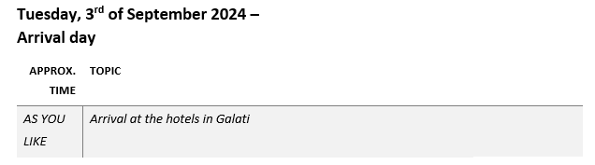
Meeting Agenda

Slide 4
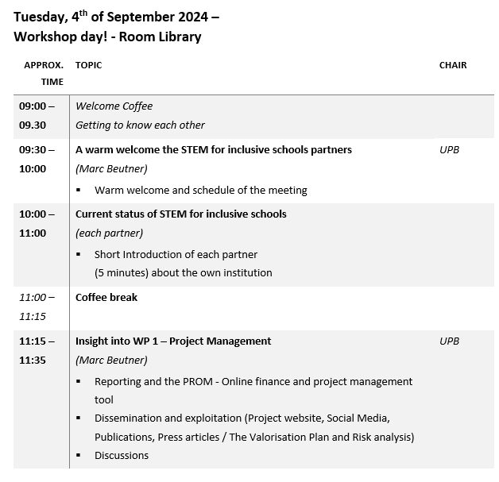

Meeting Agenda

Slide 5
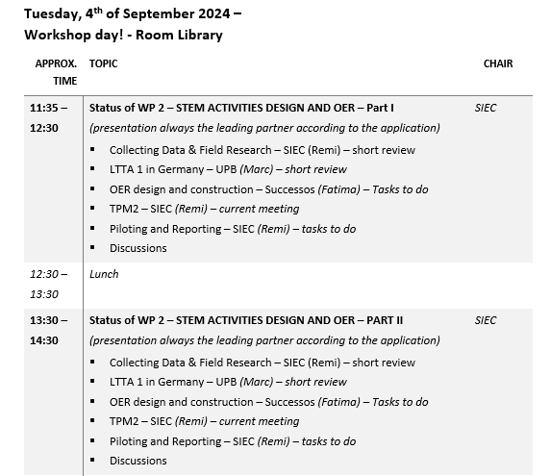
Meeting Agenda

Slide 6
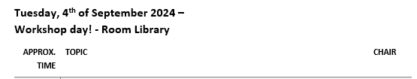
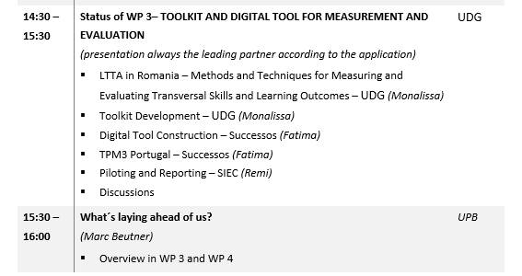
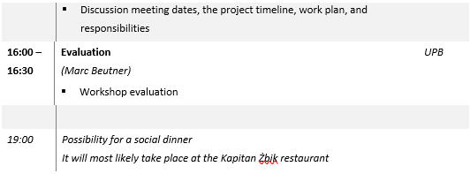
Meeting Agenda

Slide 7
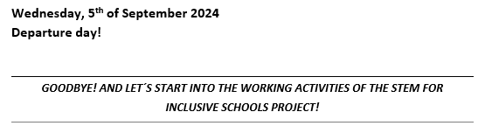
Meeting Agenda

Slide 8
Contact
Universität Paderborn
Department Wirtschaftspädagogik Lehrstuhl Wirtschaftspädagogik II Warburger Str. 100
33098 Paderborn
http://www.upb.de/wipaed
Prof. Dr. Marc Beutner
Tel: +49 (0) 52 51 / 60 - 23 67
Fax: +49 (0) 52 51 / 60 - 35 63
E-Mail: marc.beutner@uni-paderborn.de

