Slide 1

STEM for inclusive schools
School Education
ERASMUS+
KA220-NW-23-30-151162
Cooperation partnerships in school education
Reference Number:
2023-1-DE03-KA220-SCH-000151162
Duration:
03.09.2023 to 02.03.2026
(30 months)
STEM for
inclusive schools
Transnational Partner Meeting - TPM 1
The Kick-off-Meeting
11th to the 13th of March 2024
Getting to know the partners
12th of March 2024
Presentation of the leading partner:
University of Paderborn
Chair of Business and Human Resource Education II
Prof. Dr. Marc Beutner

Slide 2


Getting to know the partners
  A short information concerning:
Chair of Business, Human Resource Education and Evaluation Research Prof. Dr. Marc Beutner

Slide 3
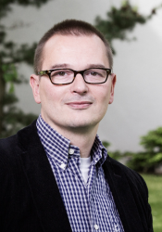
The department and the chair
Chair of Business, Human Resource Education and Evaluation Research Prof. Dr. Marc Beutner

Slide 4
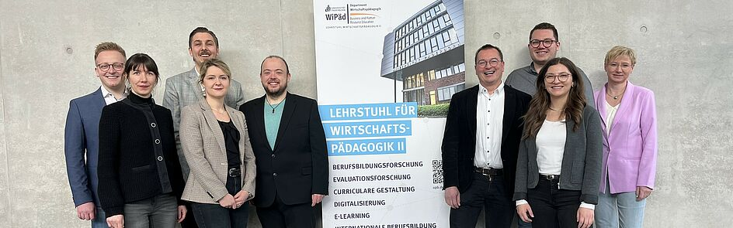
The Chair in portrait
Tim Eickels, Ilona Petsch, Sebastian Koppius, Jennifer Schneider, Elmar Janssen, Prof. Dr. Marc Beutner, Niclas Grüttner, Helene Lindenthal, Annette Steffens

Slide 5
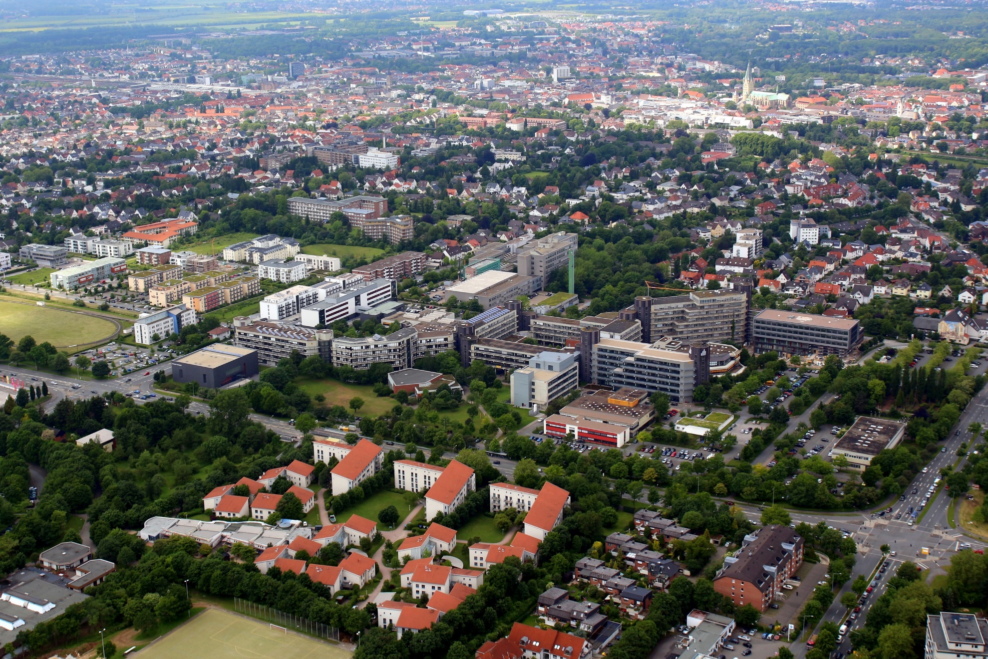
(University of Paderborn,
Picture from Patrick Kleibold, 14.06.2013)

Slide 6
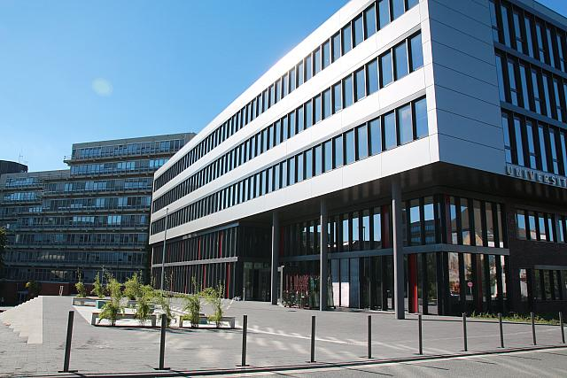

The University of Paderborn
Q-Building, University of Paderborn - Referat Presse und Kommunikation, 27.09.2013
5 faculties
About 65 different degree programmes
19.076 students 2022
2.646 staff members 2022

Slide 7
Research foci and fields of activity
  Youth education, Adult education, vocational education and
  vocational teacher education
  Education of students in the first phase (university phase) of teacher education in the field of adult education, vocational education and training
  Connection of teaching activities and research
  School education with focus on general and vocational schools
  European VET – Cultural differences and similarities
  Game-based-learning, Serious Games
  eLearning, mLearning
  Entrepreneurship Education and Career Orientation
  Evaluation in education and evaluation research
  Pedagogy, didactic and curricular approaches and designs

Slide 8
Some of our currently running projects
  Currently running international projects:
  EU-CERT: European Certificates and Accreditation for European Projects
  Interface: Using agile, interactive learning environments to promote work-based learning in cVET
  Reliable Green: Remote work, telework and learning with innovative and accessible educational resources for businesses and labor markets in Europeans Green Economy
  STEM-in-Action: Open Educational Resources for Teachers
  Learn STEM
  UglyFruitsNOT!:"Ugly" fruits and veggies...NOT! - An innovative educational program towards sustainable consumption and food waste reduction
  Currently running national projects:
  5G-Lernorte OWL: 5G-Lernorte für die Ausbildung der Zukunft
  FEL - Elektronischer Ausbildungsnachweis:
  Forschungsprojekt zur Entwicklung eines E-Learning Tools mit integriertem elektronischen Ausbildungsnachweis (FEL)
  für die berufliche Pflegeausbildung
  Weiterbildung4OWL – InWeDig:
  Intermediation von Weiterbildung und Digitale Transformation als Herausforderungen
  für Bildungs-Ökosysteme am Beispiel des Weiterbildungsraums it’s OWL

Slide 9
Contact
Universität Paderborn
Department Wirtschaftspädagogik Lehrstuhl Wirtschaftspädagogik II Warburger Str. 100
33098 Paderborn
http://www.upb.de/wipaed
Prof. Dr. Marc Beutner
Tel: +49 (0) 52 51 / 60 - 23 67
Fax: +49 (0) 52 51 / 60 - 35 63
E-Mail: marc.beutner@uni-paderborn.de

