Slide 1

STEM for inclusive schools
School Education
ERASMUS+
KA220-NW-23-30-151162
Cooperation partnerships in school education
Reference Number:
2023-1-DE03-KA220-SCH-000151162
Duration:
03.09.2023 to 02.03.2026
(30 months)
STEM for
inclusive schools
Transnational Partner Meeting - TPM 2
Pedagogical Conference – Poland - Radom
3rd to the 5th of September 2024
Insight into WP 1 – Project Management
Presentation of the leading partner:
University of Paderborn
Chair of Business and Human Resource Education II
Prof. Dr. Marc Beutner

Slide 2
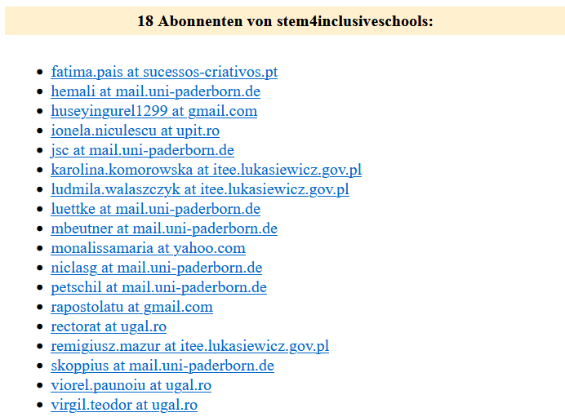
Mailinglist for the project:
STEM for inclusive schools
Let me know, if someone
should be added or removed.
Please, send me an email to:
Marc.Beutner@uni-paderborn.de
stem4inclusiveschools@lists.uni-paderborn.de

Slide 3
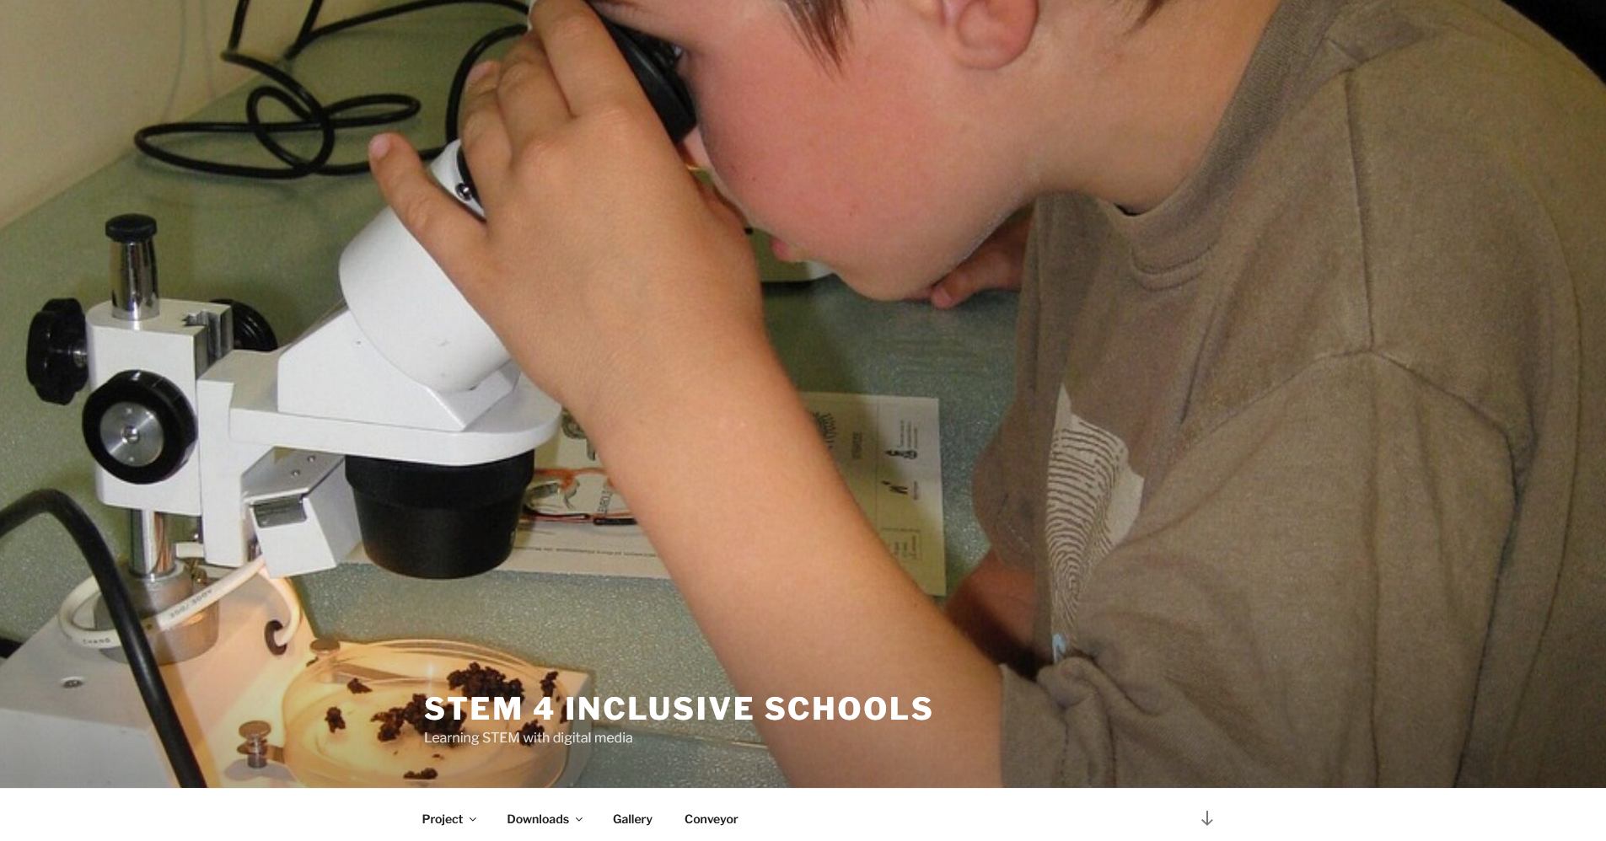
Promised general website of UPB for the NA
https://stem4inclusiveschools.eduproject.eu/

Slide 4
Poster and Translation provided by Remi
Fatima, do we have the final website address? STEMinSCH.eu or stem4inclusive.eu?
https://stem4inclusiveschools.eduproject.eu/

Slide 5
Project Website provided by Fatima
As Remi asked in his mail in June:
“Fatima, do we have the final website address?
STEMinSCH.eu or stem4inclusive.eu?”

Slide 6
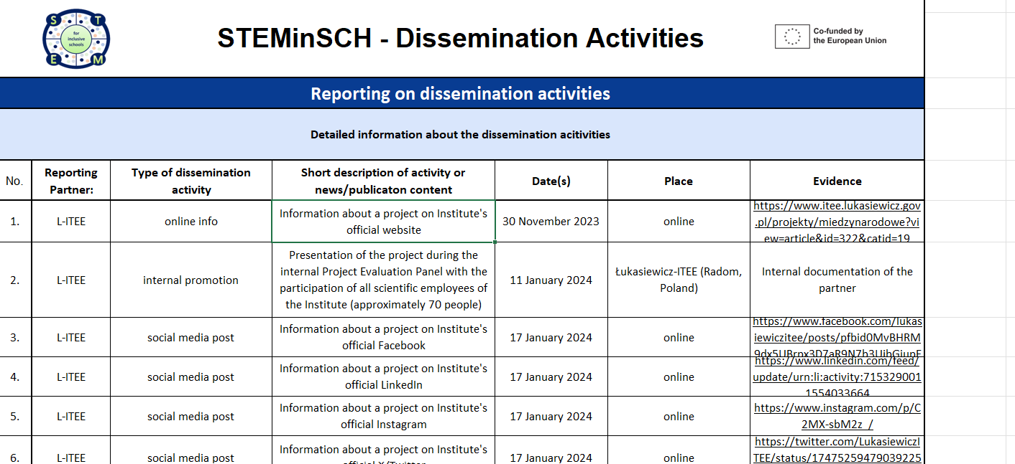
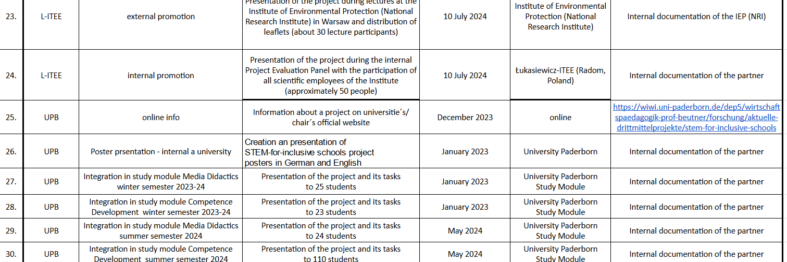
Dissemination list provided by Remi
https://docs.google.com/spreadsheets/d/1HphH30fpHhob9bVKZVP6tzfhPP7HOGQd/
edit?gid=1948846586#gid=1948846586

Slide 7
Contact
Universität Paderborn
Department Wirtschaftspädagogik Lehrstuhl Wirtschaftspädagogik II Warburger Str. 100
33098 Paderborn
http://www.upb.de/wipaed
Prof. Dr. Marc Beutner
Tel: +49 (0) 52 51 / 60 - 23 67
Fax: +49 (0) 52 51 / 60 - 35 63
E-Mail: marc.beutner@uni-paderborn.de

