Slide 1

STEM for inclusive schools
School Education
ERASMUS+
KA220-NW-23-30-151162
Cooperation partnerships in school education
Reference Number:
2023-1-DE03-KA220-SCH-000151162
Duration:
03.09.2023 to 02.03.2026
(30 months)
STEM for
inclusive schools
Transnational Partner Meeting - TPM 1
The Kick-off-Meeting
11th to the 13th of March 2024
Information on the status tasks to do until the 1st TPM
12th of March 2024
Presentation of the leading partner:
University of Paderborn
Chair of Business and Human Resource Education II
Prof. Dr. Marc Beutner

Slide 2
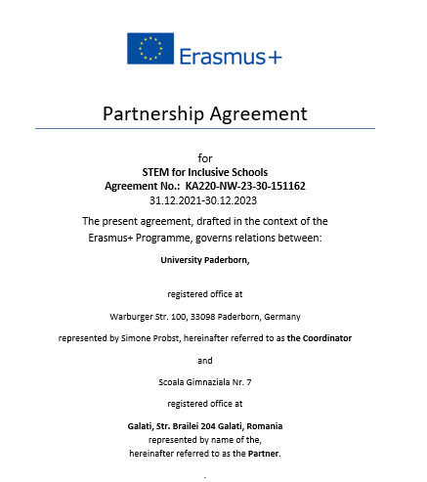
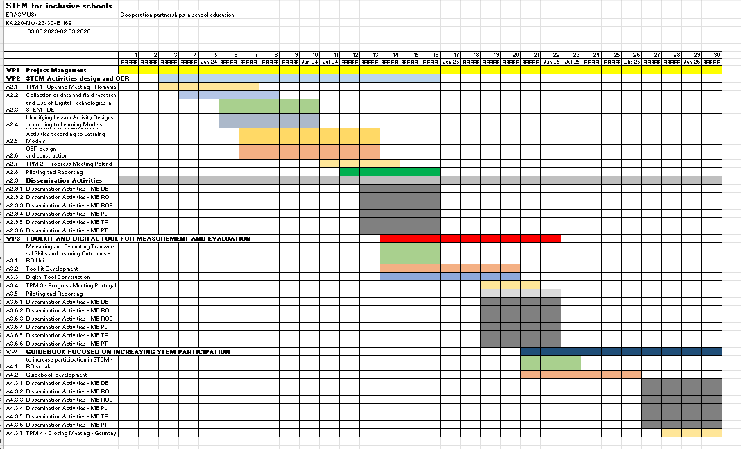
Insights into the status of
STEM for inclusive schools in Germany
Information about STEM and the project to students within the study modules for
VET-teacher training
Module: Media Didactics
Arrangements with the NA and concerning the Partner Agreements
Development of the project plan
and the Gantt-Chart

Slide 3

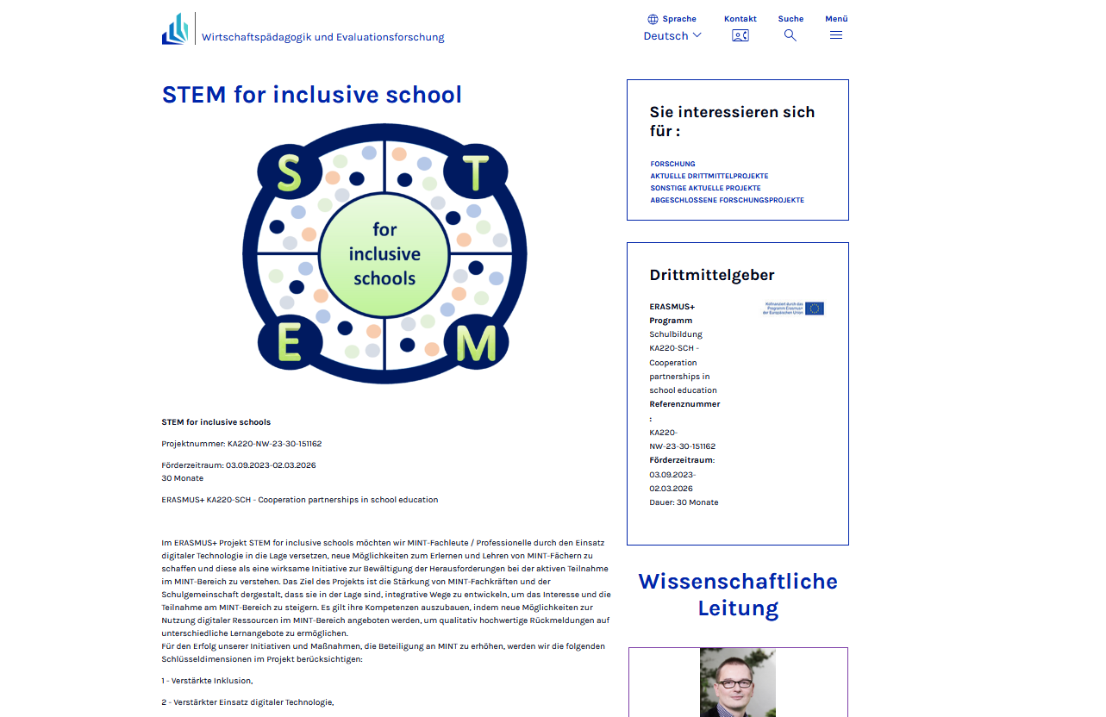
Insights into the status of
STEM for inclusive schools in Germany
Poster development
Project Website arrangements
First Press release concerning the project

Slide 4
Insights into the status of
STEM for inclusive schools in Germany
Collection of data concerning STEM
in Germany
Collection of data concerning inclusion
in Germany
Gathering OER information

Slide 5
Insights into the Status of
STEM for inclusive schools in the other partner countries
Please, be so kind and
provide us with some insights about the status in your countries.
Thank you!

Slide 6
Contact
Universität Paderborn
Department Wirtschaftspädagogik Lehrstuhl Wirtschaftspädagogik II Warburger Str. 100
33098 Paderborn
http://www.upb.de/wipaed
Prof. Dr. Marc Beutner
Tel: +49 (0) 52 51 / 60 - 23 67
Fax: +49 (0) 52 51 / 60 - 35 63
E-Mail: marc.beutner@uni-paderborn.de

