Slide 1

STEM for inclusive schools
School Education
ERASMUS+
KA220-NW-23-30-151162
Cooperation partnerships in school education
Reference Number:
2023-1-DE03-KA220-SCH-000151162
Duration:
03.09.2023 to 02.03.2026
(30 months)
STEM for
inclusive schools
Transnational Partner Meeting - TPM 1
The Kick-off-Meeting
11th to the 13th of March 2024
Insight into WP 1 – Project Management
12th of March 2024
Presentation of the leading partner:
University of Paderborn
Chair of Business and Human Resource Education II
Prof. Dr. Marc Beutner

Slide 2
WP1: Project Managment
Core information
Project Management is a task for all partners
UPB will do the coordination and is lead in WP1

Slide 3
WP1: Project Managment
Core information
Total amount for WP1:
49 875,00 €
Risk Analysis
Project Steering Commitee
Project Steering Commitee
Dissemination
+
Use of the PROM tool
- budget control /
project expenditure template
- reporting

Slide 4
WP1: Project Managment
Core information
Use always the agreed templates
(presentations, text etc.)
Make sure that always the following elements are on your files:
Logo of the project
Logo of the EU
OER Logo
Disclaimer Text of the EU

Slide 5
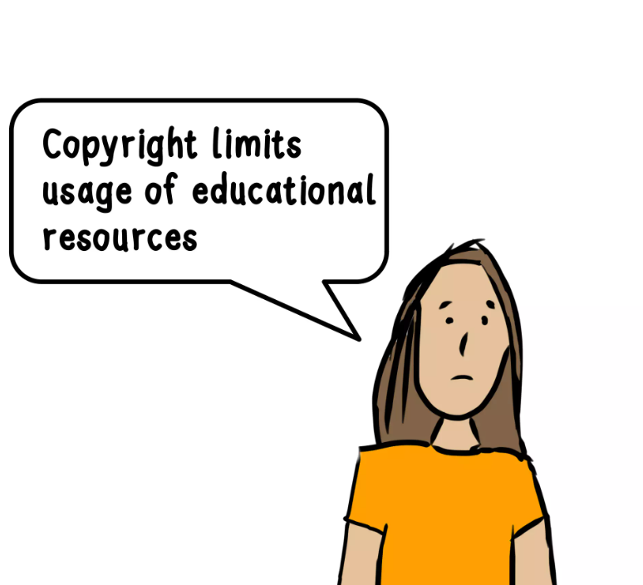
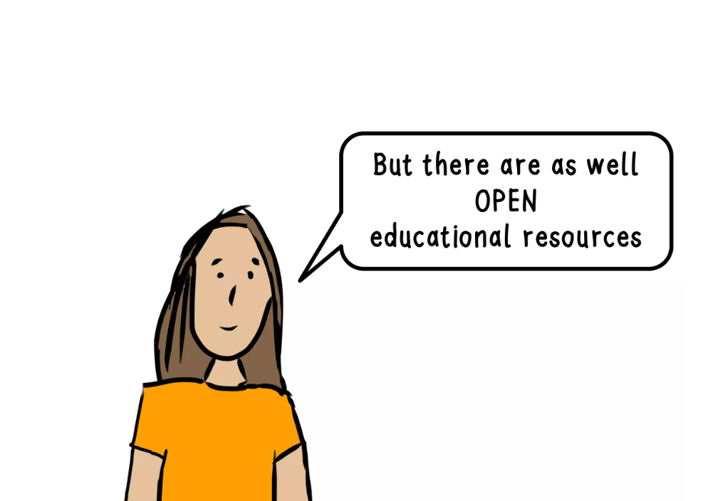
WP1
What is OER and Why do I need this?
Sandra Schoen, Keynote as ISOLEC 2020 conference (26th September) hosted by the University of Malang // CC BY- SA
Link: Open educational resources for language learning - a keynote at ISOLE… (slideshare.net)

Slide 6
Open Educational Resources
Focus on some definitions:
“Open Educational Resources are teaching, learning and research materials in any medium – digital or otherwise – that reside in the public domain or have been released under an open license that permits no-cost access, use, adaptation and redistribution by others with no or limited restrictions.” (Hewelett Foundation 2019)
Hewelett Foundation (2019): Retrieved from the Internet: https://hewlett.org/strategy/open-educational-resources/. Last access date: March 2022.

Slide 7

Attributing Sources
“You can use CC-licensed materials as long as you follow the license conditions.
One condition of all CC licenses is attribution” (Creative Commons Licences, 2022).
Creative Commons (2019/2022): Retrieved from the Internet: https://creativecommons.org/use-remix/,
Access date: 01.03.2024.
Notes:
Sie können CC-lizenzierte Materialien verwenden, solange Sie die Lizenzbedingungen einhalten. Eine Bedingung aller CC-Lizenzen ist die Namensnennung

Slide 8
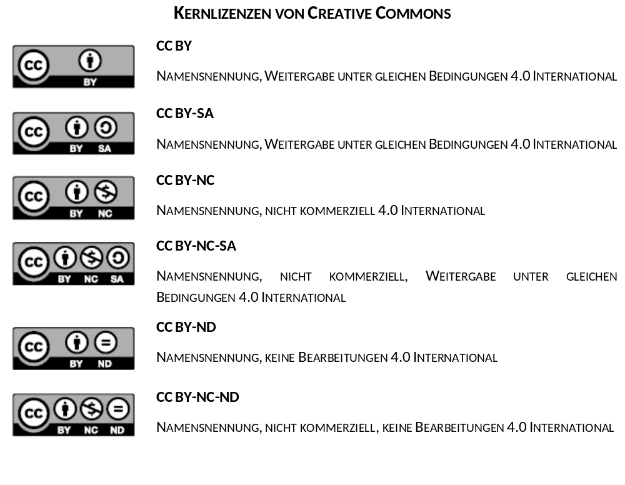
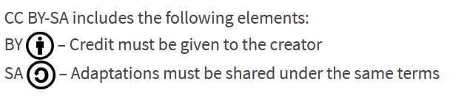
Forms and Types of OER licences
“CC BY-SA: This license allows reusers to distribute, remix, adapt, and build upon the material in any medium or format, so long as attribution is given to the creator. The license allows for commercial use. If you remix, adapt, or build upon the material, you must license the modified material under identical terms.”
© 2019. This work is licensed under a CC BY 4.0 license.
Retrieved from the Internet: https://creativecommons.org/about/cclicenses/,
Access date 01.03.2024.
Notes:
More restrictive

Slide 9
Contact
Universität Paderborn
Department Wirtschaftspädagogik Lehrstuhl Wirtschaftspädagogik II Warburger Str. 100
33098 Paderborn
http://www.upb.de/wipaed
Prof. Dr. Marc Beutner
Tel: +49 (0) 52 51 / 60 - 23 67
Fax: +49 (0) 52 51 / 60 - 35 63
E-Mail: marc.beutner@uni-paderborn.de

