Slide 1

STEM for inclusive schools
School Education
ERASMUS+
KA220-NW-23-30-151162
Cooperation partnerships in school education
Reference Number:
2023-1-DE03-KA220-SCH-000151162
Duration:
03.09.2023 to 02.03.2026
(30 months)
STEM for inclusive schools
Learning – Teaching – Training - Activity – LTTA 1
Inclusive Learning Models and Use of Digital Technologies in STEM
3rd - 7th of June 2024
OER Educational Resources – Core Information
4th of June 2024
Presentation of the leading partner:
University of Paderborn
Chair of Business and Human Resource Education II
Prof. Dr. Marc Beutner

Slide 2
Table of content
What are Open Educational Resources?
Brainstorming and loud thinking

Slide 3
What are OER?
Notes:
Middle ages and ancient times:
Teaching, sharing of knowledge and materials was already practiced in ancient times
The Idea of being open is a big topic for schools and all parts of educational landscape
The Term and the idea of open in education begins in the year 2002: Here the use of the wording OER was fistly used during the UNESCO Conference “„Forum on the Impact of Open Courseware for Higher Education in Developing Countries“
Where everything starts?
Historically, open licenses have their origins in the legal regulation of software use.
The origin of the open idea is rooted in the early 1980s by Richard Stallmann.
He is the inventor and developer of the GNU Project. 1985 Strallmann established the Free Software Foundation where even the first open licence also called GNU, abbreviation for General Public Licence was founded and used the first time.
- free and open are used synonym.
The best known and most used is the Creative Commons (CC) licensing system, which was founded in 2001 by a non-profit organization.

Slide 4
Open Educational Resources
Free Software Foundation
Open Source Movement
Open Educational Resource Movement
Open Access Movement (especially for higher education in Universities)
Open- Content Movement
Notes:
Teaching, sharing of knowledge and materials was already practiced in ancient times
The Idea of being open is a big topic for schools and all parts of educational landscape
The Term and the idea of open in education begins in the year 2002: Here the use of the wording OER was firstly used during the UNESCO Conference “„Forum on the Impact of Open Courseware for Higher Education in Developing Countries“
Where everything starts?
Historically, open licenses have their origins in the legal regulation of software use.
The origin of the open idea is rooted in the early 1980s by Richard Stallmann.
He is the inventor and developer of the GNU Project. 1985 Strallmann established the Free Software Foundation where even the first open licence also called GNU, abbreviation for General Public Licence was founded and used the first time.
- free and open are used synonym.
The best known and most used is the Creative Commons (CC) licensing system, which was founded in 2001 by a non-profit organization.

Slide 5
Open Educational Resources
Focus on some definitions:
The term OER was first used in 2002 in the UNESCO conference report "Forum on the Impact of Open Courseware for Higher Education in Developing Countries" and thus introduced into the discussions.
“The open provision of educational resources, enabled by information and communication technologies, for consultation, use and adaptation by a community of users for non-commercial purposes” (UNESCSO 2002).
UNESCO (2002),‘Forum on the Impact of Open Courseware for Higher Education in Developing Countries’ in 2002, report available online at http://portal.unesco.org/ci/en/ev.php-URL_ID=5303&URL_DO=DO_TOPIC&URL_SECTION=201.html, last accessed March 2022.

Slide 6
Open Educational Resources
Focus on some definitions:
„OER are digitised materials offered freely and openly for educators, students, and self-learners to use and reuse for teaching, learning, and research. OER includes learning content, software tools to develop, use, and distribute content, and implementation resources such as open licences.“ (OECD 2007)
OECD (2007): Giving Knowledge for Free, The emergence of open educational resources, Centre for educational research and innovation. P. 30ff. Link: http://www.oecd.org/edu/ceri/38654317.pdf.

Slide 7
Open Educational Resources
Focus on some definitions:
“Open Educational Resources are teaching, learning and research materials in any medium – digital or otherwise – that reside in the public domain or have been released under an open license that permits no-cost access, use, adaptation and redistribution by others with no or limited restrictions.” (Hewelett Foundation 2019)
Conclusion?
What are OER?
Hewelett Foundation (2019): Retrieved from the Internet: https://hewlett.org/strategy/open-educational-resources/. Last access date: March 2022.

Slide 8
What makes a resource open?
Wiley´s 5Rs of OpennEss (2014)

Slide 9
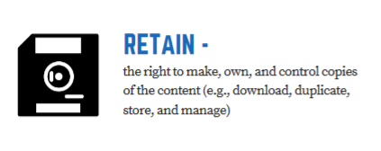
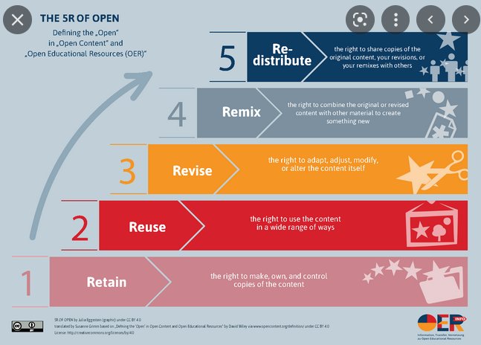
What makes a resource open?
German Translation of: „5 V-Freiheiten fu?r Offenheit“ von Julia Eggestein (Grafik), Jo?ran Muuß-Merholz (inhaltliche U?bersetzung, Anpassung und vorsichtige Erweiterung) und Jo?rg Lohrer (Wortscho?pfer) unter CC BY 4.0 basierend auf „Defining the ‘Open’ in Open Content and Open Educational Resources“ von David Wiley auf CC BY 4.0.
This material is based on original writing by David Wiley, which was published freely under a
Creative Commons Attribution 4.0 license at http://opencontent.org/definition/.
By Rachel Arteaga Creative Commons Attribution 4.0 International L
Notes:
Sichern
Common Structur/ Hierachy:
The lowest level of Openess is Retain

Slide 10
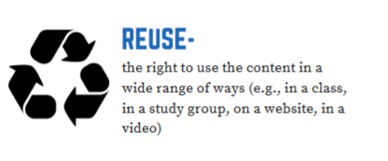
What makes a resource open?
German Translation of: „5 V-Freiheiten fu?r Offenheit“ von Julia Eggestein (Grafik), Jo?ran Muuß-Merholz (inhaltliche U?bersetzung, Anpassung und vorsichtige Erweiterung) und Jo?rg Lohrer (Wortscho?pfer) unter CC BY 4.0 basierend auf „Defining the ‘Open’ in Open Content and Open Educational Resources“ von David Wiley auf CC BY 4.0.
This material is based on original writing by David Wiley, which was published freely under a
Creative Commons Attribution 4.0 license at http://opencontent.org/definition/.
By Rachel Arteaga Creative Commons Attribution 4.0 International L

Slide 11
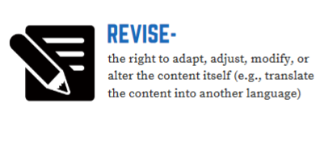
What makes a resource open?
German Translation of: „5 V-Freiheiten fu?r Offenheit“ von Julia Eggestein (Grafik), Jo?ran Muuß-Merholz (inhaltliche U?bersetzung, Anpassung und vorsichtige Erweiterung) und Jo?rg Lohrer (Wortscho?pfer) unter CC BY 4.0 basierend auf „Defining the ‘Open’ in Open Content and Open Educational Resources“ von David Wiley auf CC BY 4.0.
This material is based on original writing by David Wiley, which was published freely under a
Creative Commons Attribution 4.0 license at http://opencontent.org/definition/.
By Rachel Arteaga Creative Commons Attribution 4.0 International L

Slide 12
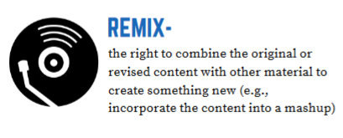
What makes a resource open?
German Translation of: „5 V-Freiheiten fu?r Offenheit“ von Julia Eggestein (Grafik), Jo?ran Muuß-Merholz (inhaltliche U?bersetzung, Anpassung und vorsichtige Erweiterung) und Jo?rg Lohrer (Wortscho?pfer) unter CC BY 4.0 basierend auf „Defining the ‘Open’ in Open Content and Open Educational Resources“ von David Wiley auf CC BY 4.0.
This material is based on original writing by David Wiley, which was published freely under a
Creative Commons Attribution 4.0 license at http://opencontent.org/definition/.
By Rachel Arteaga Creative Commons Attribution 4.0 International L
Notes:
One of the highest level of openness a author can permit

Slide 13
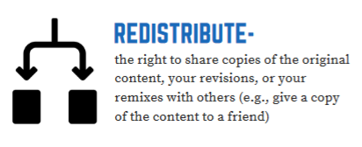
What makes a resource open?
German Translation of: „5 V-Freiheiten fu?r Offenheit“ von Julia Eggestein (Grafik), Jo?ran Muuß-Merholz (inhaltliche U?bersetzung, Anpassung und vorsichtige Erweiterung) und Jo?rg Lohrer (Wortscho?pfer) unter CC BY 4.0 basierend auf „Defining the ‘Open’ in Open Content and Open Educational Resources“ von David Wiley auf CC BY 4.0.
This material is based on original writing by David Wiley, which was published freely under a
Creative Commons Attribution 4.0 license at http://opencontent.org/definition/.
By Rachel Arteaga Creative Commons Attribution 4.0 International L

Slide 14

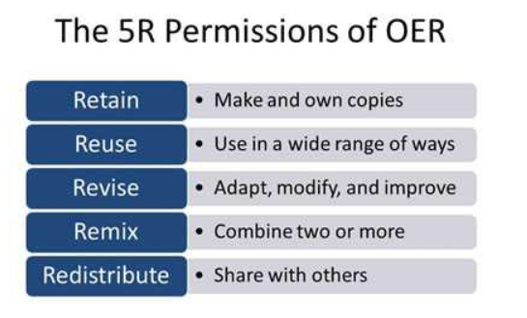
What makes a resource open?
Summary of 5R of Openness by David Willey:
Retain - the right to make, own, and control copies of the content (e.g., download, duplicate, store, and manage)
Reuse - the right to use the content in a wide range of ways (e.g., in a class, in a study group, on a website, in a video)
Revise - the right to adapt, adjust, modify, or alter the content itself (e.g., translate the content into another language)
Remix - the right to combine the original or revised content with other material to create something new (e.g., incorporate the content into a mashup)
Redistribute - the right to share copies of the original content, your revisions, or your remixes with others (e.g., give a copy of the content to a friend)
eCampusnews (2022): Retrieved from the Internet: https://www.ecampusnews.com/2014/11/19/oer-course-design-475/, Access date March 2022.
This material is based on original writing by David Wiley, which was published freely under a
Creative Commons Attribution 4.0 license at http://opencontent.org/definition/.
By Rachel Arteaga Creative Commons Attribution 4.0 International L

Slide 15
Today:
Forms and Types
Creating, Using, and Sharing
Creating your STEM Tool Box

Slide 16
Contact
Universität Paderborn
Department Wirtschaftspädagogik Lehrstuhl Wirtschaftspädagogik II Warburger Str. 100
33098 Paderborn
http://www.upb.de/wipaed
Prof. Dr. Marc Beutner
Tel: +49 (0) 52 51 / 60 - 23 67
Fax: +49 (0) 52 51 / 60 - 35 63
E-Mail: marc.beutner@uni-paderborn.de
Jennifer Schneider
Tel: +49 (0) 52 51 / 60 – 27 98
Fax: +49 (0) 52 51 / 60 - 35 63
E-Mail: Jennifer.Schneider@uni-paderborn.de

