Slide 1

STEM for inclusive schools
School Education
ERASMUS+
KA220-NW-23-30-151162
Cooperation partnerships in school education
Reference Number:
2023-1-DE03-KA220-SCH-000151162
Duration:
03.09.2023 to 02.03.2026
(30 months)
STEM for
inclusive schools
Transnational Partner Meeting - TPM 1
The Kick-off-Meeting
11th to the 13th of March 2024
Insight into WP 2 – STEM ACTIVITIES DESIGN AND OER
12th of March 2024
Presentation of the leading partner:
University of Paderborn
Chair of Business and Human Resource Education II
Prof. Dr. Marc Beutner

Slide 2
Insight into WP 2 – STEM ACTIVITIES DESIGN AND OER
Activities under WP2
2.1: Transnational Project Meeting: Opening Meeting – TPM1 Galati Romania – 11 - 13-03-2024
Universitatea Dunarea De Jos Din Galati, RO
2.2: Collecting Data & Field Research
SIEC Badawcza Lukasiewicz – Instytut Technologii Eksploatacji, PL
2.3: LTTA Inclusive Learning Models and Use of Digital Technologies in STEM
UPB – Universität Paderborn, DE
2.4: Identifying Lesson Activity Designs According to Learning Models
UPB – Universität Paderborn, DE
2.5: Preparation of STEM Lesson Activities According to Learning Models
UPB – Universität Paderborn, DE
2.6: OER design and construction
Sucessos Criativos, Lda, PT
2.7: Transnational Project Meeting-2: Progress Meeting –
„The STEM conference for School education“ Poland
SIEC Badawcza Lukasiewicz – Instytut Technologii Eksploatacji, PL
2.8: Piloting and Reporting
SIEC Badawcza Lukasiewicz – Instytut Technologii Eksploatacji, PL
Notes:
More restrictive

Slide 3
Insight into WP 2 – STEM ACTIVITIES DESIGN AND OER
Dissemination Activities under WP2
2.9.1: Dissemination Activities – Germany
UPB – Universität Paderborn, DE
2.9.2: Dissemination Activities - Romania I
Universitatea Dunarea De Jos Din Galati, RO
2.9.3: Dissemination Activities - Romania II
Scoala Gimnaziala Nr. 7 Galati, RO
2.9.4: Dissemination Activities – Poland
SIEC Badawcza Lukasiewicz – Instytut Technologii Eksploatacji, PL
2.9.5: Dissemination Activities – Türkiye
Inovatif ve Girisimci Toplum Dernegi, TR
2.9.6: Dissemination Activities – Portugal
Sucessos Criativos, Lda, PT
Notes:
More restrictive

Slide 4
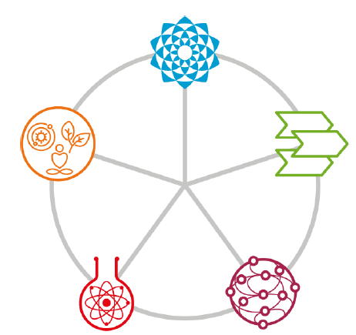
Insight into WP 2 – STEM ACTIVITIES DESIGN AND OER
2.3: LTTA Inclusive Learning Models and Use of Digital Technologies in STEM
UPB – Universität Paderborn, DE
Complex
5E-STEM
after Vu Thi Ha / Le Hong Chung / Nguyen Van Hanh / Bui Minh Hai (2023)
Engage
Process
oriented
Holistic
Evaluate
Explore
STEM
+
+
Concrete
Experience
(CE)
Elaborate
Explain
Practical
Social
Active
Experimentation
(AC)
Reflective
Observation
(RO)
The pedagogic principles according to
Stracke, et.al. 2019
The experiential
Learning Cycle
after Kolb, D. A. 1984
Abstract
Conceptualisation
(AC)
Notes:
More restrictive

Slide 5
Insight into WP 2 – STEM ACTIVITIES DESIGN AND OER
2.4: Identifying Lesson Activity Designs According to Learning Models
UPB – Universität Paderborn, DE
Various student activities contribute to the learning process. These activities encompass reading journal articles, textbook chapters, and lecture materials, as well as writing papers and essays. Additionally, participating in discussions, taking tests, giving presentations, conducting surveys, making observations, and running experiments all play a role in enhancing knowledge and understanding.
Elements of the lesson activity:
Presentation (20 pages)
At least 3 integrated classroom tasks
(on group task, one partner task and one work alone task)
2 infographics and 1 video
5 H5P online learning tasks
(Free version: https://h5p.org; chargeable version: https://h5p.com/
Take all three
models into account!
Notes:
More restrictive

Slide 6
Insight into WP 2 – STEM ACTIVITIES DESIGN AND OER
2.5: Preparation of STEM Lesson Activities According to Learning Models
UPB – Universität Paderborn, DE
Act 2.5: According to the activity templates, partners (exc. P6) will design at least 5 STEM activities with digital content and sustainability
Template will be provided in March 2024 after the
agreement on the activities at this meeting (TPM1)
Notes:
More restrictive

Slide 7
Contact
Universität Paderborn
Department Wirtschaftspädagogik Lehrstuhl Wirtschaftspädagogik II Warburger Str. 100
33098 Paderborn
http://www.upb.de/wipaed
Prof. Dr. Marc Beutner
Tel: +49 (0) 52 51 / 60 - 23 67
Fax: +49 (0) 52 51 / 60 - 35 63
E-Mail: marc.beutner@uni-paderborn.de

