Slide 1


STEM 4 inclusive Schools
LTTA 1
5th of June 2024
Entrepreneurship and the Walt Disney Method

Slide 2
Entrepreneurship
Introduction to Entrepreneurship
by Niclas C. Grüttner

Slide 3



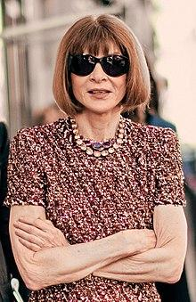
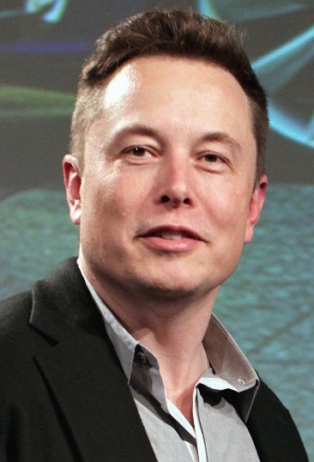


What is an Entrepreneur?
Someone who creats and/or runs a business is called an entrepreneur!
"Dieses Foto" von Unbekannter Autor ist lizenziert gemäß CC BY-SA
"Dieses Foto" von Unbekannter Autor ist lizenziert gemäß CC BY-SA-NC
"Dieses Foto" von Unbekannter Autor ist lizenziert gemäß CC BY-SA
Notes:
Mark Zuckerberg (Facebook/ Instagram/ Snapchat/ Twitter(X))
Elon Musk (Tesla/ SpaceX)
Steve Jobs (Apple)
Anna Wintour (The Vogue: editor-in-chief of Vogue since 1988)

Slide 4



What is Entrepreneurship?
“Entrepreneurship is when you act upon opportunities and ideas and transform them into value for others. The value that is created can be
financial, cultural, or social.”
(FFE-YE –Fonden for Entreprenrørskab (2012): Impact of Entrepreneurship Education in Denmark-2011: The Danish Foundation for Entrepreneurship –
Young Enterprise, Ejlskovsgade3D, 5000 Odense C, Denmark)
"Dieses Foto" von Unbekannter Autor ist lizenziert
gemäß CC BY
"Dieses Foto" von Unbekannter Autor ist lizenziert
gemäß CC BY-ND

Slide 5
Facts and Numbers of Entrepreneurship

Slide 6
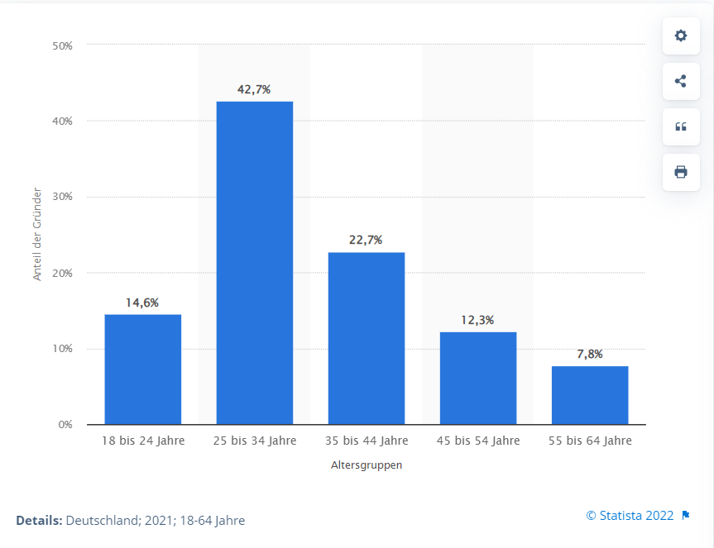
Facts and Numbers of Entrepreneurship
Who are the German Start-up Entrepreneurs?
Focus on Germanys Start-up Culture:
42,7% of all start- up Entrepreneurs are 25 till 34 years old!
Statistika (2022): Im Internet: https://de.statista.com/statistik/daten/studie/183850/umfrage/unternehmensgruender-nach-altersklassen-in-deutschland/. Zugriff: 09.12.2022

Slide 7
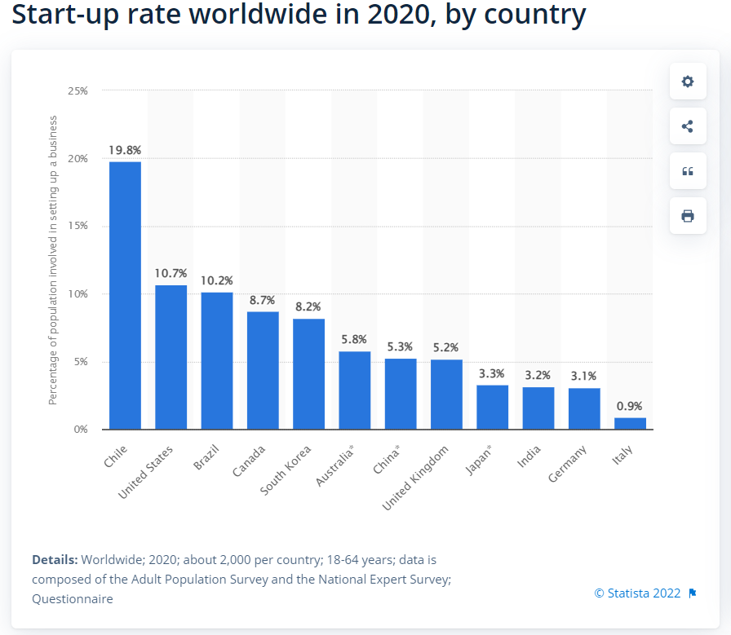
Facts and Numbers of Entrepreneurship
How is the Start-up rate worldwide?
Statistika (2022) Im Internet: https://www.statista.com/statistics/268786/start-ups-in-leading-economic-nations/. Zugriff: 08.12.2022.

Slide 8
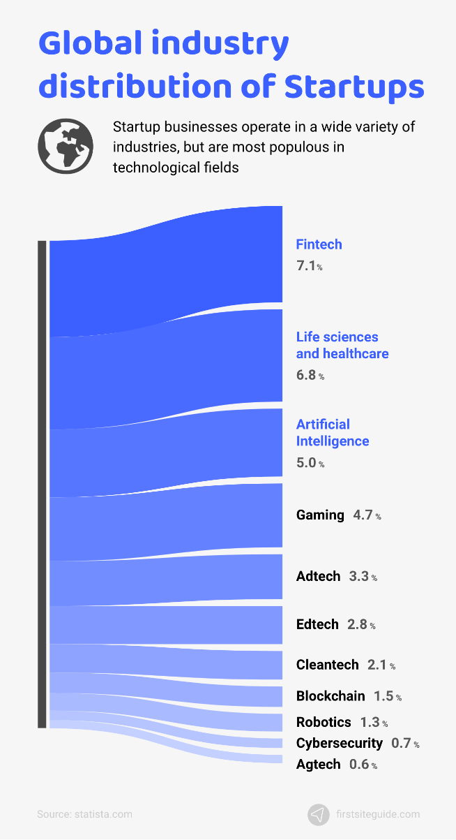
Facts and Numbers of Entrepreneurship
Which industries are particularly represented in the start-ups?
Firstsiteguide (2022): Im Internet: https://firstsiteguide.com/startup-stats/. Zugriff: 09.12.2022

Slide 9
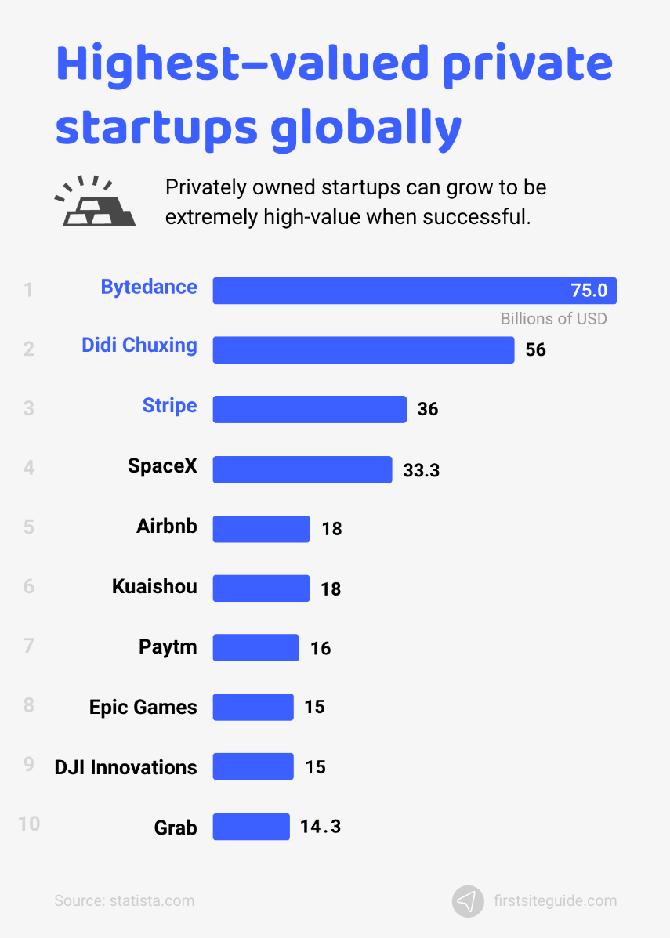
Facts and Numbers of Entrepreneurship
Who are the most highest-valued private start-ups globally?
Firstsiteguide (2022): Im Internet: https://firstsiteguide.com/startup-stats/. Zugriff: 09.12.2022

Slide 10
Most highest-valued private Start-ups globally
Storys of Success

Slide 11

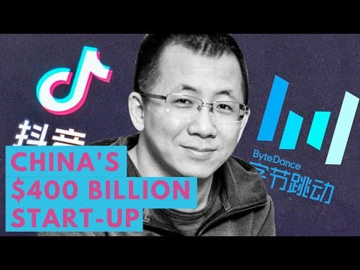
Most highest-valued private Start-ups globally
Story of success!
ByteDance
The World's Most Valuable Startup: ByteDance - YouTube
Notes:
ByteDance Ltd. is a Chinese internet technology company headquartered in Haidian, Beijing and incorporated in the Cayman Islands.^{[7]}
Founded by Zhang Yiming, Liang Rubo and a team of others in 2012, ByteDance developed the video-sharing apps TikTok and Douyin. The company is also the developer of the news platform Toutiao.
ByteDance has attracted legislative and media attention in several countries over security, surveillance, and censorship concerns.^{[8][9][10]}

Slide 12
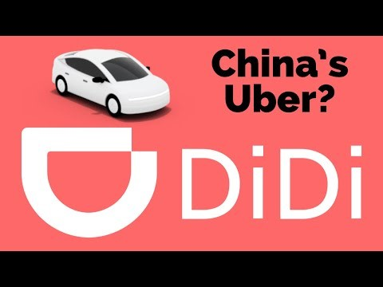
Most highest-valued private Start-ups globally
Story of success!
Didi Chuxing
What is Didi Chuxing? The great challenger to Uber - YouTube
Notes:
Didi Chuxing Technology Company^{[7]} is a Chinese vehicle for hire company headquartered in Beijing with over 550 million users and tens of millions of drivers.^{[8][9][10][4]} The company provides app-based transportation services, including taxi hailing, private car hailing, social ride-sharing, and bike sharing; on-demand delivery services; and automobile services, including sales, leasing, financing, maintenance, fleet operation, electric vehicle charging, and co-development of vehicles with automakers.^{[11][12][13]} The company is a subsidiary of Xiaoju Kuaizhi Inc.^{[14]}

Slide 13
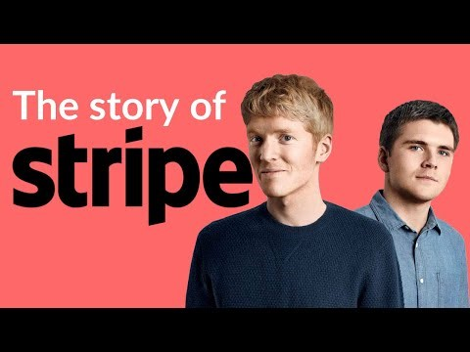
Most highest-valued private Start-ups globally
Story of success!
stripe
What is Stripe? The financial software you don’t even know you’re using - YouTube
Notes:
Stripe, Inc. is an Irish-American multinational financial services and software as a service (SaaS) company dual-headquartered in South San Francisco, California, United States and Dublin, Ireland.^{[3][4]} The company primarily offers payment-processing software and application programming interfaces for e-commerce websites and mobile applications.^{[5]}

Slide 14
To Sum up…
Summary: Facts and Numbers of Entrepreneurship

Slide 15
Summary: Facts and Numbers of Entrepreneurship
Start-up Statistics
“South America (Chile) is the leading country by the number of startups (71,153).
7.1% of the startups in the world operate in the Fintech (Financial technology) industry.
The highest-valued private startup in the world is Bytedance from China ($75 billion).
Over 69% of startup companies started as home businesses.
Only 40% of startups are able to become profitable.
Competition (19%) is the greatest challenge when starting a business.
58% of startups have less than $25,000 at their disposal during the startup phase.
60% of entrepreneurs agree that AI is currently the most promising innovation technology.”
FirstSiteguide (2022): Im Internet: https://firstsiteguide.com/startup-stats/. Zugriff: 09.12.2022

Slide 16
The Entrepreneurial Skills

Slide 17

The Entrepreneurial Skills - I
To think outside of the box is important for entrepreneurs.
Here are some characteristics which help to do this:
Emotional Intelligence
Ability to Understand Root Problems
Identify Causes
Innovation
Technology
Building a team
Think Outside the Box

Slide 18
The Entrepreneurial Skills - II
To think outside of the box is important for entrepreneurs:
Here are some characteristics which help to do this:
Building Business Plans
Critical Thinking
Decision Making
Organization
Planning
Positivity
Social Media Activities

Slide 19
Ideas for Students
What could I do in order to get to know how skilled my students are? Can they experience their skills by their own?

Slide 20
Have a look at yourself
Please, think about situation in your daily life.
How do you act in this situations.
Rate the entrepreneurial skills for yourself. Were do you have fields to improve?
Take a paper and fill in a table were you rate the presented skills with regard to yourself.
It should look like this:
Task
skill | Already good at it | Should be improved | Not good at all
Emotional Intelligence
Ability to Understand Root Problems
Identify Causes
…

Slide 21
Have a look at a friend of yours
Have a look at a friend who has done the last take for him-/herself as well and think about his/her competences and skills. Take a paper and fill in the same table for him/her.
He/She should do it for you as well. It should also look like this:
skill | Already good at it | Should be improved | Not good at all
Emotional Intelligence
Ability to Understand Root Problems
Identify Causes
Task
Compare you ratings. Discuss with him/her similarities or differences between the own rating and the rating of the friend.

Slide 22
skill | Already good at it | Should be improved | Not good at all
Emotional Intelligence
Ability to Understand Root Problems
Identify Causes
Organization
Planning
Positivity
Social Media Activity
Decision Making
Think outside the box
Innovation
Critical thinking
Building a team
Lead a team

Slide 23
Summary: What is Entrepreneurship?
Key Facts of Entrepreneurship:
Every Business Idea can be succsseful! It only depends on the implementation!
The majority of all companies are small and medium-sized enterprises
One person as well as more than 100 people can be an entrepreneur of one business – size does not matter
(Self-) Marketing is one adjusting screw for success
Represent your company and stand behind your concept
Increase your profile, visibility and awareness
Get familiar with your competitors:
  What makes them successful? What is so impressive about this company?

Slide 24
Creative Thinking
The Walt Disney Method
by Niclas C. Grüttner

Slide 25
A creative way of designing learning resources
?
!
Walt Disney Method
Notes:
Topic of this session: finding and using a creative way of designing learning resources.
In order to design learning resources in a creative way, you could use the Walt Disney Method.

Slide 26
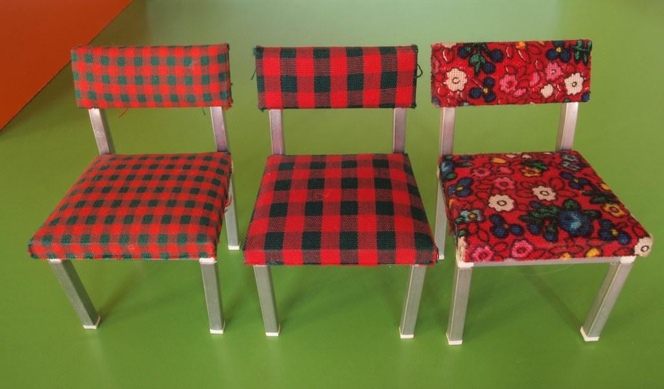
Walt Disney Method
Dreamer
Realist
Critic
"Dieses Foto" von Unbekannter Autor ist lizenziert gemäß CC BY-SA-NC
Notes:
The Walt Disney Method is a creative strategy that involves three distinct stages or roles: the Dreamer, the Realist, and the Critic.
By going through these roles, you can develop, refine, and evaluate ideas effectively.

Slide 27








Walt Disney Method
1
2
3
Dreamer
Realist
Critic
The objectives are looked at the perspective of the dreamer. The creative and visual thoughts that come up should not be hindered by reality and possible risks.
- brainstorming power and the quantity of all the ideas
The objective are looked at from the perspective of the realist. This concerns the ability of making a dream a reality.
- Limitations and possible risks should therefore not be seen as obstacles but as challenges.
The critic’s perspective will be used to represent how the end user will experience the plan or idea. Possible risks and gaps will be critically examined, and changes and areas of improvement will be submitted.
Notes:
Dreamer: The visionary stage where wild and imaginative ideas are generated without any limitations.
Realist: The practical stage where the focus is on how to implement the ideas realistically.
Critic: The evaluation stage is where ideas are critically assessed to identify potential flaws and improvements.

Slide 28
Application to Designing Learning Resources
1. Dreamer Stage: Generating Creative Ideas
Activity: Brainstorming Session
Gather your team and encourage everyone to think creatively without any restrictions. The goal is to generate as many ideas as possible, no matter how unconventional they may seem.
What innovative tools or technologies can we use to design learning resources?
How can we make learning more engaging and interactive for students?
What unconventional formats can we explore (e.g., gamification, virtual reality, storytelling)?

Slide 29
Application to Designing Learning Resources
2. Realist Stage: Planning and Implementation
Activity: Project Planning Session
Review the ideas generated in the Dreamer stage and start thinking about how to implement them practically. This involves creating detailed plans, identifying resources, and setting timelines.
Which ideas are feasible with our current resources and technology?
What steps are necessary to bring these ideas to life?
What tools and platforms will we need to develop these resources?

Slide 30
Application to Designing Learning Resources
3. Critic Stage: Evaluation and Improvement
Activity: Critical Review Session
Analyse the plans from the Realist stage critically to identify potential issues, weaknesses, and areas for improvement. This stage ensures that the ideas are not only creative and feasible but also effective and sustainable.
What are the potential challenges and risks associated with each idea?
How can we address these challenges to improve the feasibility and effectiveness of the resources?
Are there any ethical or practical concerns we need to consider?

Slide 31

Application to Designing Learning Resources
Get together in teams and use the Walt Disney Method and think about a business that includes STEM and inclusion:
What is the name of the business?
What is the goal of the business?
What do you produce in the business?
How can people from different groups work together?
Present your ideas to the group.
Recap the Walt Disney Method and its application to designing learning resources.
Discussion
15min
10min
5min

Slide 32
What is the name of the business?
What is the goal of the business?
What do you produce in the business?
How can people from different groups work together?
Dream
Be Realistic
Be Critical
15min
10min
5min
"Dieses Foto" von Unbekannter Autor ist lizenziert gemäß CC BY-SA-NC
Notes:
The Walt Disney Method is a creative strategy that involves three distinct stages or roles: the Dreamer, the Realist, and the Critic.
By going through these roles, you can develop, refine, and evaluate ideas effectively.

Slide 33
Discussion
Sharing Experiences and Group work
Discussion on creative ways of designing learning resources

