Slide 1

STEM for inclusive schools:
School Education
ERASMUS+
KA220-SCH - Strategic Partnerships for School Education
Cooperation partnership
Reference Number:
2023-1-DE03-KA220-SCH-000151162
Duration:
03.09.2023 to 02.03.2026
(30 months)
STEM for inclusive schools
Creating, using, and sharing OER
University of Paderborn
Saskia Happ

Slide 2
Table of content
Forms and Types of OER licences
Creating, Using, and Sharing Open Educational Resources
Sharing Experiences – Where and how to share?
Creation of your own Tool Box/Business Canvas

Slide 3
Forms and Types of OER licenses
Notes:
Essentially, the American scientist (focus on law) Lawrence Lessig coined and propagated the Open Content Licensing model by founding the Creative Commons (CC) initiative at Stanford University in 2001.

Slide 4

Forms and Types of OER licenses
Special type of license
CC 0 1.0 Universell „No Rights Reserved”
“CC0 (aka CC Zero) is a public dedication tool, which allows creators to give up their copyright and put their works into the worldwide public domain.
CC0 allows reusers to distribute, remix, adapt, and build upon the material in any medium or format, with no conditions.”
© 2019. This work is licensed under a CC BY 4.0 license.
Retrieved from the Internet: https://creativecommons.org/about/cclicenses/, Access date 27.04.2022.

Slide 5
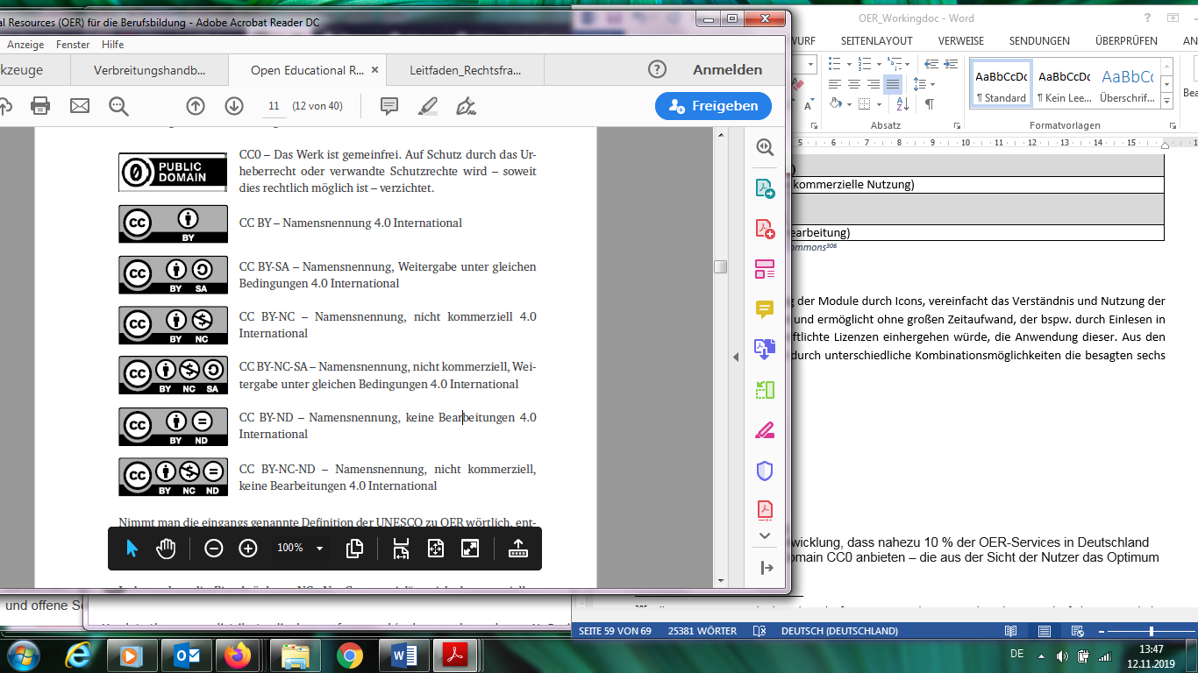
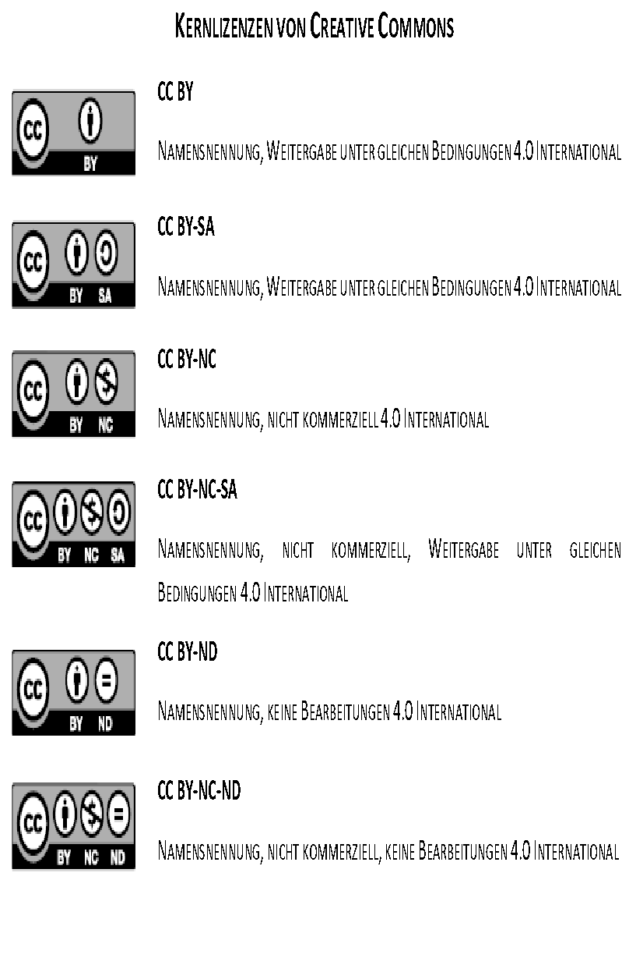
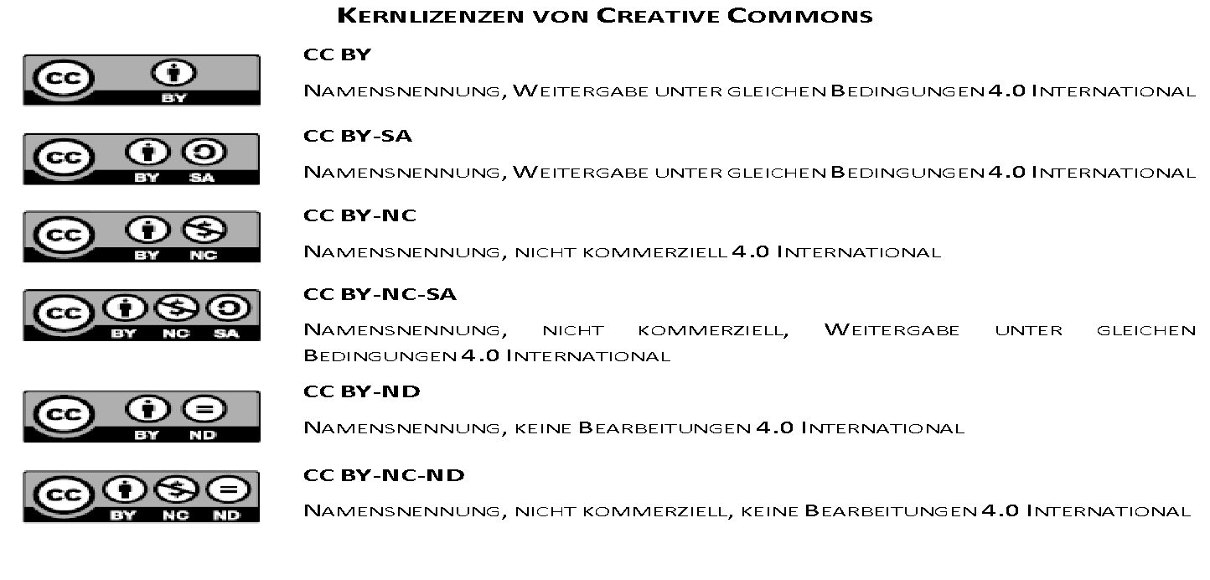
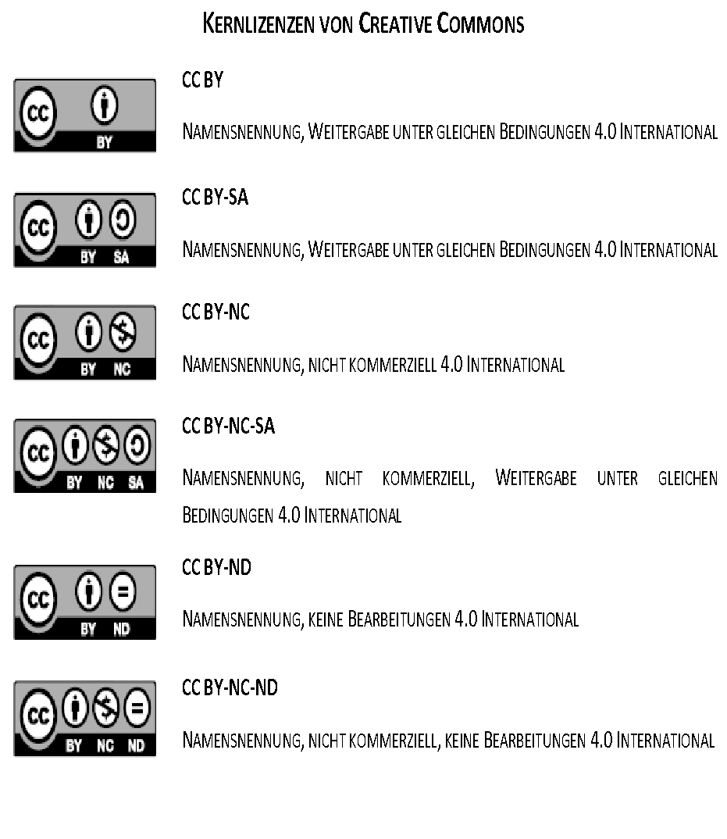
Forms and Types of OER licences
CC BY
CC BY- NC- SA
1
2
CC BY- SA
CC BY- ND
Most restrictive licence
CC BY- NC
CC BY- NC- ND
© 2019. This work is licensed under a CC BY 4.0 license.
Retrieved from the Internet: https://creativecommons.org/about/cclicenses/, Access date 27.04.2022.

Slide 6
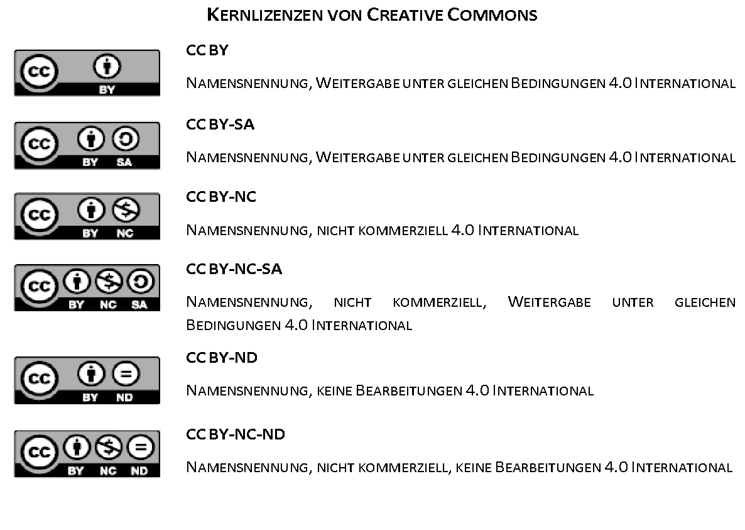

Forms and Types of OER licences
“This license allows reusers to distribute, remix, adapt, and build upon the material in any medium or format, so long as attribution is given to the creator. The license allows for commercial use.”
© 2019. This work is licensed under a CC BY 4.0 license.
Retrieved from the Internet: https://creativecommons.org/about/cclicenses/, Access date 27.04.2022.
Notes:
I germany you can not unpin all your rights even when you are creator of the product/work
Attribution means Information regarding the autor, year, name of content.

Slide 7

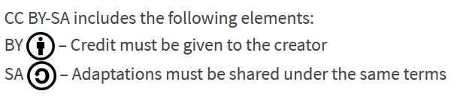
Forms and Types of OER licences
“CC BY-SA: This license allows reusers to distribute, remix, adapt, and build upon the material in any medium or format, so long as attribution is given to the creator. The license allows for commercial use. If you remix, adapt, or build upon the material, you must license the modified material under identical terms.”
© 2019. This work is licensed under a CC BY 4.0 license.
Retrieved from the Internet: https://creativecommons.org/about/cclicenses/, Access date 27.04.2022.
Notes:
More restrictive

Slide 8
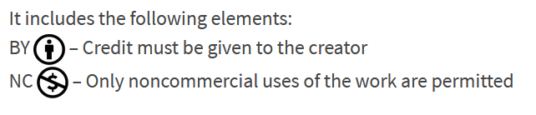
Forms and Types of OER licences
“CC BY-NC: This license allows reusers to distribute, remix, adapt, and build upon the material in any medium or format for noncommercial purposes only, and only so long as attribution is given to the creator.”
© 2019. This work is licensed under a CC BY 4.0 license.
Retrieved from the Internet: https://creativecommons.org/about/cclicenses/, Access date 27.04.2022.
Notes:
As I mentioned before, can cause problems in private schools like language schools or e.g. dance schools
Even when the schools have some specific entry terms which align to fees and commercial activities this restriction can cause that the OER under this licence can not be used in this environment

Slide 9

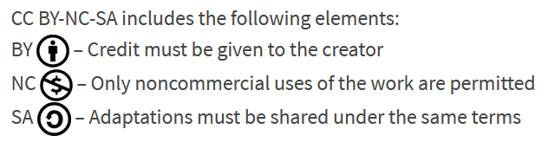
Forms and Types of OER licences
“CC BY-NC-SA: This license allows reusers to distribute, remix, adapt, and build upon the material in any medium or format for noncommercial purposes only, and only so long as attribution is given to the creator. If you remix, adapt, or build upon the material, you must license the modified material under identical terms.”
© 2019. This work is licensed under a CC BY 4.0 license.
Retrieved from the Internet: https://creativecommons.org/about/cclicenses/, Access date 27.04.2022.
Notes:
The following license is even more restrictive

Slide 10
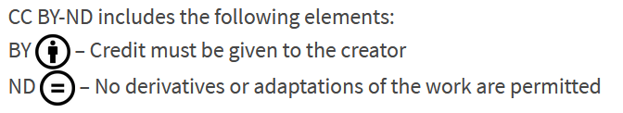
Forms and Types of OER licences
“CC BY-ND: This license allows reusers to copy and distribute the material in any medium or format in unadapted form only, and only so long as attribution is given to the creator. The license allows for commercial use.”
© 2019. This work is licensed under a CC BY 4.0 license.
Retrieved from the Internet: https://creativecommons.org/about/cclicenses/, Access date 27.04.2022.

Slide 11
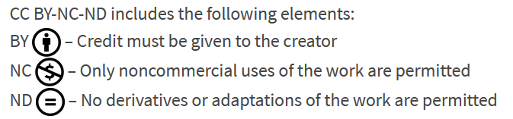
Forms and Types of OER licenses
“CC BY-NC-ND: This license allows reusers to copy and distribute the material in any medium or format in unadapted form only, for noncommercial purposes only, and only so long as attribution is given to the creator.”
© 2019. This work is licensed under a CC BY 4.0 license.
Retrieved from the Internet: https://creativecommons.org/about/cclicenses/, Access date 27.04.2022.
Notes:
The most restrictive license is this one

Slide 12

Forms and Types of OER licenses
CC BY
CC BY- NC- SA
CC BY- SA
CC BY- ND
CC BY- NC
CC BY- NC- ND
Foster the use of CC BY and CC BY-SA

Slide 13
Attributing Sources
Where and how to share?

Slide 14

Attributing Sources
“You can use CC-licensed materials as long as you follow the license conditions.
One condition of all CC licenses is attribution” (Creative Commons Licenses, 2022).
Creative Commons (2019/2022): Retrieved from the Internet: https://creativecommons.org/use-remix/, Access date: 27.04.2022.
Notes:
Sie können CC-lizenzierte Materialien verwenden, solange Sie die Lizenzbedingungen einhalten. Eine Bedingung aller CC-Lizenzen ist die Namensnennung

Slide 15
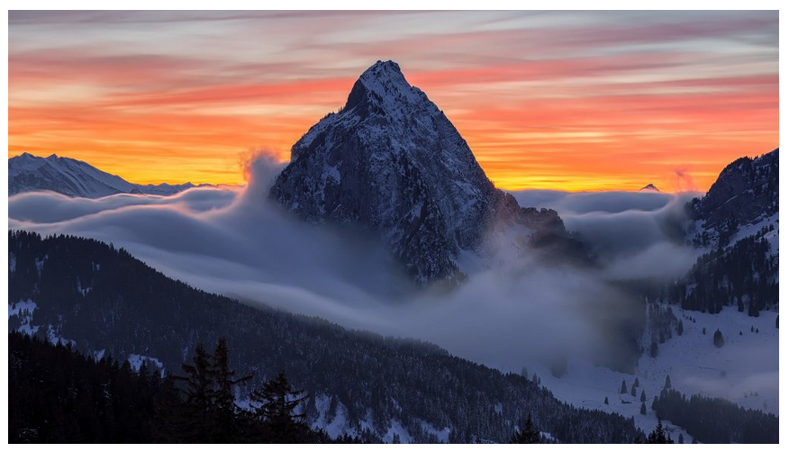
Attributing Sources
This is an ideal attribution because it includes the:
Title: “Furggelen afterglow”
Author: “Lukas Schlagenhauf“—with a link to their profile page
Source: “Furggelen afterglow“—with a link to the original photo on Flickr
License: “CC BY-ND 2.0”—with a link to the license deed
How you attribute authors of the CC works will depend on whether you modify the content, if you create a derivative, if there are multiple sources, etc.
“Furggelen afterglow” by Lukas Schlagenhauf is licensed under CC BY-ND 2.0.

Slide 16
Comments for creating a module to the STEM for inclusive schools partners
Have in mind that all your graphics have to be license free or OER or self created.
The ones in this presentation are all license free from pixabay!
Due to European law, you are not allowed to just copy pictures from websites or from Google!!!!!

Slide 17
Business Canvas
Usage with students
getting to know the parts of a business canvas

Slide 18
Create an OER toolbox that trains teachers in the use of digital technologies and inclusive methods in STEM.
Your toolbox should contain
practical tools,
guides and resources
to help teachers integrate innovative and digital resources into the classroom to increase student engagement and interest.

Slide 19
Contact
Universität Paderborn
Department Wirtschaftspädagogik Lehrstuhl Wirtschaftspädagogik II Warburger Str. 100
33098 Paderborn
http://www.upb.de/wipaed
Prof. Dr. Marc Beutner
Tel: +49 (0) 52 51 / 60 - 23 67
Fax: +49 (0) 52 51 / 60 - 35 63
E-Mail: marc.beutner@uni-paderborn.de
Jennifer Schneider
Tel: +49 (0) 52 51 / 60 – 27 98
Fax: +49 (0) 52 51 / 60 - 35 63
E-Mail: Jennifer.Schneider@uni-paderborn.de

