Slide 1

STEM for inclusive schools:
School Education
ERASMUS+
KA220-SCH - Strategic Partnerships for School Education
Cooperation partnership
Reference Number:
2023-1-DE03-KA220-SCH-000151162
Duration:
03.09.2023 to 02.03.2026
(30 months)
STEM for inclusive schools
Our STEM Business Idea
University of Paderborn
Saskia Happ

Slide 2



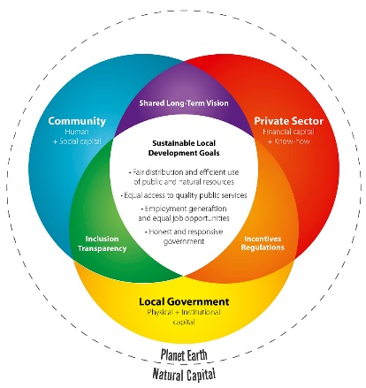



Our STEM Business Idea
"Dieses Foto" von Unbekannter Autor ist lizenziert gemäß CC BY-SA-NC

Slide 3
Creative Thinking
Start-Up Your STEM Business

Slide 4

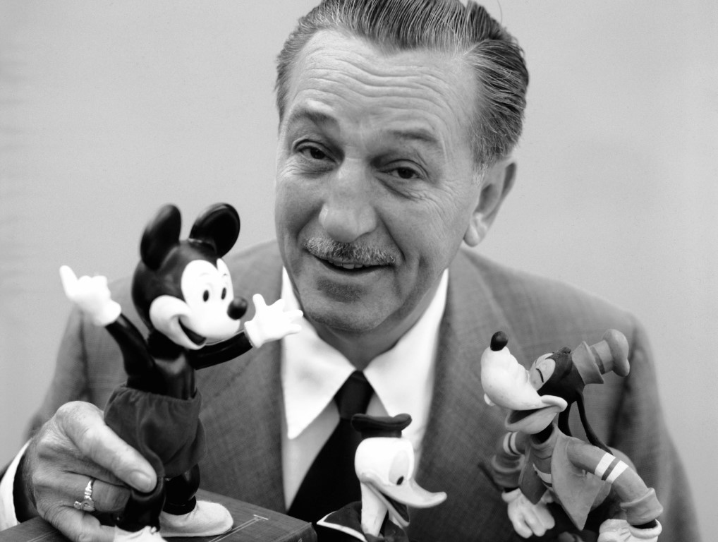
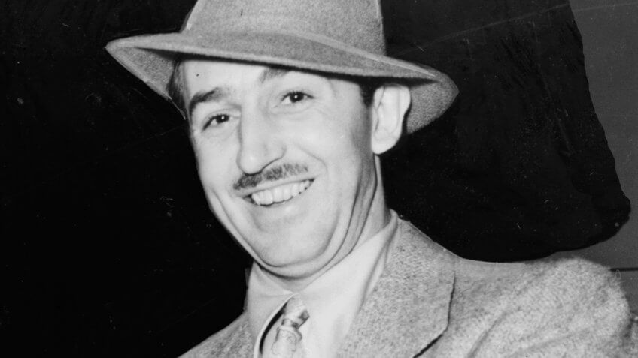
Creative Thinking
Who is this person?
"Dieses Foto" von Unbekannter Autor ist lizenziert gemäß CC BY
"Dieses Foto" von Unbekannter Autor ist lizenziert gemäß CC BY-NC
"Dieses Foto" von Unbekannter Autor ist lizenziert gemäß CC BY-NC-ND

Slide 5
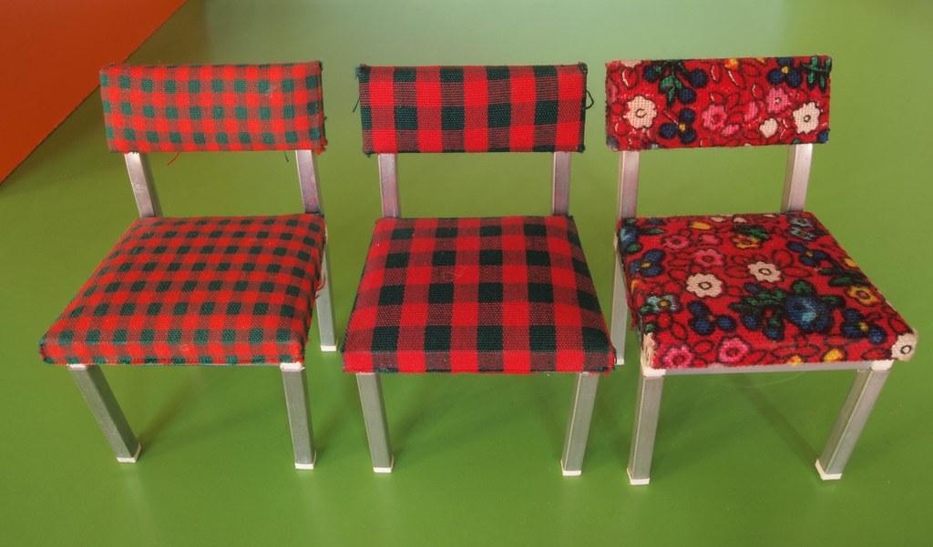
Creative Thinking – Walt Disney Method
Dreamer
Realist
Critic
"Dieses Foto" von Unbekannter Autor ist lizenziert gemäß CC BY-SA-NC

Slide 6








Creative Thinking – Walt Disney Method
1
2
3
Dreamer
Realist
Critic
The objectives are looked at the perspective of the dreamer. The creative and visual thoughts that come up should not be hindered by reality and possible risks.
- brainstorming power and the quantity of all the ideas
The objective are looked at from the perspective of the realist. This concerns the ability of making a dream a reality.
- Limitations and possible risks should therefore not be seen as obstacles but as challenges.
The critic’s perspective will be used to represent how the end user will experience the plan or idea. Possible risks and gaps will be critically examined and changes and areas of improvement will be submitted.

Slide 7
Start-up your STEM Business
Becoming active

Slide 8
Our STEM Business Idea
Cinema of Conciousness:
You are founders of a STEM enterprise in your respective country. You want to establish a
start-up innovation center
for youths and young adults. You aim to raise young people's awareness for STEM ideas, to educate them in this perspetive and to provide them with further education and training
(the basics in general business administration: finance, marketing, and how to create a business model canvas to present your bank for financing possibilities).

Slide 9
Be creative and start your own STEM Innovation Centre!
First things, first!
get togehter in your national groups

Slide 10
Be creative and start your own STEM innovation centre!
Start-up innovation center for youths and young adults
Don‘t forget to focus on this question:
What are the scientific, technological,
engineering, or mathematical aspects of your business?
Task
Start-up Name?
Be creative and think about what makes a good branding of a business?
What are no-goes? And what must-haves?

Slide 11
STEM Innovation Centre
Creative Thinking with the Walt Disney Method
Brainstorming Activity
1
2
3
Dreamer
Realist
Critic
Task
The objectives are looked at the perspective of the dreamer. The creative and visual thoughts that come up should not be hindered by reality and possible risks.
- brainstorming power and the quantity of all the ideas
The objective are looked at from the perspective of the realist. This concerns the ability of making a dream a reality.
- Limitations and possible risks should therefore not be seen as obstacles but as challenges.
The critic’s perspective will be used to represent how the end user will experience the plan or idea. Possible risks and gaps will be critically examined and changes and areas of improvement will be submitted.
Start with the perspectiv of a dreamer!

Slide 12
Critic Perspectiv
Failures of start-ups

Slide 13
Facts and Numbers of Entrepreneurship
How many Start-ups fail?
Honest statistics show, that many Start-up Businesses fail:
9 out of 10 startups don’t make it!
20% of startups fall apart after a year.
30% of startups close within two years.
50% of startups shut their doors within five years.
70% of startups dissolve within 10 years
https://firstsiteguide.com/startup-stats/

Slide 14
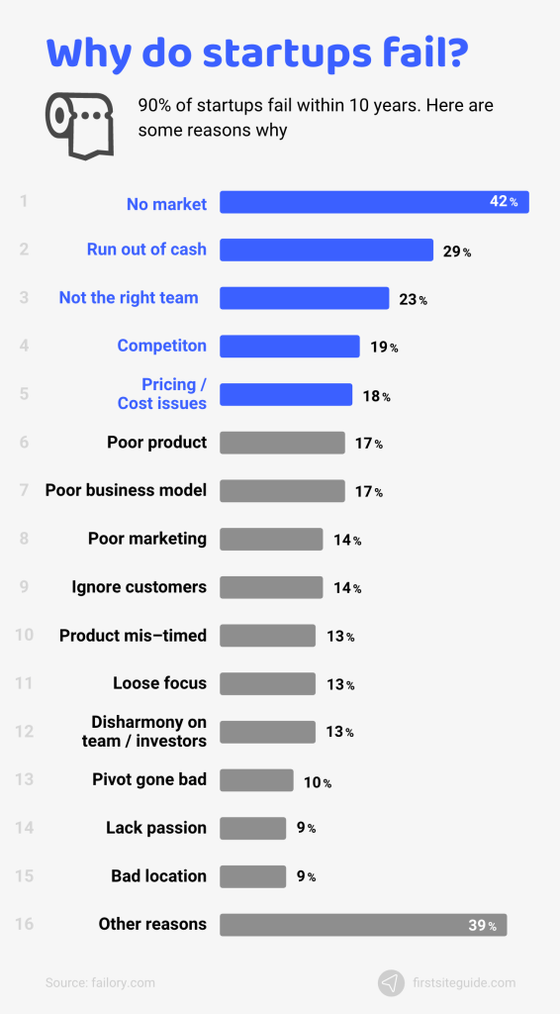
Facts and Numbers of Entrepreneurship
Main reasons of Start-up failures!
https://firstsiteguide.com/startup-stats/

Slide 15
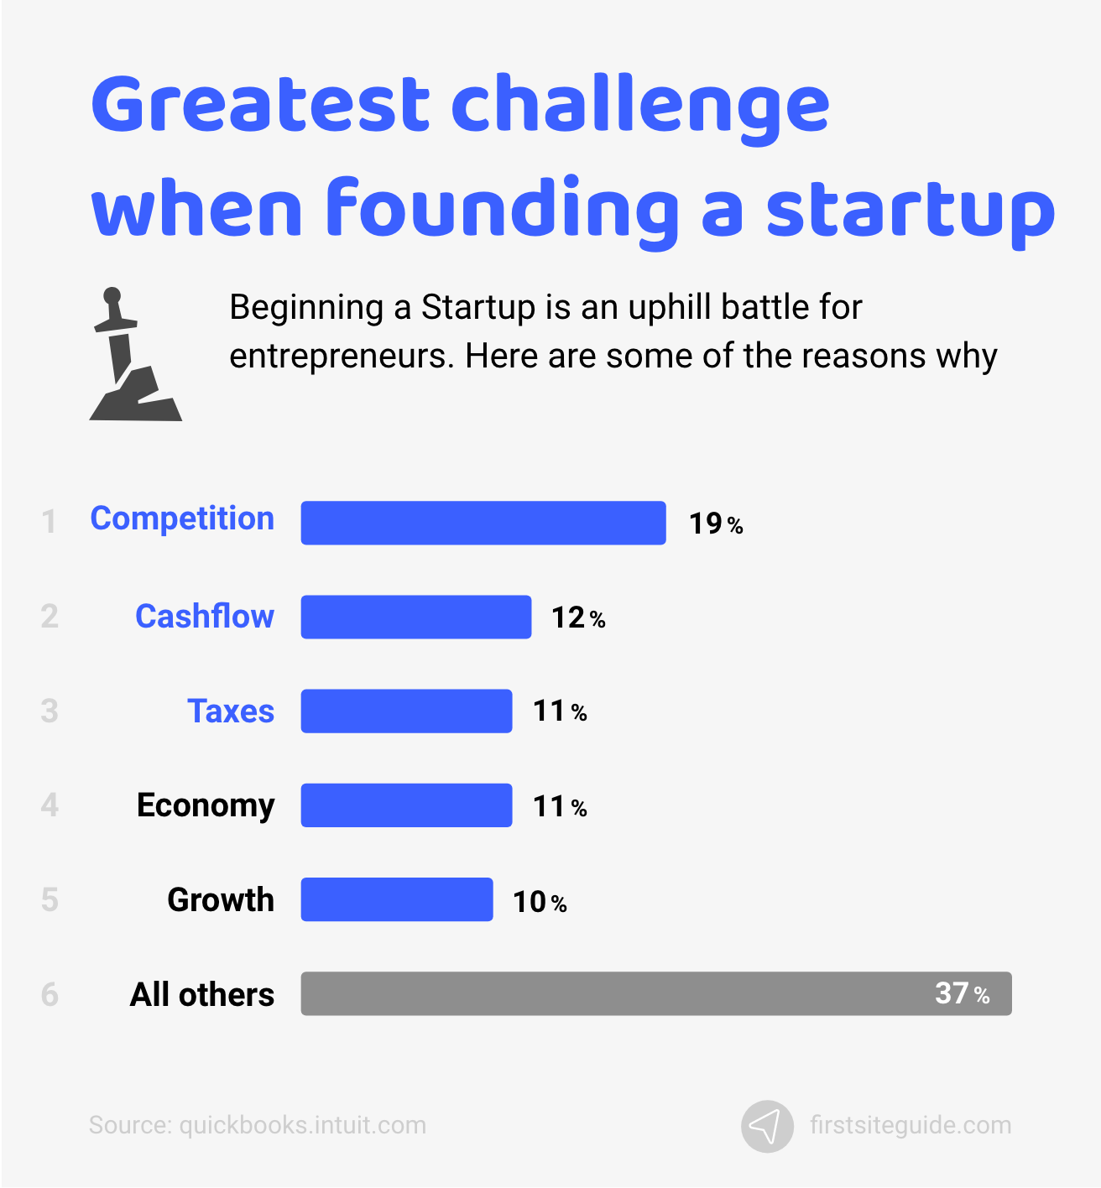
Facts and Numbers of Entrepreneurship
Greates Challenges when starting a Business!
https://firstsiteguide.com/startup-stats/

Slide 16
Contact
Universität Paderborn
Department Wirtschaftspädagogik Lehrstuhl Wirtschaftspädagogik II Warburger Str. 100
33098 Paderborn
http://www.upb.de/wipaed
Prof. Dr. Marc Beutner
Tel: +49 (0) 52 51 / 60 - 23 67
Fax: +49 (0) 52 51 / 60 - 35 63
E-Mail: marc.beutner@uni-paderborn.de
Jennifer Schneider
Tel: +49 (0) 52 51 / 60 - 27 98
Fax: +49 (0) 52 51 / 60 - 35 63
E-Mail: Jennifer.Schneider@uni-paderborn.de

