Slide 1

STEM for inclusive schools:
School Education
ERASMUS+
KA220-SCH - Strategic Partnerships for School Education
Cooperation partnership
Reference Number:
2023-1-DE03-KA220-SCH-000151162
Duration:
03.09.2023 to 02.03.2026
(30 months)
STEM for inclusive schools
Introduction to Canvas Model
University of Paderborn
Saskia Happ

Slide 2
Learning Outcomes
Canvas Model
The learners
explain what the Canvas Model is
why it is important to create a Canvas for the Start-up Business
understand the chances of describing and explaining the benefits of the model

Slide 3
The Business Model CANVAS

Slide 4
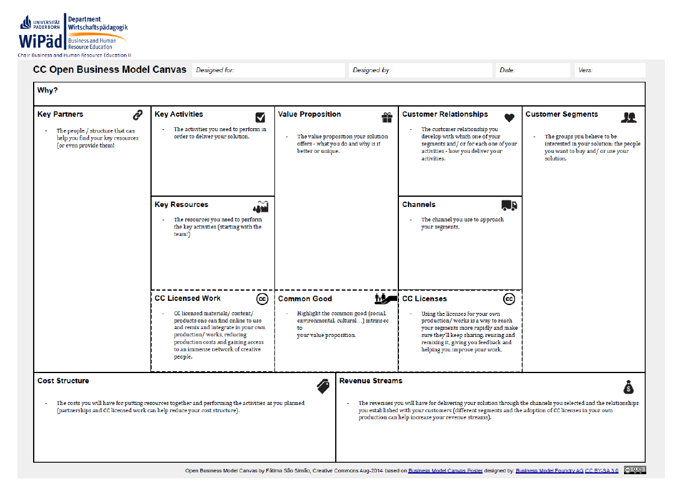
Cost Structure
Revenue Streams

Slide 5
7. Partners
Who are the Key Partners and suppliers needed to make the business work?
How to fill in the CANVAS Model?
2. Who are my customers?
Your customer do not exist to buy! You exist for them!
Why would they buy?
3. Channels
How does the product get from our business to the customer?
Physical channels? Local channels?
8. Activities
What are the most important things the company must do to run the business?
Production? Problem solving or service management? Supply Chain Management?
1. Value Proposition
It’s not about your Idea or Product, it is about solving a Need or Problem
4. Customer Relationship
How does the company get, keep and grow customers?
9. Costs
Not just the obvious costs?
What are the most important costs to operate the Business,? Fix Costs? Variable Costs? Etc.
6. Key Resources
What are the most important Assets required to make the Business model work?
Finance (money, line of credits?)
Physical (manufacturing, vehicles,…?), intellectual (patents, people…etc)
5. Revenue Streams
How does the company make money from each customer segment?
Is it for free? Direct sales? Strict prices?

Slide 6
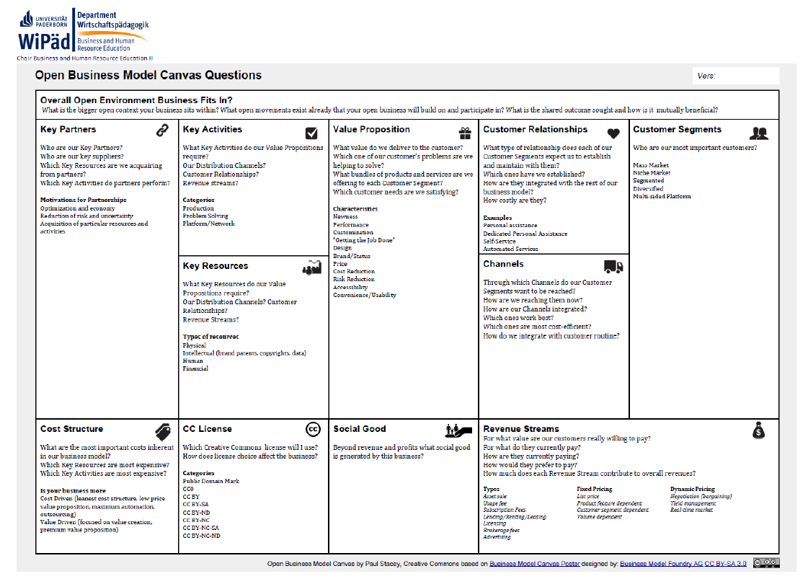

Slide 7
Contact
Universität Paderborn
Department Wirtschaftspädagogik Lehrstuhl Wirtschaftspädagogik II Warburger Str. 100
33098 Paderborn
http://www.upb.de/wipaed
Prof. Dr. Marc Beutner
Tel: +49 (0) 52 51 / 60 - 23 67
Fax: +49 (0) 52 51 / 60 - 35 63
E-Mail: marc.beutner@uni-paderborn.de
Jennifer Schneider
Tel: +49 (0) 52 51 / 60 - 27 98
Fax: +49 (0) 52 51 / 60 - 35 63
E-Mail: Jennifer.Schneider@uni-paderborn.de

