Slide 1

STEM for inclusive schools
School Education
ERASMUS+
KA220-NW-23-30-151162
Cooperation partnerships in school education
Reference Number:
2023-1-DE03-KA220-SCH-000151162
Duration:
03.09.2023 to 02.03.2026
(30 months)
STEM for
inclusive schools
Learning Teaching Training Activity- LTTA
Pedagogical Conference – Galati – Romania
25th to the 29th of November 2024
Transversal Skills and Competencies
Presentation of the leading partner:
University of Paderborn
Chair of Business and Human Resource Education II
Prof. Dr. Marc Beutner

Slide 2
A starting point – 21st century skills
ITC-Skills
Participation and involvement skills
Multiliteracy
Worklife skills
Cultural skills
Managing daily life
Learning skills
See a similar approach at:
Polar partners (2024):
21st century skills.
On the internet: https://www.polarpartners.fi/blog/category/21st-century-skills/

Slide 3
Transversal skills and competencies
Introduction:
The world is undergoing rapid change – economic, technological, social and cultural changes are challenging education systems. To prepare students and learners for these challenges, transversal skills are becoming the focus of modern educational approaches.
Definition: Skills that can be applied in different areas of life and work.
Objective: holistic development of the personality and adaptability to the VUCA world (volatility, uncertainty, complexity, ambiguity).
Why now?
The VUCA world requires new skills
Globalisation, technological progress and social change are increasing the demand for transversal skills
Question for the project partners:
“What transferable skills do you need in your daily work?”
and from different perspective:
“What skills do students need?”

Slide 4
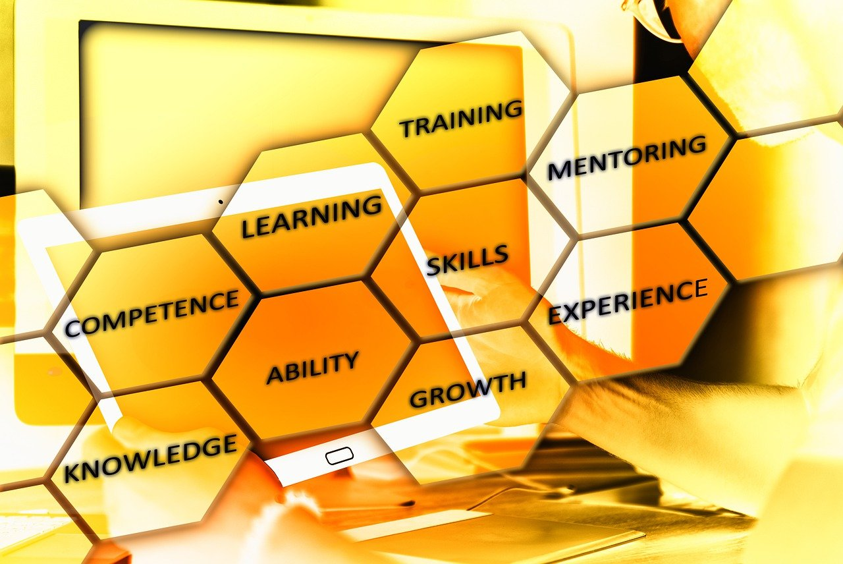
Transversal skills and competencies
pixabay free licence 2024

Slide 5
Transversal skills and competencies
“Skills vs competencies
A skill is something which is learnable and then can be tested. For example, if an employee claims to know how to use the Microsoft Office software, they can be tested to see if they do have the skill. A competency is different. It’s about behaviour and attitude. Decision-making, for instance, is a competency which can be learnt and then goes on to become a skill which can be tested. Essentially, competency refers to ´behaviour which can be observed´. “
The telegraph online / Sen, R. (2024): Transversal skills or 21st-century skills? Ron Morrain explains the difference. On the internet: https://www.telegraphindia.com/my-kolkata/events/transversal-skills-or-21st-century-skills-ron-morrain-explains-the-difference/cid/1901936

Slide 6
Transversal skills –
A first approach
Transversal skills
Sellf leadership
Social skills
Media and information literacy
Taking initiative
Critical Thinking
Solution-oriented thinking
See a similar approach of LAB University of applied science (2024): Teaching Transversal Skills to Tackle the Skills Gap. On the internet: https://blogit.lab.fi/labfocus/en/teaching-transversal-skills-to-tackle-the-skills-gap/

Slide 7
UNESCO definition of transversal skills
“Transversal skills are those typically considered as not specifically related to a particular job, task, academic discipline or area of knowledge but as skills that can be used in a wide variety of situations and work settings (IBE 2013). These skills are increasingly in high demand for learners to successfully adapt to changes and to lead meaningful and productive lives.” (UNESCO Education Policy Brief (Vol.2), 2014: Skills for holistic human development, p. 2)
Key features:
Support adaptation to change
Promote a meaningful and productive life
Also referred to as ‘21st century skills’,’generic skills’, ‘soft sklls’ or ‘non-cognitive skills’.

Slide 8
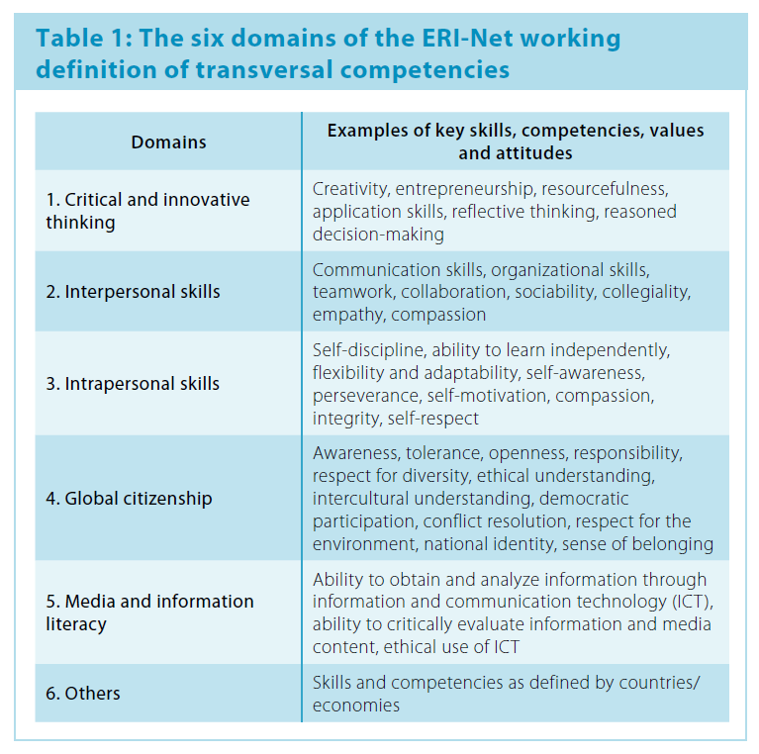
UNESCO approach: The six main domains
Figure: Transversal skills on the basis of UNESCO 2016: ERI-Net Asia-Pacific Regional Policy Series 2014 Regional Study on Transversal Competencies in Education Policy and Practice (Phase II). School and Teaching Practices for Twenty-first Century Challenges: Lessons from the Asia-Pacific Region. Regional Synthesis Report 2016, p. 6

Slide 9
Scientific background
Research results:
“Transversal competences are key factors for educational success and professional career.” (Rauber, 2007)
“Soft skills are just as important as academic skills.”
(Heckman & Kautz, 2012)
Pedagogical perspective:
Education aims at the development of the whole person,
not only at professional excellence.

Slide 10
STEM-for-inclusive-Schools project
Aims of the project:
Promoting problem solving and teamwork in science contexts
Developing an inclusive approach that takes into account different learning styles
Objective:
Integrating transversal skills into STEM subjects
Methodology:
Using digital technologies to foster inclusion

Slide 11
STEM-for-inclusive-Schools project
Focus:
Adapting STEM content to different learning styles
Fostering problem-solving skills and teamwork
Supporting teachers with training
Benefits:
Strengthening the inclusive learning environment
Promoting a holistic approach to school teaching

Slide 12
Teaching
Transversal skills
Integration of knowing and doing
Experiental learning
Knowledge
Transversal skills
See a similar approach of LAB University of applied science (2024): Teaching Transversal Skills to Tackle the Skills Gap. On the internet: https://blogit.lab.fi/labfocus/en/teaching-transversal-skills-to-tackle-the-skills-gap/

Slide 13
Contact
Universität Paderborn
Department Wirtschaftspädagogik Lehrstuhl Wirtschaftspädagogik II Warburger Str. 100
33098 Paderborn
http://www.upb.de/wipaed
Prof. Dr. Marc Beutner und Jan-Phillip Lüttke
Tel: +49 (0) 52 51 / 60 - 23 67
Fax: +49 (0) 52 51 / 60 - 35 63
E-Mail: marc.beutner@uni-paderborn.de
luettke@mail.uni-paderborn.de

