Slide 1

Coding a simple game with Scratch
STEM4inclusive schools
WP2 – Toolbox
Chair of Business and Human Resource Education II
Prof. Dr. Marc Beutner

Slide 2
Structure of the activity
A
Introduction
about the topic
Coding and the use of Scratch
B
Training phase
about the training
Create your own simple Scratch game

Slide 3
A: About the topic
Coding and the use of Scratch

Slide 4
Definition!
What is coding?
Coding is the process of creating instructions for a computer to follow. These instructions, written in a programming language, tell the computer how to perform specific tasks, such as calculations, data processing, or controlling devices. Coding is the foundation of software development and is used to create everything from simple scripts to complex applications and systems.

Slide 5
Some concepts of coding:
Coding uses programming languages:
These are the languages used to write code, such as Python, Java, C++, JavaScript, etc.
Each language has its own syntax (rules) and is suited to different types of tasks. Syntax means specific rules and structure of a programming language that dictate how code must be written for the computer to understand and execute it.
Coding uses algorithms. This is a set of steps or instructions designed to solve a specific problem or perform a task.

Slide 6
Some concepts of coding:
Coding needs debugging. This is the process of finding and fixing errors or bugs in the code.
Coding also needs compilation/interpretation. The code must be converted into a form that the computer can execute. This is done through a compiler or an interpreter, depending on the programming language.

Slide 7
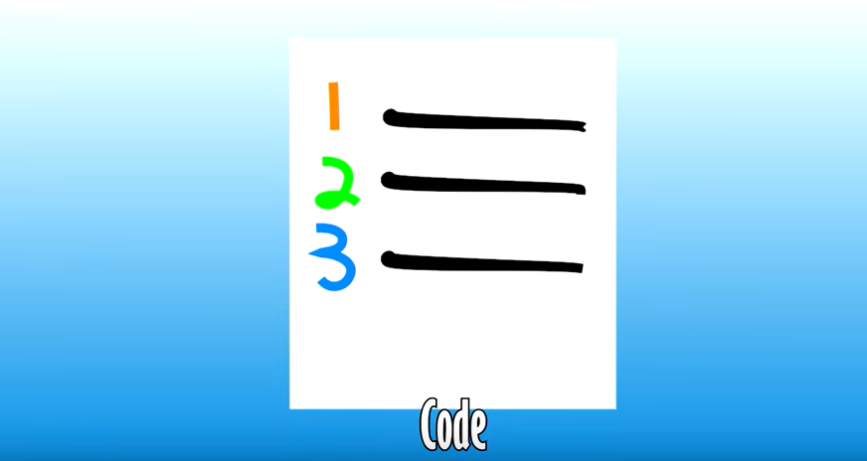
Let´s have a look at this youtube video about coding!
Coding
Video
https://www.youtube.com/watch?v=N7ZmPYaXoic

Slide 8
A flow chart:
A flowchart is a diagram that visually depicts a workflow or process.
It can also be described as a graphical representation of an algorithm, illustrating a step-by-step method for completing a task.
A program flowchart, shows the controls in a program within a system.

Slide 9



Flow chart elements - Part 1:
Arrow / Flowline:
Shows the process's order of operation
Terminal
Represents the beginning and ending of a program
Process
Represents a set of operations

Slide 10


Flow chart elements - Part 2:
Input / Output:
Show where to enter data or to display results
Decision / True-or-False test
Indicates a conditional operation that decides which path the program will follow.

Slide 11
Flow chart elements - Example: The car does not start!
Car does not start
Fuel in car?
No
refuel
Yes
Used ignition key or ignition button?
No
Use ignition
Yes
Visit car repair shop

Slide 12
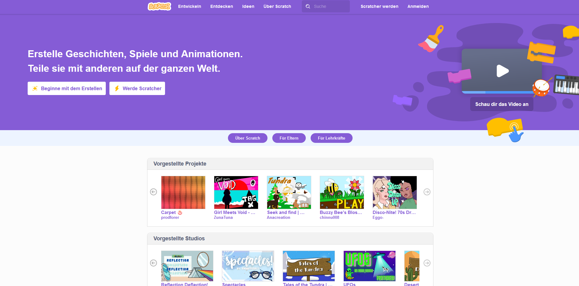
Definition!
What is Scratch?
Scratch is a visual programming language and online community designed to make coding accessible, particularly for beginners and younger learners. It was developed by the Lifelong Kindergarten Group at the MIT Media Lab.
MIT recommends Scratch for children and young people between the ages of
8 and 16.
https://scratch.mit.edu/

Slide 13
Benefits of coding with scratch
Low barrier to entry
Creative and fun: users create games, animations, and interactive stories.
Accessibility
Platform for sharing, learning, and collaborating with others
Creative Expression
Community Learning
Logical Thinking
Simplified and using fundamental programming concepts like sequencing, loops, conditionals, and event handling

Slide 14
Key Features of Scratch – Part I:
:
Visual Blocks: Instead of typing code, Scratch uses colorful blocks that represent different coding commands. Users can drag and drop these blocks to create sequences of instructions.
Sprites: In Scratch, characters or objects are called sprites. These sprites can be animated and programmed to move, interact with each other, and respond to user inputs.
Stages: The stage is the background or environment where the sprites perform. Users can design and customize stages to fit the theme of their project.

Slide 15
Key Features of Scratch – Part II:
Scripts: A script is a series of connected blocks that control the behavior of a sprite. For example, a script might make a sprite move across the screen when the user clicks a button.
Events: Scratch programs are often triggered by events, such as pressing a key, clicking a sprite, or starting the program. Event blocks in Scratch help manage these interactions.
Loops and Conditionals: Like traditional coding, Scratch includes loops (for repeating actions) and conditionals (for making decisions based on certain conditions).
Broadcasting: Scratch allows sprites to communicate with each other through broadcast messages, enabling complex interactions and synchronized actions.

Slide 16
Coding in Scratch – How does it work?
Create a project
Drag and Drop Blocks
Build Scripts
Test and Debug

Slide 17
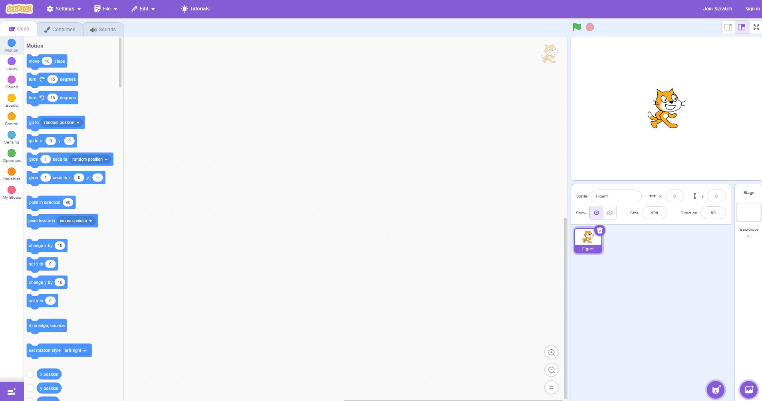
What does Scratch look like?
https://scratch.mit.edu/

Slide 18

Types of coding blocks
https://scratch.mit.edu/

Slide 19
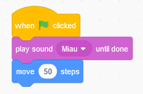

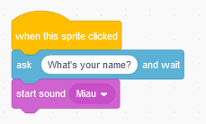
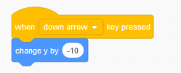
Small visual coding parts - scripts. Just drag and Drop. Part I
https://scratch.mit.edu/

Slide 20
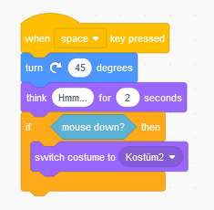
Small visual coding parts - scripts. Just drag and Drop. Part II
https://scratch.mit.edu/

Slide 21
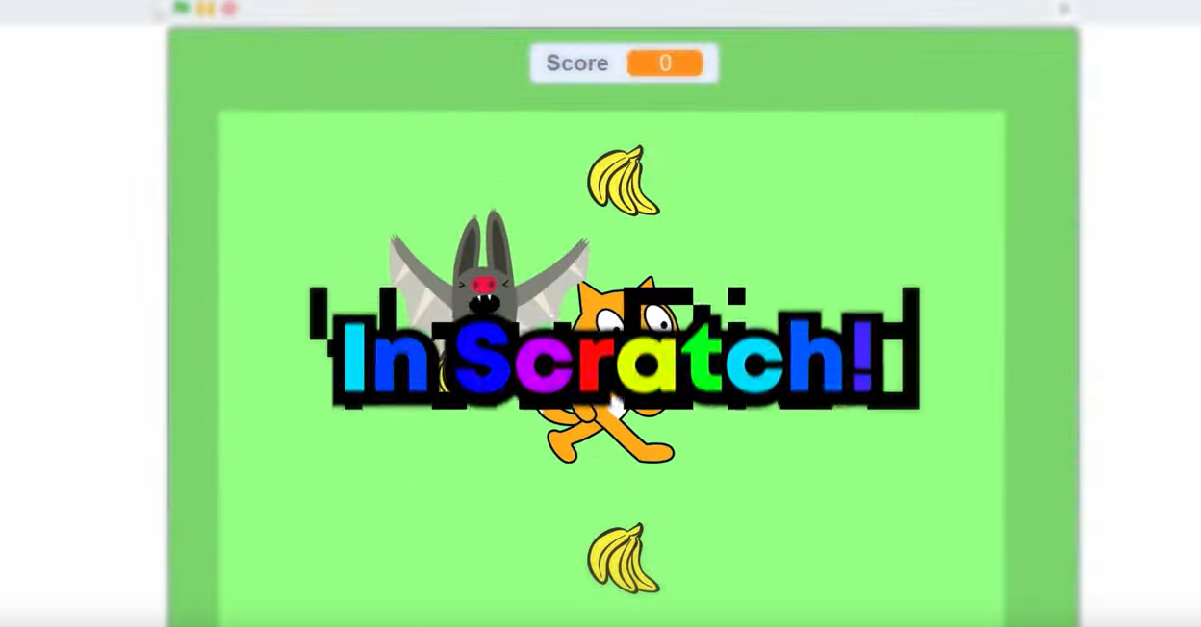
Let´s have a look at this youtube video on Scratch!
A fist game
in Scratch
Video
https://www.youtube.com/watch?v=D-nW4jvzRr8

Slide 22
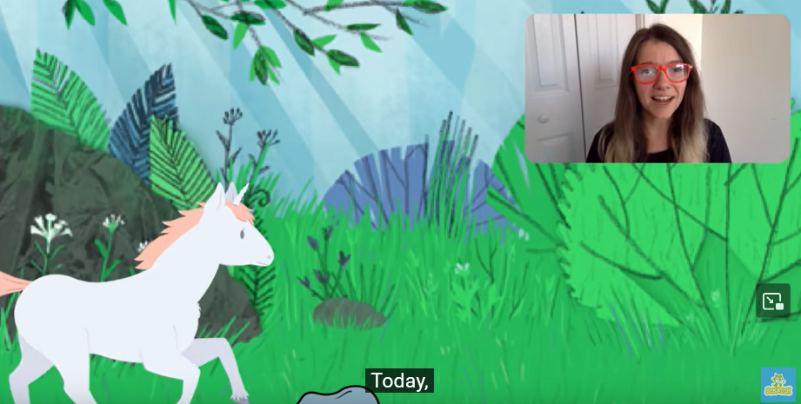
Let´s have a look at this youtube video on another Scratch game!
A jumping game
in Scratch
Video
https://www.youtube.com/watch?v=1jHvXakt1qw

Slide 23
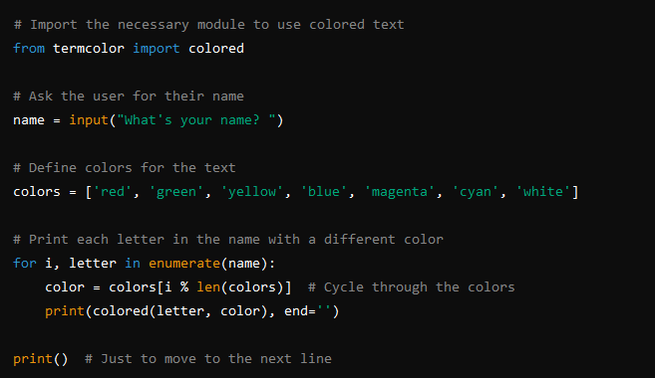
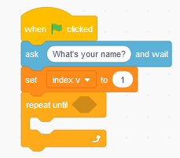
Coding in other programme languages? – example of a coding programme which asks for you name and write the name in coloured letters.
In Python
In Scratch (with Blocks)
When [green flag] clicked
Ask [What's your name?] and wait
Set [index v] to [1]
Repeat (length of [answer])
Create a clone of [myself]
Set [text v] to [letter (index) of [answer]]
Set color effect to (pick random 1 to 200)
Go to x: (index * 20 - 100) y: 0
Increase [index v] by [1]
End repeat

Slide 24
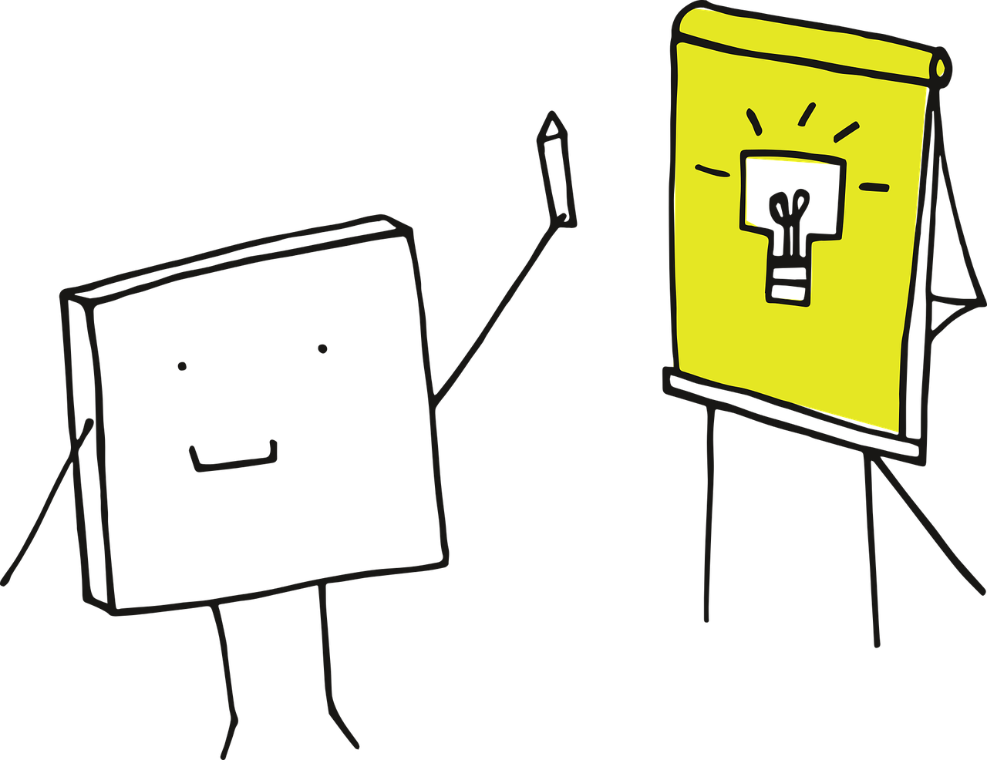
B: About the training
Training phase

Slide 25



Task 1:
Open Scratch and let the cat move when you are
hitting the keys “arrow up”, “arrow down”,
“arrow left” and “arrow right”
Work in a group. You have 20 minutes for the creation.
If you have people with special needs in your
group you will get additional 10 minutes for the
creation while the other groups have to check
and improve their solutions
Show you results to the other learners

Slide 26
Task 2:
Open Scratch and let the cat (or another sprite)
move between to lines by using the arrow keys
(like in task 1). On contact of the cat with the lines
play the sound “miau”
Work in a group. You have 30 minutes for the creation.
If you have people with special needs in your
group you will get additional 10 minutes for the
creation while the other groups have to check
and improve their solutions
Show you results to the other learners

Slide 27



Task 3:
Think about an own small game which
you would like to design and write down
or record your idea with your mobile phone.
Meet each other in the class.
Share your idea and collect feedback.
Open Scratch design you game.
Help each other in your group but also
help other groups if they ask you.

Slide 28
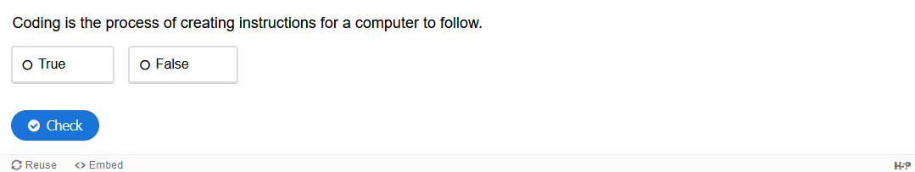
H5P- Tasks 1 about Scratch and Coding – Coding definition

Slide 29
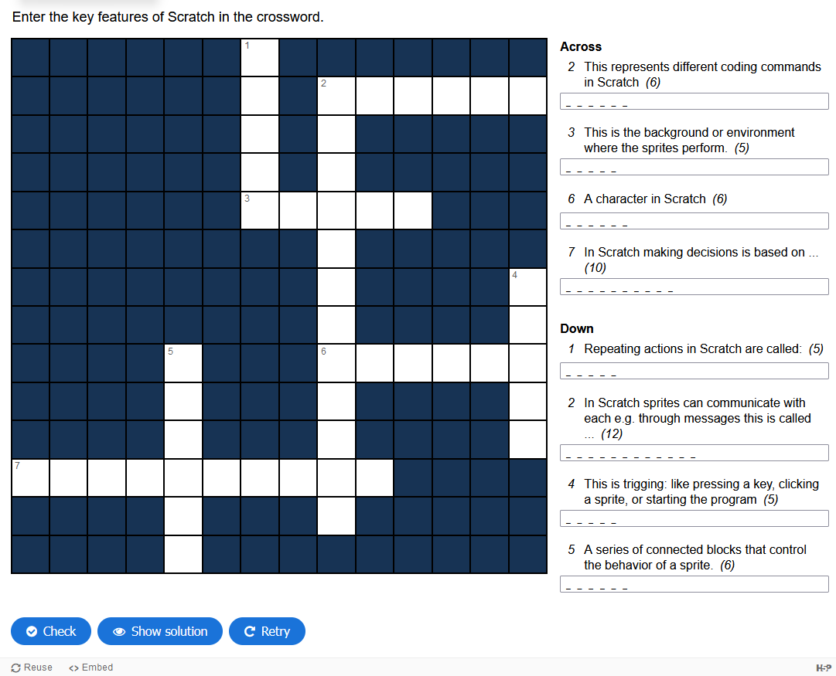
H5P- Tasks 2 about Scratch and Coding –
Key features

Slide 30
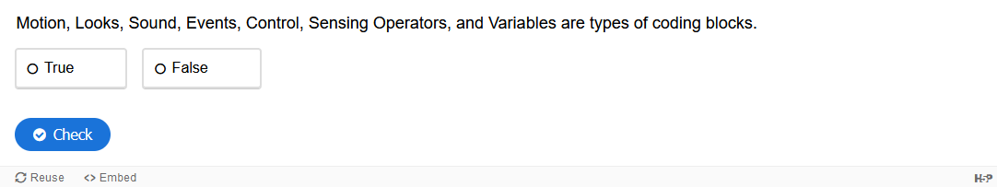
H5P- Tasks 3 about Scratch and Coding –
Coding blocks

Slide 31
Congratulation!
You mastered the activity on coding and game development in Scratch!

