Slide 1

Creating a weather station
STEM4inclusive schools
WP2 – Toolbox
Chair of Business and Human Resource Education II
Prof. Dr. Marc Beutner

Slide 2
Structure of the activity
A
Introduction
about the topic
What´s the weather like?
Measurement devices at weather stations
B
Training phase
about the training
Create your own simple weather station

Slide 3
A: About the topic
What's the weather like?
Measurement devices at weather stations

Slide 4
Definition!
What is climate change?
Climate change refers to significant and lasting changes in the Earth's climate patterns, particularly those that have occurred since the late 19th century due to human activities. While the Earth's climate has always experienced natural fluctuations, the term "climate change" today is most commonly associated with the recent, rapid changes driven by human activity, especially the burning of fossil fuels, deforestation, and industrial processes.
Climate change is a long-term change in the average weather patterns that have come to define Earth's local, regional and global climates. It is not the change of the weather from day to day. And it is becoming more challenging these days.

Slide 5

Let´s have a look at this youtube video!
The climate change
Video
https://www.youtube.com/watch?v=dcBXmj1nMTQ

Slide 6
Climate change and weather observation
Weather observation helps us to forecast the weather for the next day.
Moreover, weather observation with weather stations collects the necessary data to have also a closer look at the weather and the climate over longer time, e.g. over many years to provide information on climate change.

Slide 7
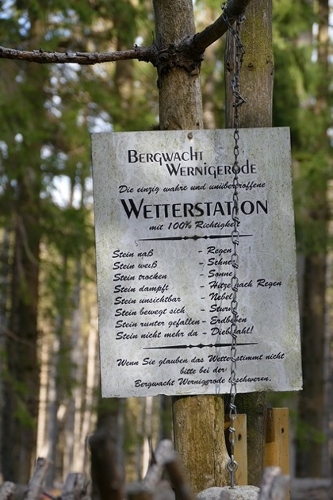
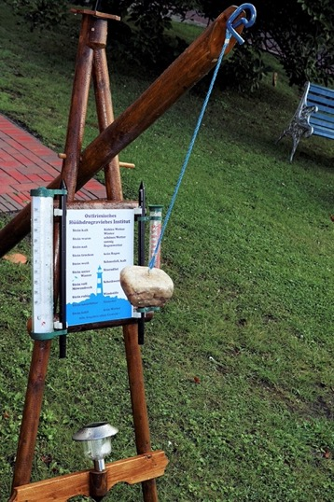

The easiest
weather station
Stone wet – Rain
Stone white – Snow
Stone steaming – Hot after rain
Stone not visible – Fog
Stone moving – Storm
Stone fallen to earth – Earthquake
Stone not there any more - Theft
Pixabay photo by Boke9a
– Haide – free licence
Pixabay photo by Kapa65
– Karsten Paulick – free licence

Slide 8
Definition!
What is a weather station?
A weather station is a site, located on land or at sea. Usually, it is equipped with instruments and tools to measure atmospheric conditions. These measurements are used to generate weather forecasts.
The idea is to analyse weather patterns and climate. Data are collected, analysed and stored.

Slide 9
What sort of data do we collect in a weather station?
temperature,
atmospheric pressure,
humidity,
wind speed,
wind direction and
precipitation levels.

Slide 10
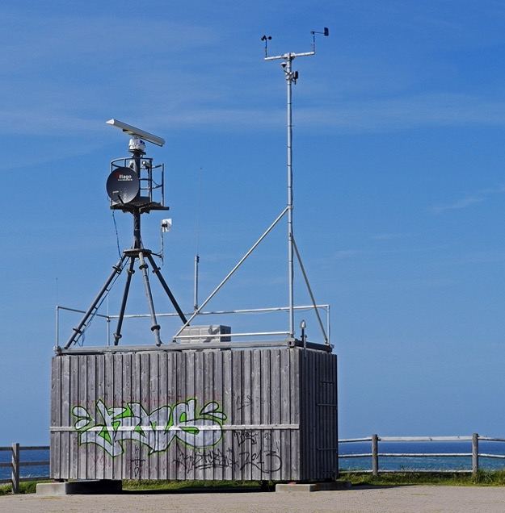
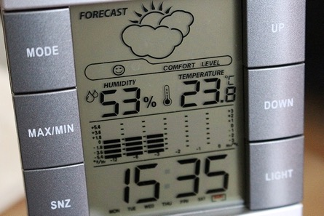
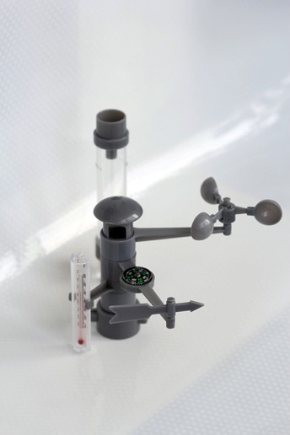
Different types of weather stations – Part I
Pixabay photo by Pix1861
– Csaba Nagy – free licence
Pixabay photo by Irina Kukuts
– Irina – free licence
Pixabay photo by hpgruesen
– Erich Westendarp – free licence

Slide 11
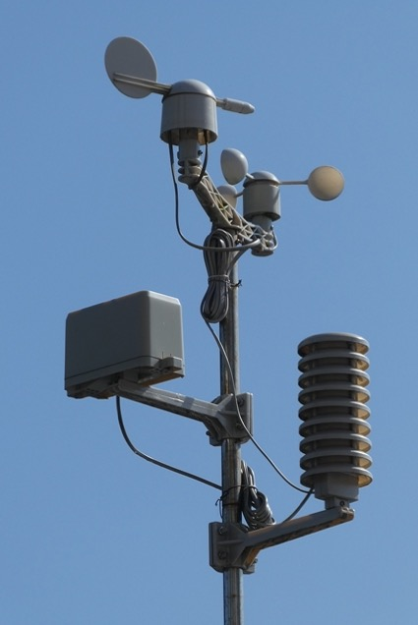
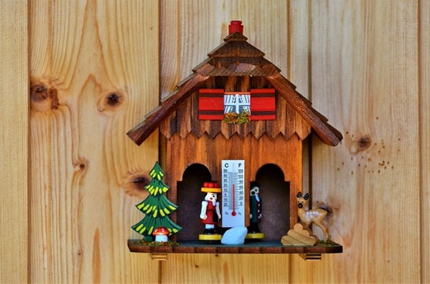
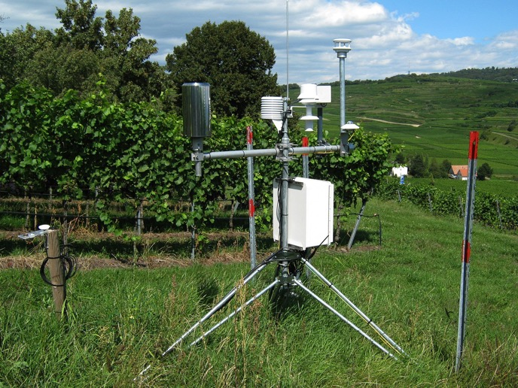
Different types of weather stations – Part II
Pixabay photo by Ralphs_Fotos – Ralph – free licence
Pixabay photo by geralt – Gerd Altmann – free licence
Pixabay photo by Elsemargriet
– free licence

Slide 12
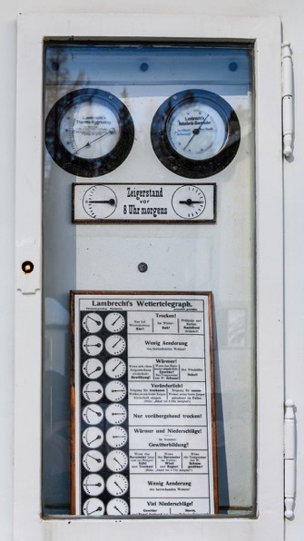
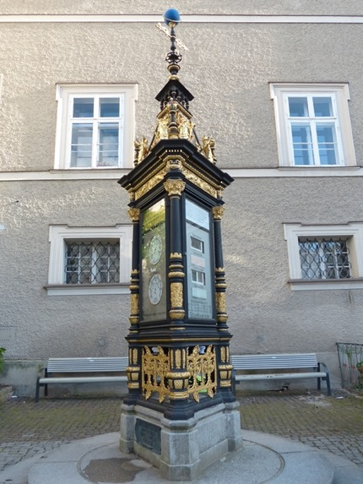
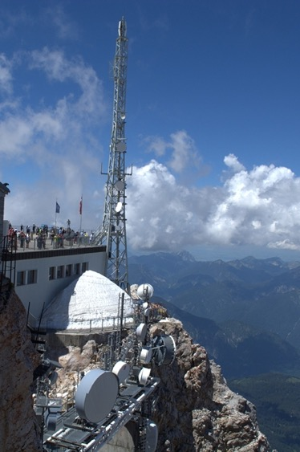
Different types of weather stations – Part III
Zugsitze - Pixabay photo by Meli1670 – Melanie – free licence
Pixabay photo by Hans
– free licence
Pixabay photo by susnpics – Susanne Stöckli – free licence

Slide 13
What sort of instruments belong to a typical real weather station?
Thermometer measuring air and sea surface temperature
Barometer measuring atmospheric pressure
Hygrometer measuring humidity
Anemometer measuring wind speed
Pyranometer measuring solar radiation
Rain gauge measuring liquid precipitation over a specific period of time.
Wind sock measuring general wind speed and wind direction
Wind vane showing which way the wind is blowing.
Evaporation pan measuring evaporation.

Slide 14
Let´s have a closer look at:
Wind vane
Thermometer
Barometer
Hygrometer
Rain gauge

Slide 15
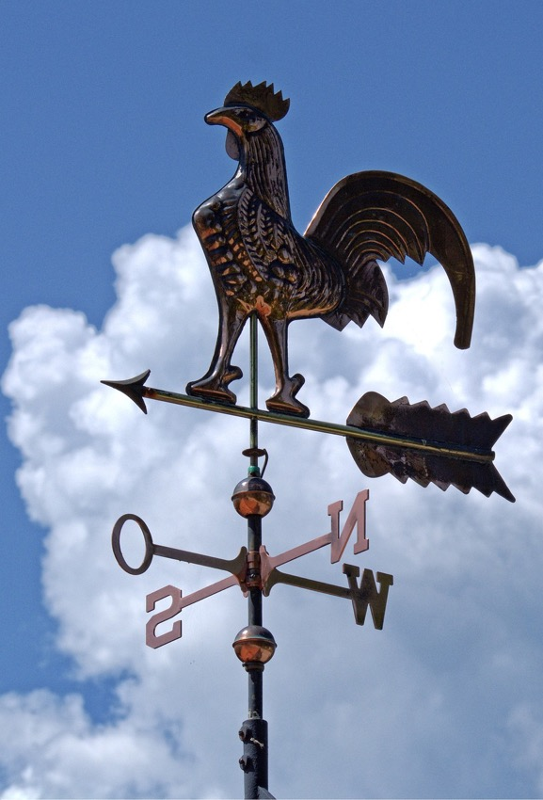
A wind vane
(also called
weather vane or weathercock)
Pixabay photo by Antranias – Manfred Antranias Zimmer– free licence

Slide 16
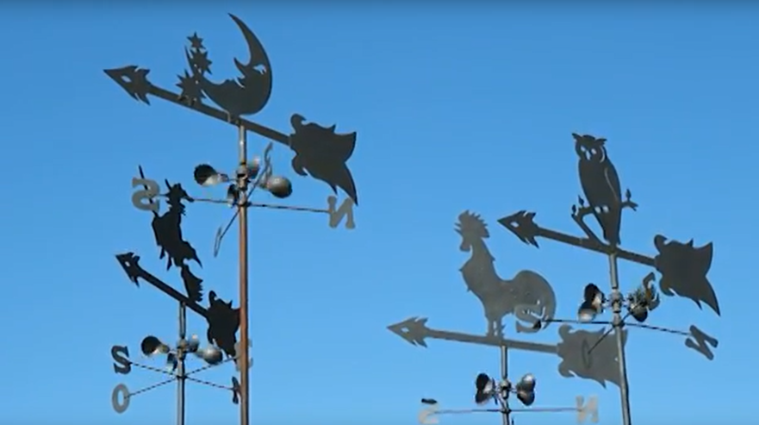
Have a look at this short youtube video!
Weather vane
Video
https://www.youtube.com/watch?v=-rQc4uYnBe8

Slide 17
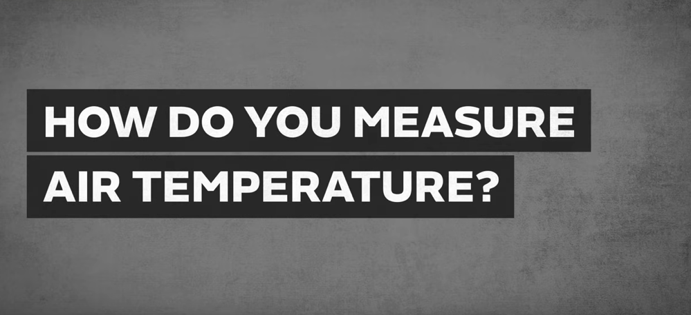
Let´s have a look at this youtube video on temperature measurement!
The Thermometer
Video
https://www.youtube.com/watch?v=rARnTlPax8E&t=28s

Slide 18
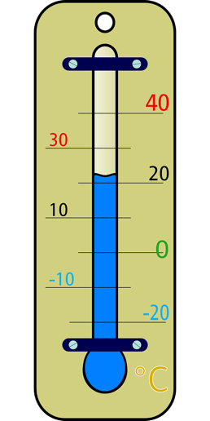
How does a thermometer work?
Liquid-in-Glass Thermometers
A thermometer is an instrument used to measure temperature.
The liquid-in-glass thermometer is one of the most common types of thermometers, which uses a liquid (like mercury or colored alcohol) inside a glass tube. The liquid inside the glass tube expands when heated and contracts when cooled. The glass tube has a calibrated scale marked in degrees (Celsius, Fahrenheit, etc.). As the temperature increases, the liquid expands and rises in the tube. The level of the liquid indicates the temperature. When the temperature decreases, the liquid contracts and falls in the tube, again indicating the temperature on the scale.
Pixabay photo by Clker-Free-Vector-Images – free licence

Slide 19
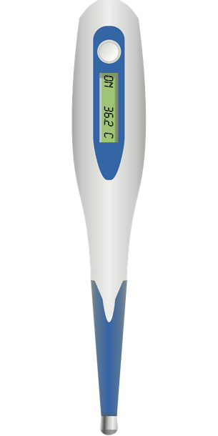
How does a thermometer work?
Digital Thermometers
The digital thermometer is an electronic thermometer that measure temperature using sensors.
They use a thermistor, a type of resistor whose resistance changes with temperature. As the temperature changes, the resistance in the thermistor changes, which is detected by the thermometer's electronics. The thermometer converts this resistance into a temperature reading, which is displayed on a digital screen.
Pixabay photo by Clker-Free-Vector-Images – free licence

Slide 20
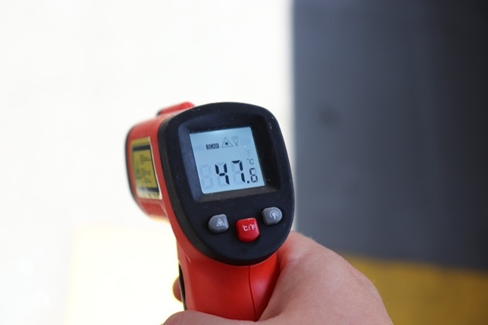
How does a thermometer work?
Infrared Thermometers
The infrared thermometers detect the infrared radiation emitted by an object. Every object emits infrared radiation, and the amount increases with temperature. The thermometer’s sensor detects this radiation and converts it into an electrical signal.
The thermometer’s electronics then translate this signal into a temperature reading displayed on the screen.
.
Pixabay photo by www_InfoTimisoara_ro– Viorel Vașadi – free licence

Slide 21
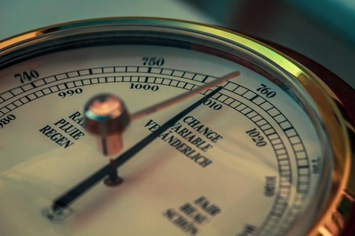
How does a barometer work? Part I
The Mercury Barometer is is the traditional and oldest type of barometer, invented by Evangelista Torricelli in 1643. A mercury barometer consists of a glass tube filled with mercury, inverted in a dish (also containing mercury) called a reservoir or cistern. The tube is closed at one end and open at the other, with the open end submerged in the mercury in the reservoir. The weight of the mercury in the tube creates a vacuum at the top, and the atmospheric pressure pushes down on the mercury in the reservoir. This pressure forces the mercury up the tube.
Pixabay photo by Tom– free licence

Slide 22
How does a barometer work? Part II
The height of the mercury column in the tube corresponds to the atmospheric pressure.
Atmospheric pressure is typically measured in millimeters or inches of mercury (mmHg or inHg). Standard atmospheric pressure at sea level is about 760 mmHg. As atmospheric pressure increases, it pushes more mercury up the tube. If pressure decreases, the mercury level falls. 1 mmHg is the same a 133 Pascal and 1,33 Hectopascal (hPa).
Pixabay photo by Tom– free licence

Slide 23
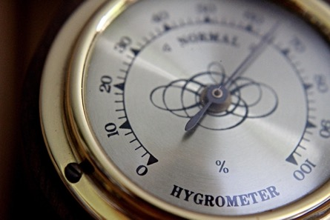
How does a hygrometer work?
Mechanical (Hair-Tension) Hygrometer
A hygrometer is an instrument used to measure the humidity, or the amount of moisture, in the air. Hair, especially human hair, changes length based on the humidity level in the air. It lengthens when the air is more humid and shortens when the air is drier. In a mechanical hygrometer, a bundle of hair is connected to a mechanical lever system. As the humidity changes, the hair length changes, which moves the lever. The lever movement is transferred to a needle that points to a calibrated scale, indicating the relative humidity (RH) as a percentage. These hygrometers are simple, but they need regular calibration and can be less accurate over time. The relative humidity is measured in percent (o to 100%).
Pixabay photo by rschaller98 – Raphael Schaller– free licence

Slide 24
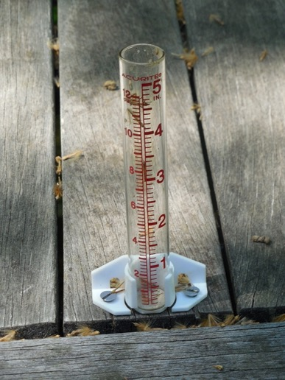
How does a rain gauge work? – Part I
A rain gauge is a simple instrument used to measure the amount of rainfall over a specific period. It collects and measures precipitation, providing data that is essential for weather forecasting, agricultural planning, and hydrological studies. I typically consists of a cylindrical container.
The gauge has a funnel at the top that directs rainwater into a graduated measuring tube inside the cylinder.
The funnel ensures that all the rain that falls into the gauge is funneled into the measuring tube, reducing evaporation losses.
Pixabay photoby StillWorksImagery – Rebecca Matthews – free licence

Slide 25
How does a rain gauge work? – Part II
The measuring tube is usually narrower than the outer cylinder, allowing for more precise measurements because the water level rises higher for a given amount of rainfall.
The tube is marked with a scale, usually in millimeters or inches, so that the amount of rainfall can be easily read.
After a rainfall event, the collected water is measured by observing the water level in the tube. The measurement represents the depth of rainfall that has fallen over the area covered by the gauge.
If the rainfall exceeds the capacity of the inner tube, the excess water overflows into the outer container, and the total is then calculated by adding the inner and outer readings.
Pixabay photoby StillWorksImagery – Rebecca Matthews – free licence

Slide 26

B: About the training
Training phase

Slide 27



Task 1:
Draw a plan for your weather station. Work
together in groups of four persons and include
also the learners who are not able to draw on
their own by integrating their comments and ideas.
You have 20 minutes for the creation.
If you have people with special needs in your
group you will get additional 10 minutes for the
creation while the other groups have to check
and improve their solutions
Please, collaborate. Support learners with
visual impairments or disabilities.
Afterwards, everyone should share ideas

Slide 28

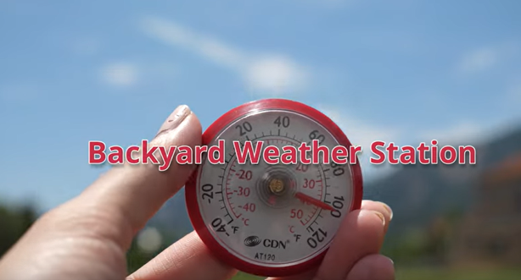
Task 2:
Let´s have a look at the following video:
Describe what you saw in a short text.
If you are not able to write, please, work
together with other persons or record an
audio about your ideas with your mobile phone.
https://www.youtube.com/watch?v=sdxPTl8k9bI&t=18s

Slide 29



Task 3:
Create your own simple weather station:
Bring it outside and observe it for
two week. Write down your observations
in the observation protocol each day.
Meet each other after the two weeks and
share your observations and experiences.
Everybody has to be involved according to
discuss classroom norms and community agreements.

Slide 30
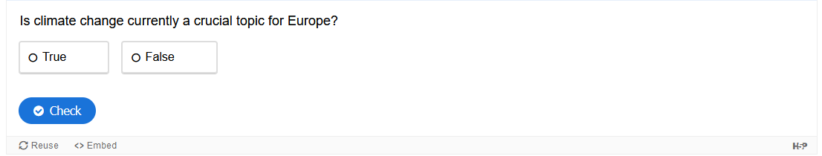
H5P- Tasks 1 about climate and the weather station – Climate change

Slide 31
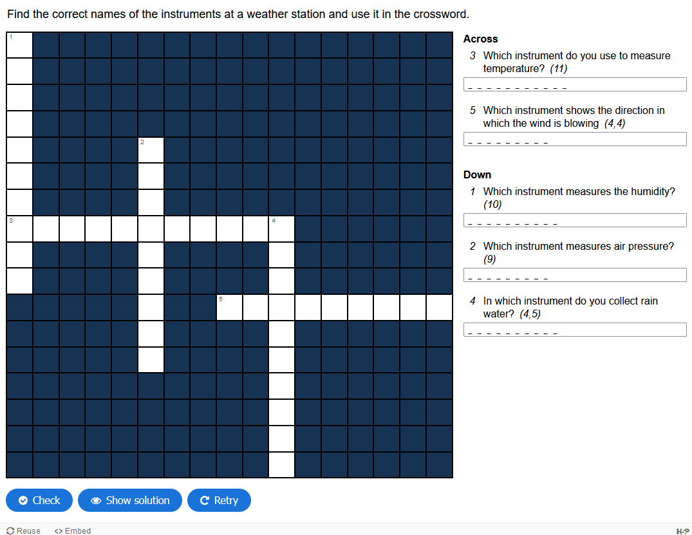
H5P- Tasks 2 about climate and the weather station - Instruments

Slide 32
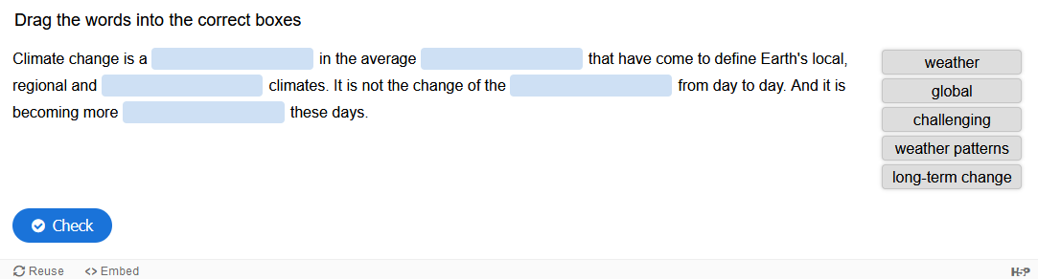
H5P- Tasks 3 about climate and the weather station – Global climate

Slide 33
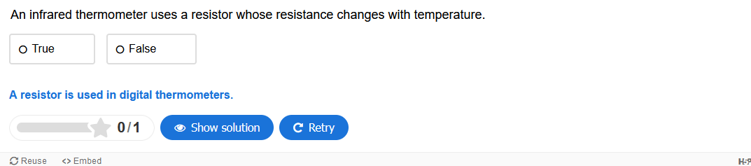
H5P- Tasks 4 about climate and the weather station – Thermometers

Slide 34
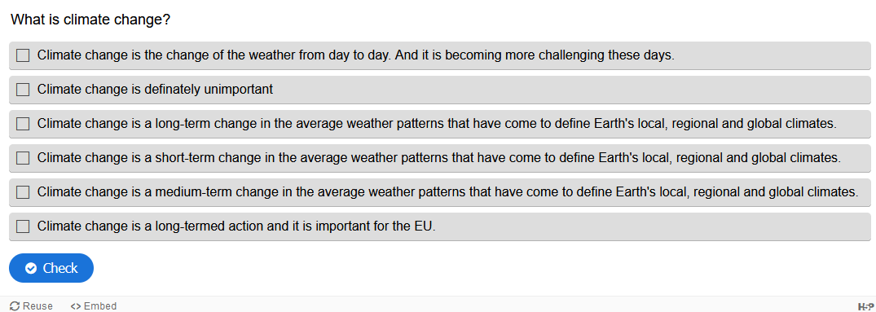
H5P- Tasks 5 about climate and the weather station – What is climate change?

Slide 35
Congratulation!
You mastered the activity on climate and the creation of a weather station!

