Slide 1
Control of Geometric and Constructive Elements of Twist Drills
STEM for Inclusive Schools
Project no:
KA220-NW-23-30-151162
STEM4inclusive schools
WP2 – Toolbox

Slide 2
Overview
STEM for Inclusive Schools
Project no:
KA220-NW-23-30-151162
The terminology of twist drills is given in SR ISO 5419:2012, the constructive elements and geometric parameters of the cutting part – in STAS R 1112/4-87, and the general quality conditions in STAS 6359-86.
The drill can be assimilated to a tool consisting of two internal turning knives, solidified by a common core having helical channels for chip evacuation.

Slide 3
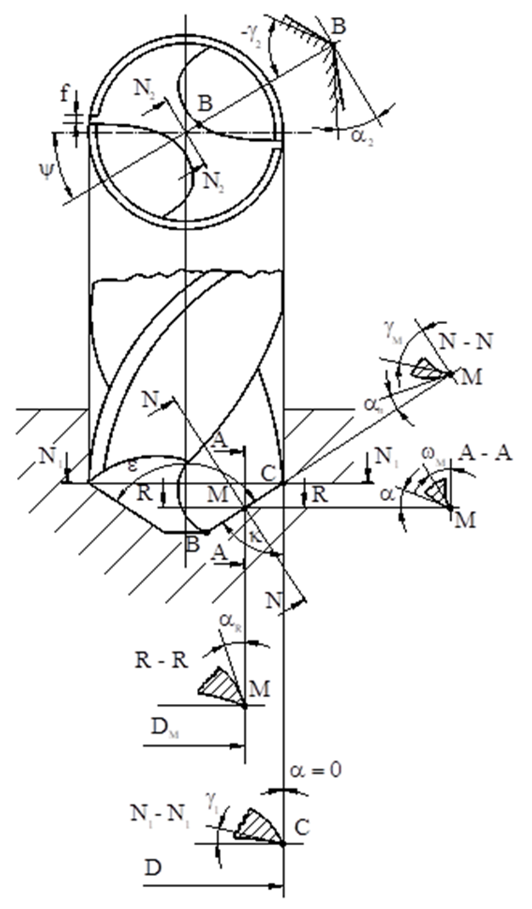
STEM for Inclusive Schools
Project no:
KA220-NW-23-30-151162
The edges of the main cutting edges, resulting from the intersection of the clearance faces with the main seating faces, are joined in the central area by a transverse cutting edge. In a section N2 – N2 normal to the transverse cutting edge, a negative clearance angle γ2<0 is found. The existence of the ground facets of the secondary seating faces is motivated by the need to guide the tool in the machined bore. In order to reduce friction, the drill has a slight reverse taper, which leads to the appearance of the secondary approach angle k2.
The constructive geometric parameters of the drill will be defined as for an internal turning tool.
Cutting tool design – UDJG laboratory guide

Slide 4
STEM for Inclusive Schools
Project no:
KA220-NW-23-30-151162
The constructive clearance angle is considered in the section plane N – N, and the constructive main seating angle in the section A – A (this coincides with the working plane).
The clearance angle γ is formed between the tangent to the clearance surface at a point M on the cutting edge and the normal at the same point to the surface generated by the cutting edge by rotating the drill around its axis.
The main seating angle α is measured between the tangent to the seating face at the considered point and the tangent at the same point M to the circle described by it by rotating around the drill axis.
The angle of inclination of the helical groove ω is formed between the tangent to the outer helical surface and the drill axis.
Cutting tool design – UDJG laboratory guide

Slide 5
STEM for Inclusive Schools
Project no:
KA220-NW-23-30-151162
On the cylinder corresponding to point M, the clearance angle γM plane A – A is equal to ωM.
The constructive main angle of attack is defined between the projection of the main cutting edge on the base plane and the tool axis. The double of the angle of attack is called the tip angle of the drill.
The angle of inclination of the transverse cutting edge ψ is measured between the projections of the cutting edges of the main cutting edge and the transverse cutting edge, in a plane normal to the drill axis.
The secondary angle of attack k1 has very small values ​​(due to this angle, the drill becomes slightly conical).
The secondary landing angle α1 is zero due to the leading facet.
Cutting tool design – UDJG laboratory guide

Slide 6
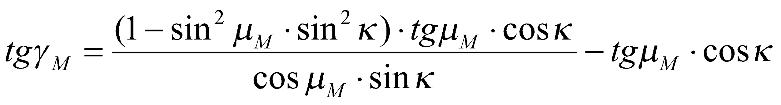
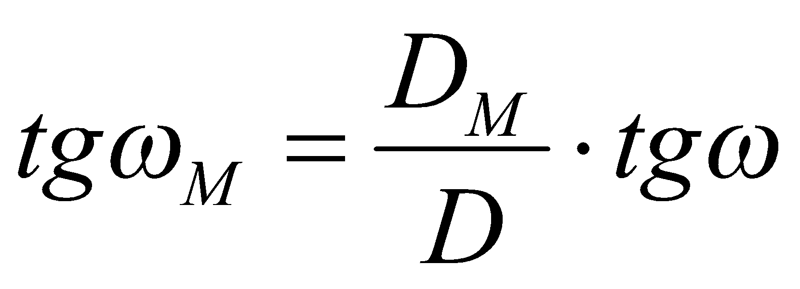
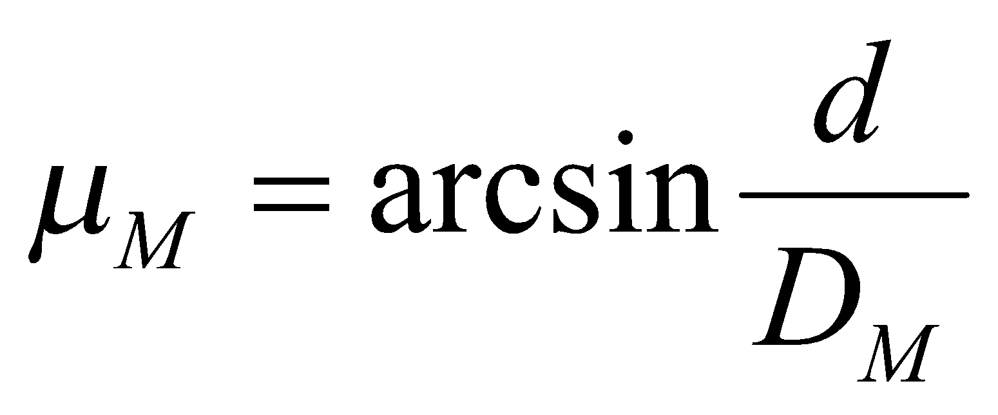
STEM for Inclusive Schools
Project no:
KA220-NW-23-30-151162
The geometric parameters of the drill have the following relationship:
where:
D is the diameter of the drill;
DM is the diameter of the circle on which point M is located;
d is the diameter of the drill core.
Cutting tool design – UDJG laboratory guide

Slide 7
STEM for Inclusive Schools
Project no:
KA220-NW-23-30-151162
The seating angle has values ​​ranging from 6° ÷ 10° at the edge periphery, increasing towards the core of the drill up to 20° ÷ 30°.
This variation is necessary because during the cutting process the functional seating angle decreases towards the drill axis.

Slide 8
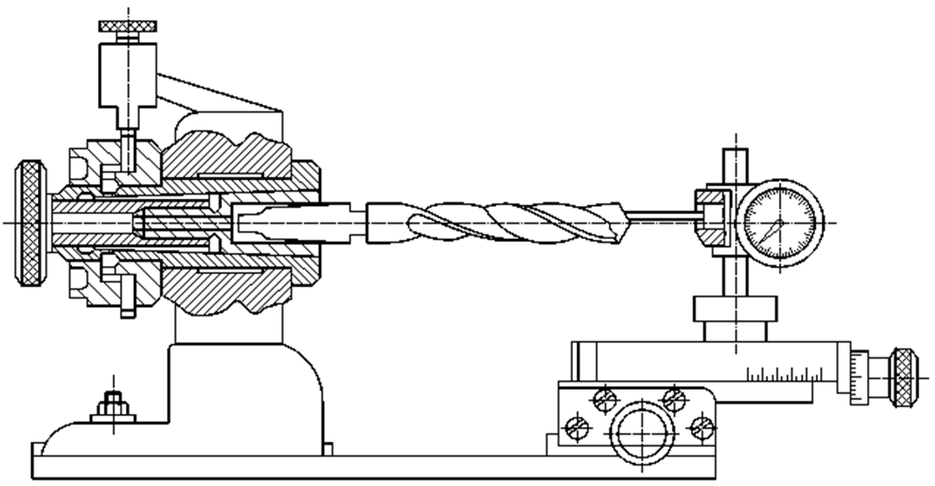
Relief angle control
STEM for Inclusive Schools
Project no:
KA220-NW-23-30-151162
The relief angle is measured at several points on the drill bit, using the device in the figure.
For this purpose, the measuring drill bit is fixed on the cone of the device, which can be precisely rotated around its axis by the required angle.
Cutting tool design – UDJG laboratory guide

Slide 9
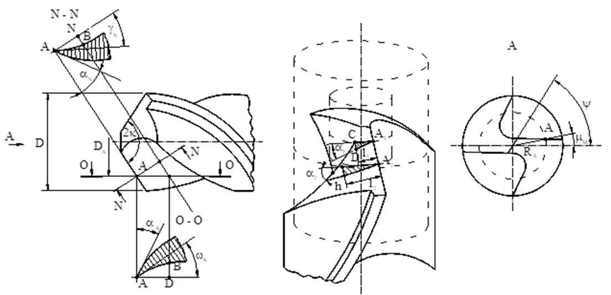
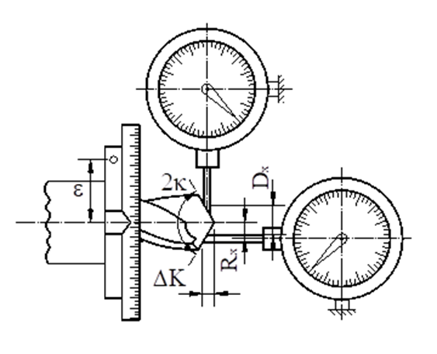
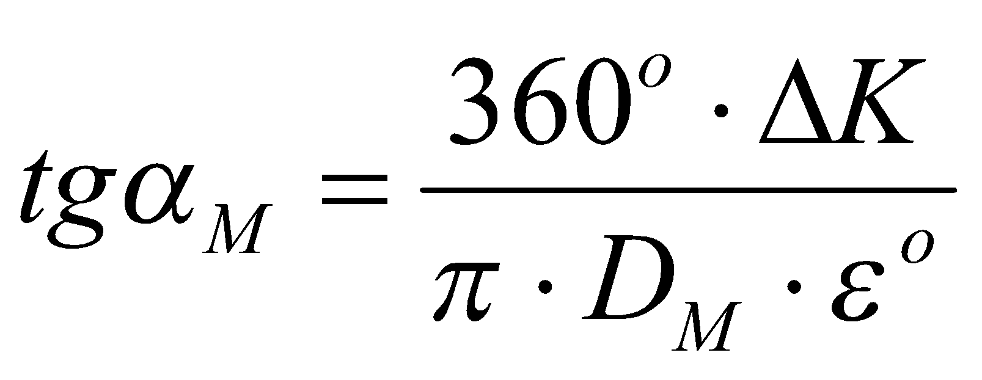
Relief angle control
STEM for Inclusive Schools
Project no:
KA220-NW-23-30-151162
The measurement of the elements necessary to determine the relief angle is done with two comparators, mounted according to the diagram in the figure on two sleds, which can move in the plane in two perpendicular directions.
Cutting tool design – UDJG laboratory guide
The measurement method is based on the fact that the triangle A1CD is considered to be a right triangle. The error made by replacing the arc A1D with the respective chord is small.
The angle of inclination αM, corresponding to the diameter DM of the point considered M where the measurement is made, is given by the relationship:

Slide 10
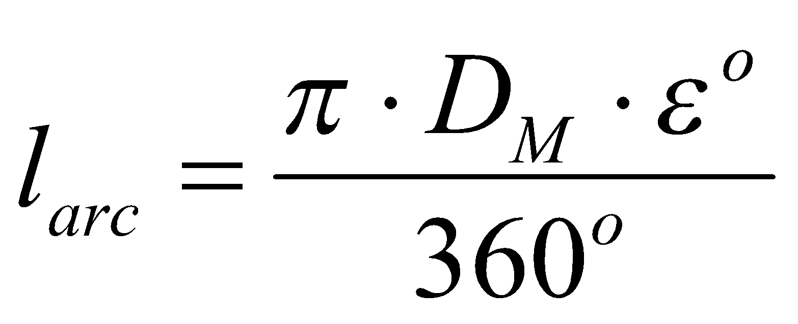
STEM for Inclusive Schools
Project no:
KA220-NW-23-30-151162
For a better approximation, it is necessary that the angle is as small as possible (normally ε=5°). In this way, the calibration curves corresponding to each diameter DM can be determined.
In order to measure the seating angle, proceed as follows:
- fix the drill to be measured in the cone of the device, which allows rotation by the required angle;
- move the comparator to the diameter where the measurement is to be made, fixing the respective size with the scales of the device's slides;
- touch, with the comparator's feeler, the seating face of the tooth, adjusting the indicator needle to zero;
- rotate the drill by the angle ε and read the size Δk on the comparator's dial, this representing one of the legs of the curvilinear triangle A1CD.
- the other leg, being equal to the length of the arc of a circle, corresponding to the rotation angle, is calculated with the relation:

Slide 11
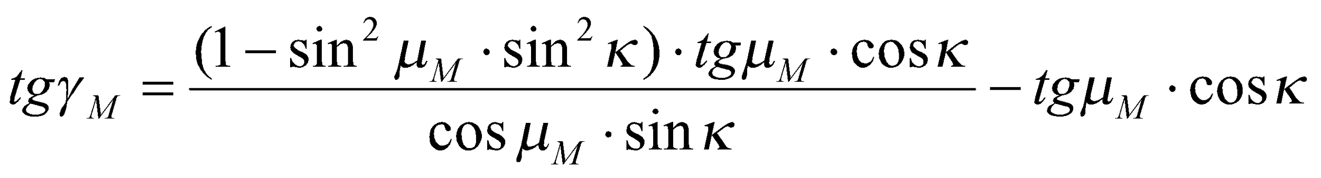
Rake angle control
STEM for Inclusive Schools
Project no:
KA220-NW-23-30-151162
The rake angle is determined by calculation with the relationship below, in which the values ​​of the DM diameters are entered for the points where the seating angle measurement was made.

Slide 12
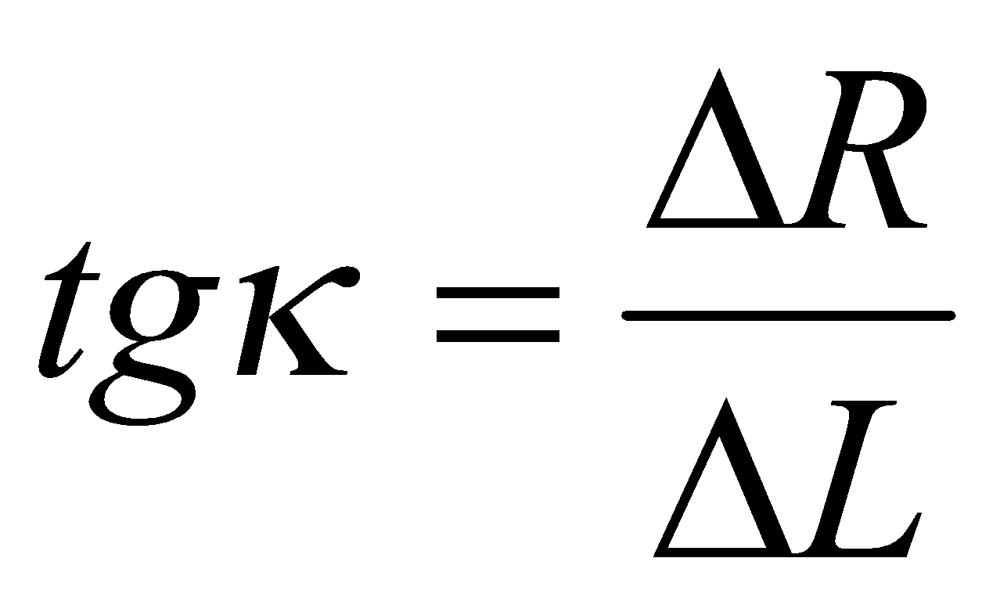
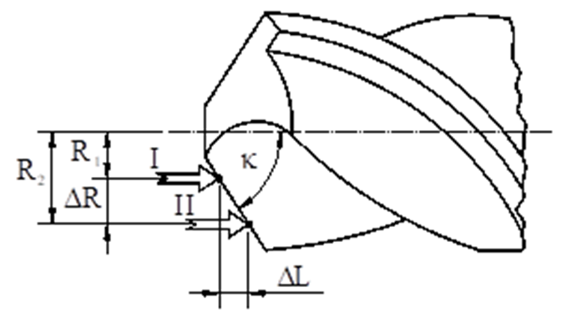
Main working angle control
STEM for Inclusive Schools
Project no:
KA220-NW-23-30-151162
The determination of the main working angle k is done with the relation:
where:
ΔR is the difference in radii in two measured bridges;
ΔL is the axial displacement of the probe, corresponding to the two measurement positions.
Cutting tool design – UDJG laboratory guide

Slide 13
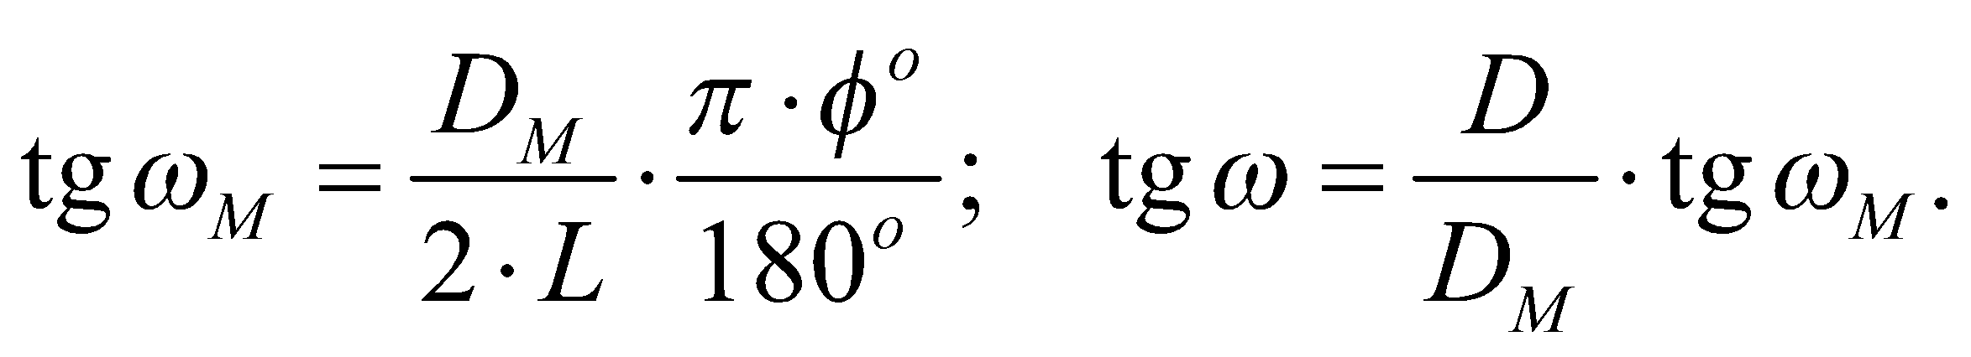
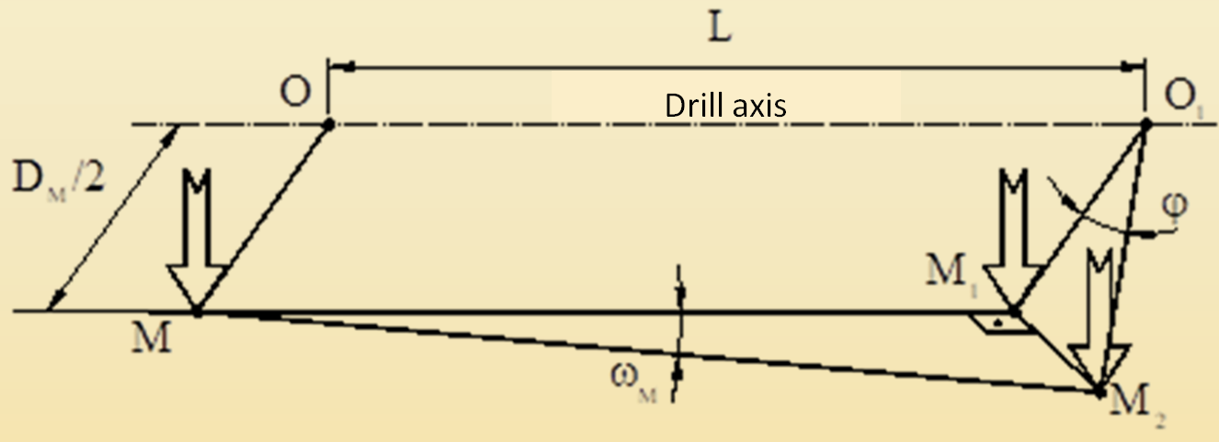
Helical flute inclination angle control
STEM for Inclusive Schools
Project no:
KA220-NW-23-30-151162
The angle ω is measured using a dial gauge, fixed so that in the initial position it touches the drill rake face with the probe at a point M. After the longitudinal movement of the gauge by the distance L, the drill is rotated until the probe touches the rake face again, noting the rotation angle φ.
The value of the helical groove inclination angle ω is determined by the relationship:
Cutting tool design – UDJG laboratory guide

Slide 14
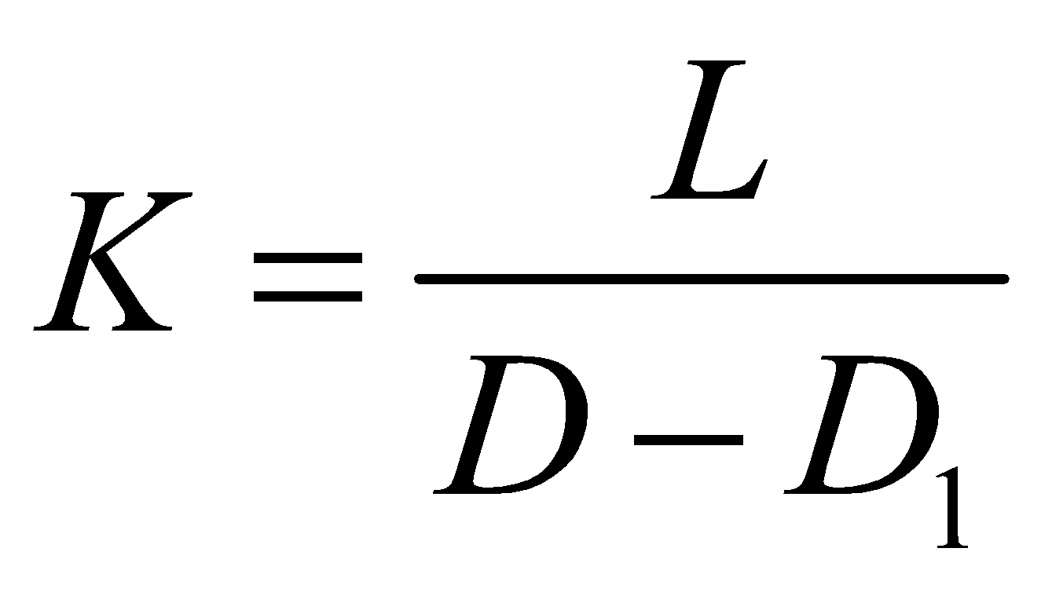
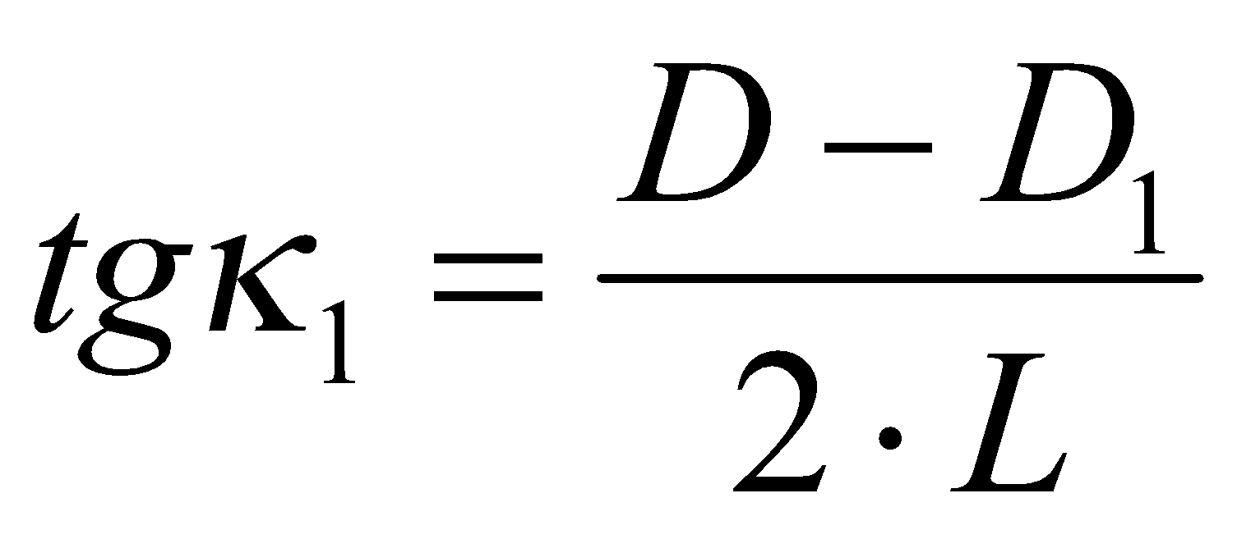
Checking the reverse taper of the drill bit
STEM for Inclusive Schools
Project no:
KA220-NW-23-30-151162
The reverse taper of the drill is determined by the relationship:
where: D is the diameter of the drill at the tip; D1 the diameter of the drill near the tail; L the distance along the drill axis between the planes in which the two diameters were measured.
The reverse taper of the drill leads to the appearance of the secondary angle of attack k1, which will have the value:

Slide 15
Drill tooth facet control
STEM for Inclusive Schools
Project no:
KA220-NW-23-30-151162
The tooth face is measured using a workshop microscope or a profile projector.
The control of the other construction elements is done with universal measuring instruments.

