Slide 1
Machining Accuracy
STEM for Inclusive Schools
Project no:
KA220-NW-23-30-151162
STEM4inclusive schools
WP2 – Toolbox

Slide 2
Mechanical processing
STEM for Inclusive Schools
Project no:
KA220-NW-23-30-151162
The dimensions and shape of the parts cannot be obtained at the nominal values.
Deviations in dimensions and shape depend on the factors that generate them.

Slide 3
STEM for Inclusive Schools
Project no:
KA220-NW-23-30-151162
The main causes of deviations
Precision of machine tools.
Precision of devices.
Precision of measuring instruments.
Tool wear.
Thermal gradient.
Unevenness of machining allowance.
Inhomogeneity of material.

Slide 4
STEM for Inclusive Schools
Project no:
KA220-NW-23-30-151162
Statistical control
Random deviations can be controlled using statistical and probability theory methods.
The limits of deviations resulting from the machining of a part can be calculated.

Slide 5
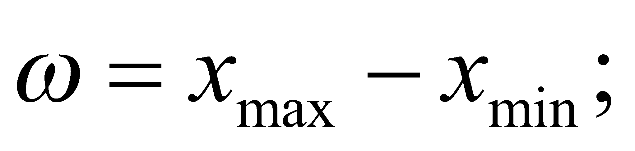
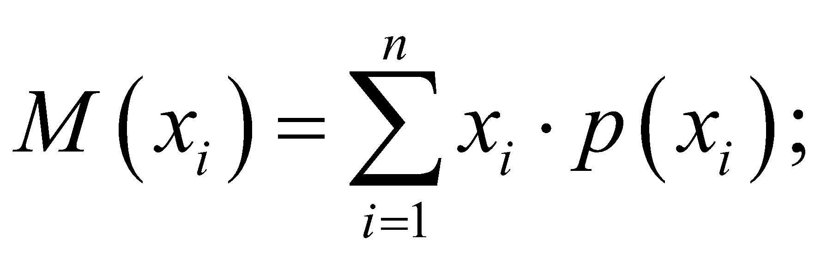
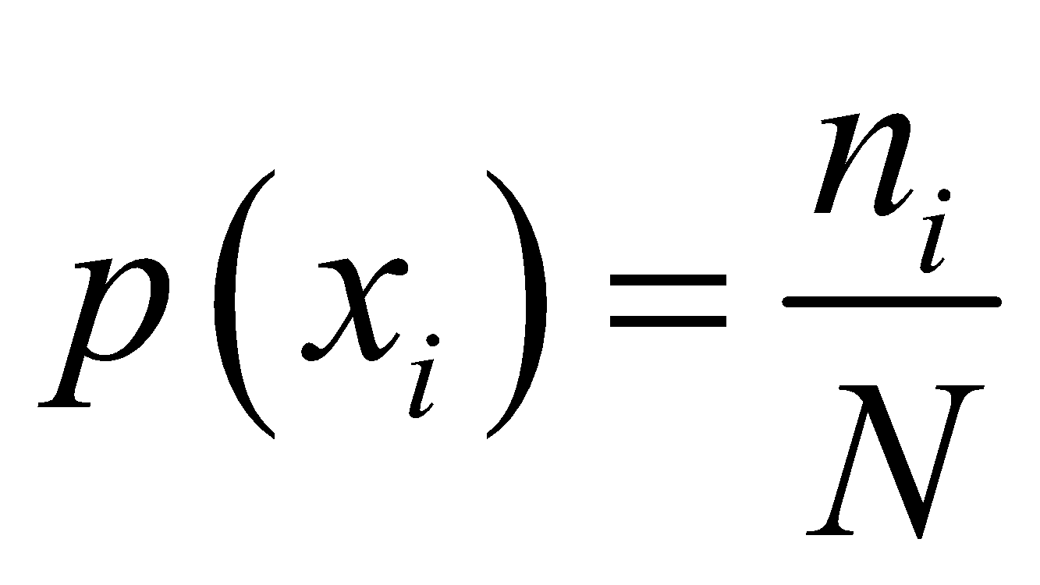
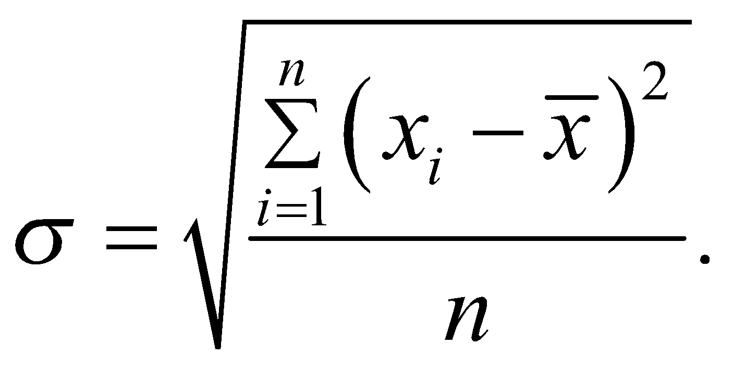
STEM for Inclusive Schools
Project no:
KA220-NW-23-30-151162
Tracking processing deviations
Numerical characteristics of the distribution of processing deviations:
deviation amplitude
weighted average value of dimensions
relative frequency of dimension xi.
root mean square deviation

Slide 6
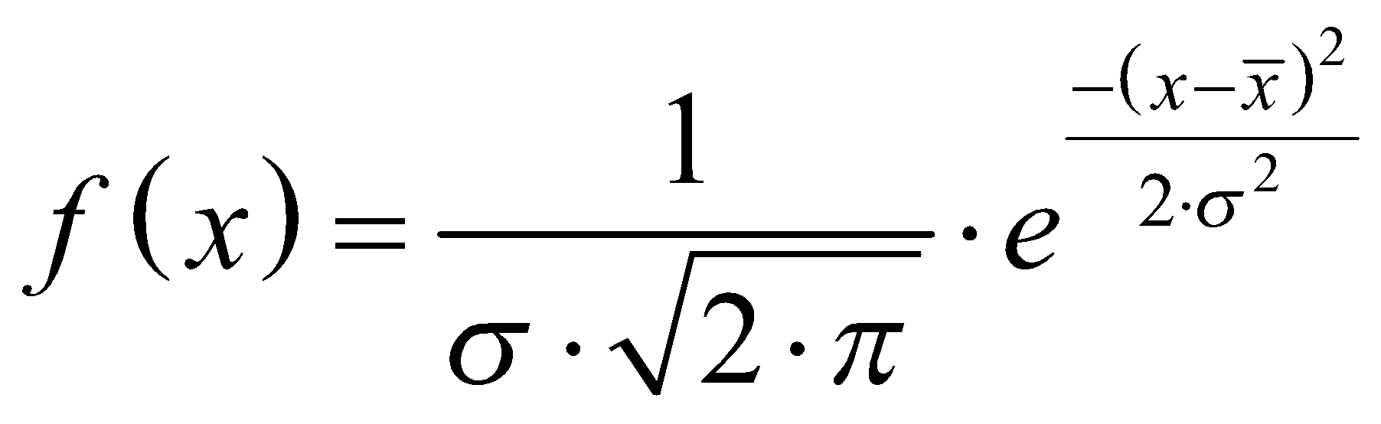
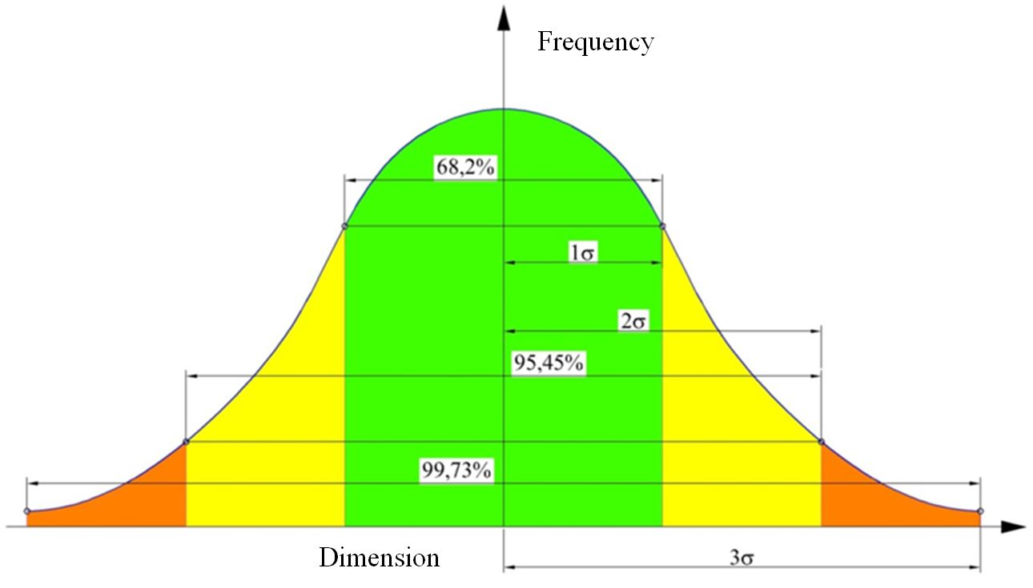
STEM for Inclusive Schools
Project no:
KA220-NW-23-30-151162
Gauss distribution law

Slide 7
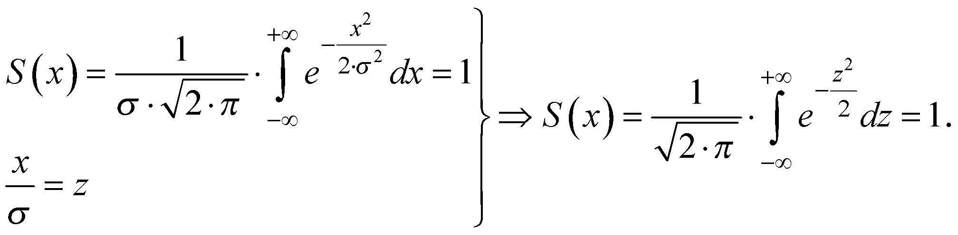
STEM for Inclusive Schools
Project no:
KA220-NW-23-30-151162
Interpreting the Gauss curve
Geometrically, σ represents the distance from the axis of symmetry of the curve to the point of inflection.
The area limited by the curve and the abscissa represents the total number of deviations of the dimensions and is equal to unity:

Slide 8
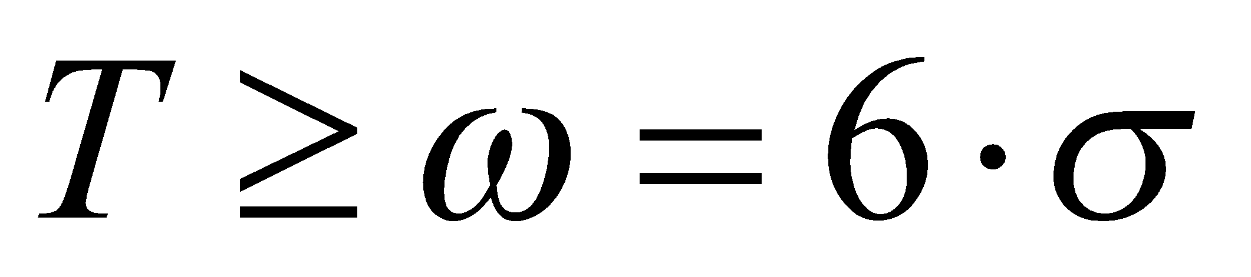
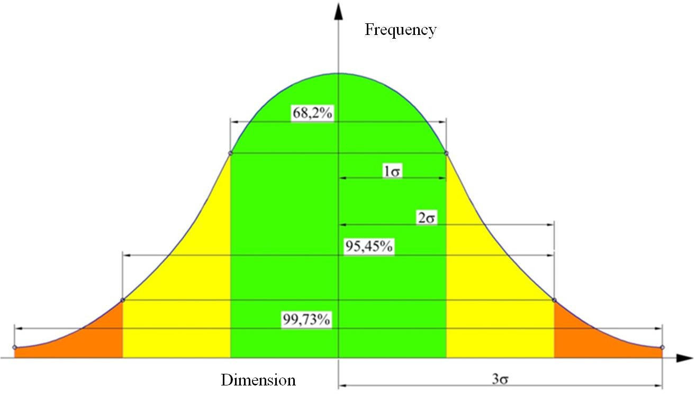
STEM for Inclusive Schools
Project no:
KA220-NW-23-30-151162

Slide 9
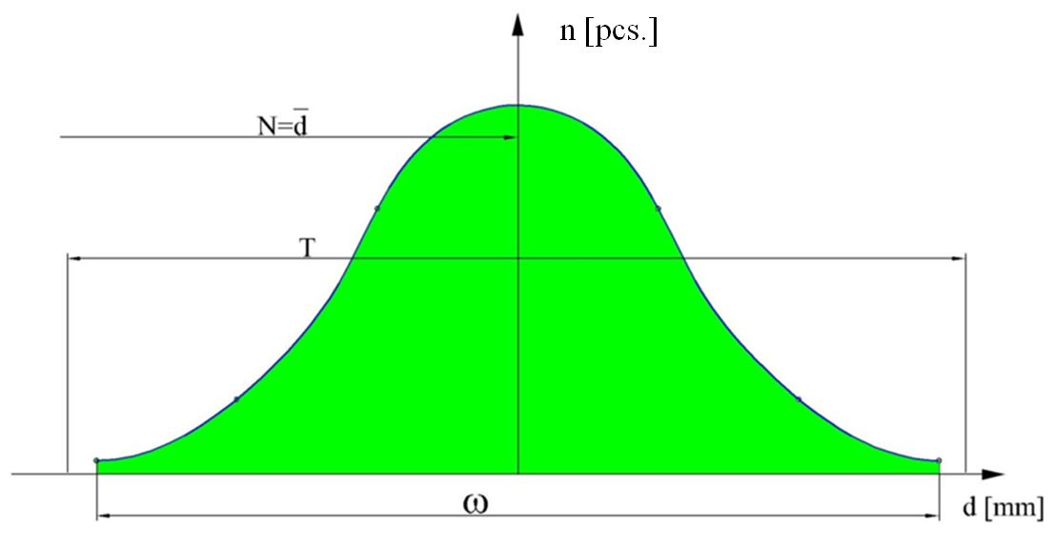
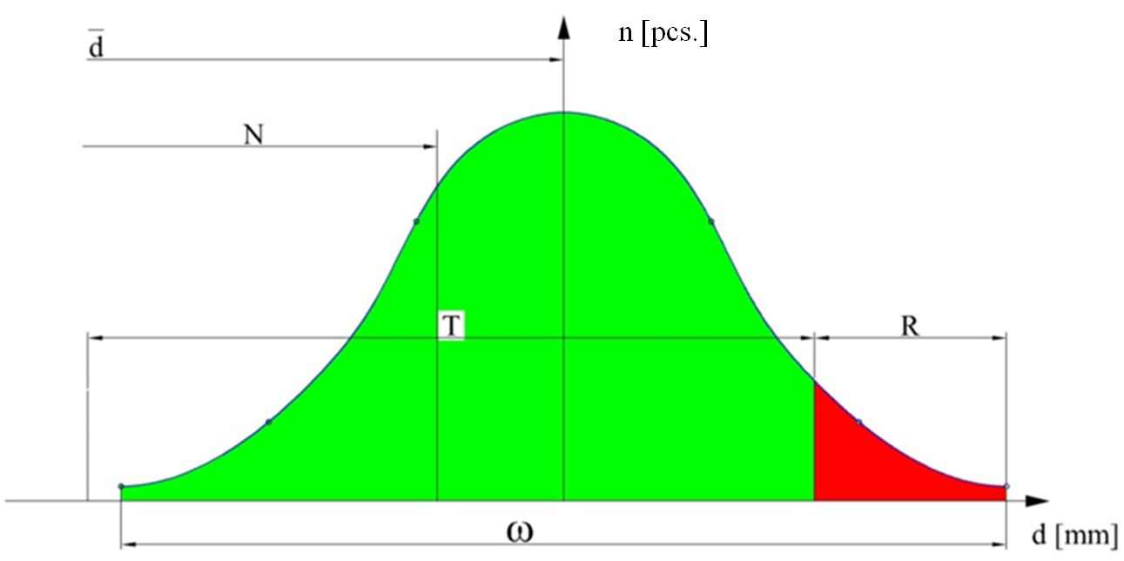
STEM for Inclusive Schools
Project no:
KA220-NW-23-30-151162
The condition T≥6σ is not sufficient.
In addition, the axis of symmetry of the error distribution curve must coincide with the middle of the tolerance field.
If the axis of symmetry is shifted from the center of the tolerance field by an amount called the adjustment error, then a percentage of rejected parts, R[%], results.

Slide 10
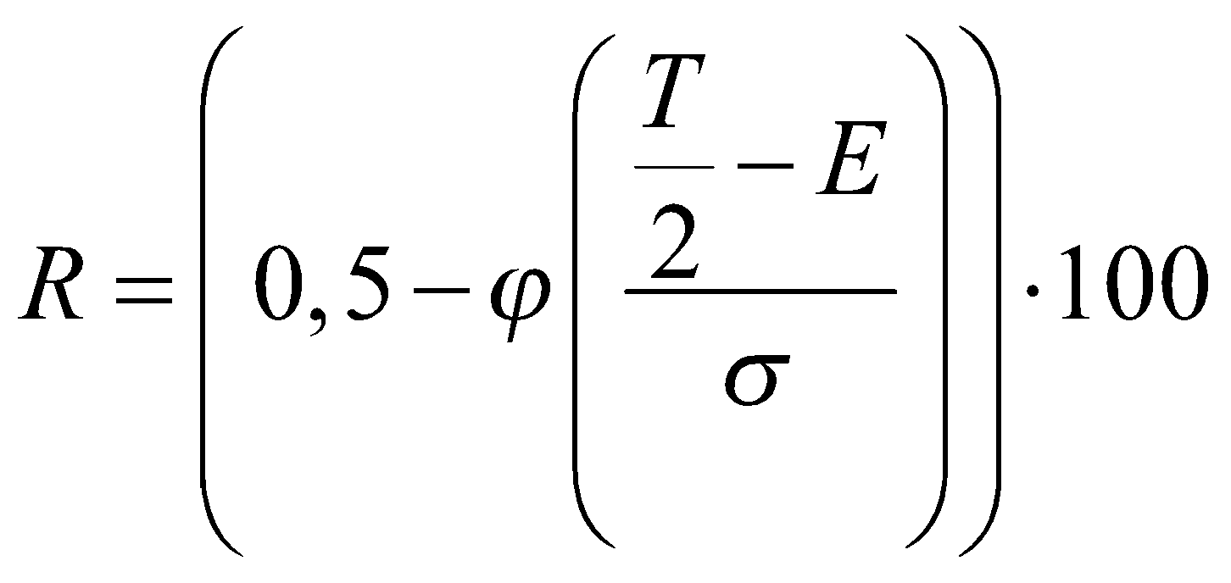
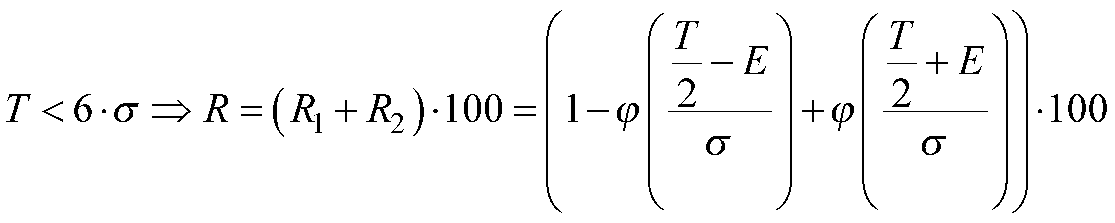
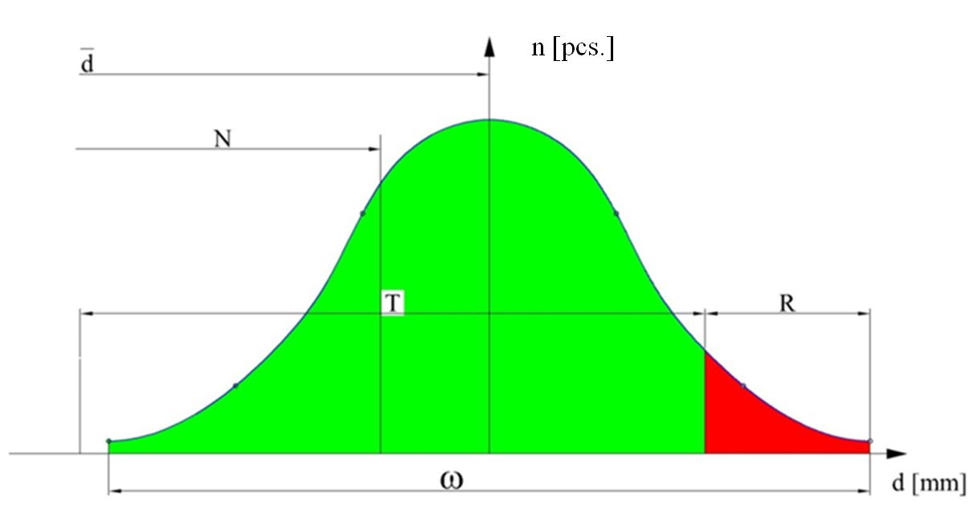
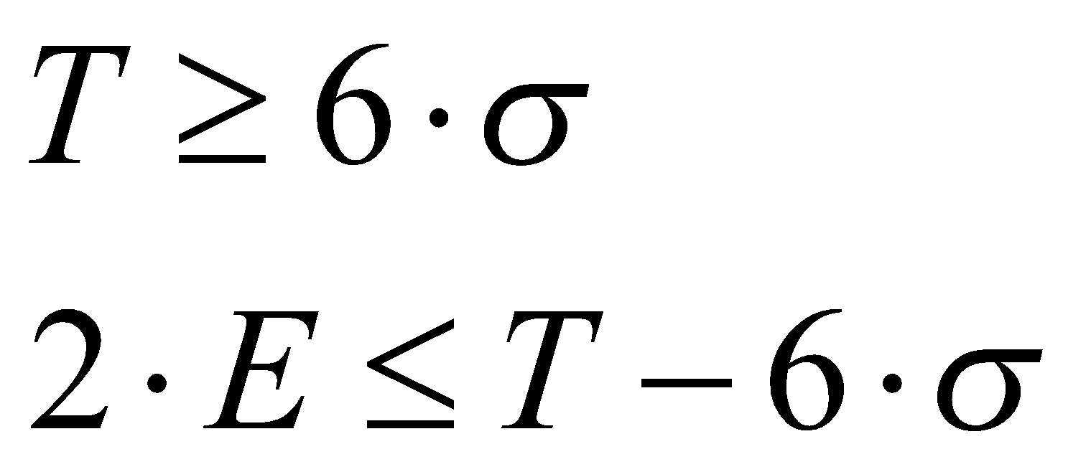
STEM for Inclusive Schools
Project no:
KA220-NW-23-30-151162
To avoid errors, is necessary that:

Slide 11
STEM for Inclusive Schools
Project no:
KA220-NW-23-30-151162
The values ​​of the function φ(z)
z | 0,1 | 0,2 | 0,3 | 0,4 | 0,5 | 0,6 | 0,7 | 0,8 | 0,9 | 1,0
φ(z) | 0,0389 | 0,0793 | 0,1179 | 0,1554 | 0,1915 | 0,2257 | 0,2580 | 0,2881 | 0,3159 | 0,3413
z | 1,1 | 1,2 | 1,3 | 1,4 | 1,5 | 1,6 | 1,7 | 1,8 | 1,9 | 2,0
φ(z) | 0,3643 | 0,3849 | 0,4032 | 0,4192 | 0,4332 | 0,4452 | 0,4554 | 0,4641 | 0,4713 | 0,4772
z | 2,1 | 2,2 | 2,3 | 2,4 | 2,5 | 2,6 | 2,7 | 2,8 | 2,9 | 3,0
φ(z) | 0,4821 | 0,4861 | 0,4893 | 0,4918 | 0,4938 | 0,4953 | 0,4965 | 0,4974 | 0,4974 | 0,4986

Slide 12
STEM for Inclusive Schools
Project no:
KA220-NW-23-30-151162
d | d | d
d=26 mm; T=21 μm.

