Slide 1

STEM for inclusive schools
School Education
ERASMUS+
KA220-NW-23-30-151162
Cooperation partnerships in school education
Reference Number:
2023-1-DE03-KA220-SCH-000151162
Duration:
03.09.2023 to 02.03.2026
(30 months)
STEM for inclusive schools
Welcome to participants to the
3rd Transnational Project Meeting in Porto
6th – 8th of May 2025
Presentation of the coordinating partner:
University of Paderborn
Chair of Business and Human Resource Education II
Prof. Dr. Marc Beutner

Slide 2

STEM Activities
*At least 25 STEM activities
*Translation Task

Slide 3

Act 3.5 Piloting and Reporting
*90 participants targeted for dissemination activities, activity contents and audio-visual materials:Each partner will conduct
workshops and other activities for at least 15 participants for dissemination activities that will promote and use OER and
STEM activities.Outputs of these activities will be certificates distributed, documents produced for the activities and audio-
visual materials.
ME-Report??

Slide 4
Contact
Prof. Dr. Marc Beutner
Tel: +49 (0) 52 51 / 60 - 23 67
Fax: +49 (0) 52 51 / 60 - 35 63
E-Mail: marc.beutner@uni-paderborn.de
Universität Paderborn
Department Wirtschaftspädagogik Lehrstuhl Wirtschaftspädagogik II Warburger Str. 100
33098 Paderborn
http://www.upb.de/wipaed
Sebastian Koppius
E-Mail: sebastian.koppius@uni-paderborn.de
Saskia Happ
E-Mail: saskia.happ@uni-paderborn.de

Slide 5

STEM for inclusive schools
School Education
ERASMUS+
KA220-NW-23-30-151162
Cooperation partnerships in school education
Reference Number:
2023-1-DE03-KA220-SCH-000151162
Duration:
03.09.2023 to 02.03.2026
(30 months)
STEM for inclusive schools
Welcome to participants to the
3rd Transnational Project Meeting in Porto
6th – 8th of May 2025
Presentation of the leading partner:
University of Paderborn
Chair of Business and Human Resource Education II
Prof. Dr. Marc Beutner

Slide 6
Structure
The idea of the guidebook
The structure of the guidebook – A suggestion by UPB
Allocation of Texts

Slide 7
The idea of the guidebook
Sharing good STEM practicies in school
Promoting inclusive learning strategies
Transfer of experiences

Slide 8
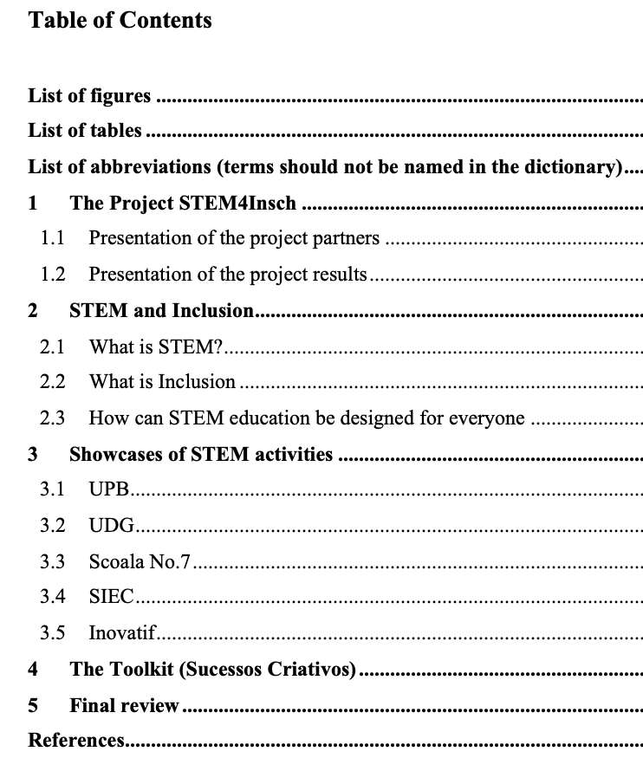
The structure of the guidebook – A suggestion by UPB
https://docs.google.com/document/d/1h0t9WxvIyO4Ul9MbMnE0L4ZBxUabpDew/edit

Slide 9
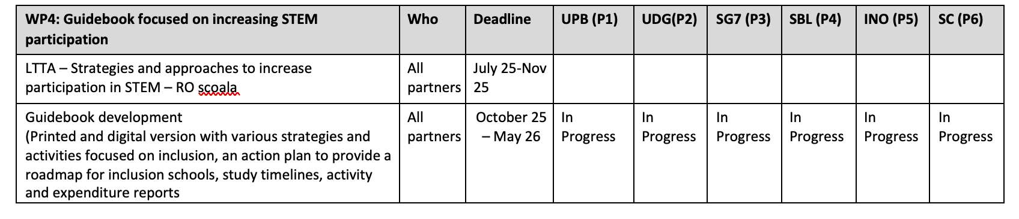
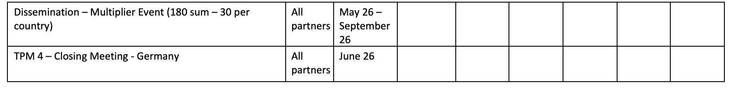
Workplan – W4

Slide 10
Contact
Prof. Dr. Marc Beutner
Tel: +49 (0) 52 51 / 60 - 23 67
Fax: +49 (0) 52 51 / 60 - 35 63
E-Mail: marc.beutner@uni-paderborn.de
Universität Paderborn
Department Wirtschaftspädagogik Lehrstuhl Wirtschaftspädagogik II Warburger Str. 100
33098 Paderborn
http://www.upb.de/wipaed
Sebastian Koppius
E-Mail: sebastian.koppius@uni-paderborn.de
Saskia Happ
E-Mail: saskia.happ@uni-paderborn.de

Slide 11
STEM for inclusive schools
School Education
ERASMUS+
KA220-NW-23-30-151162
Cooperation partnerships in school education
Reference Number:
2023-1-DE03-KA220-SCH-000151162
Duration:
03.09.2023 to 02.03.2026
(30 months)
STEM for inclusive schools
Learning – Teaching – Training - Activity – LTTA 1
Inclusive Learning Models and Use of Digital Technologies in STEM
3rd - 7th of June 2024
Insights in the current status of the STEM4inclusive project
3rd of June 2024
Presentation of the leading partner:
University of Paderborn
Chair of Business and Human Resource Education II
Prof. Dr. Marc Beutner

Slide 12
Workpackages of STEM for inclusive schools
WP 1 – PROJECT MANAGEMENT
WP 2 – STEM ACTIVITIES DESIGN AND OER
WP 3 – TOOLKIT AND DIGITAL TOOL FOR MEASUREMENT AND
EVALUATION
WP 4 – GUIDEBOOK FOCUSED ON INCREASING STEM PARTICIPATION

Slide 13
Work plan for Quality and Monitoring purposes
Latest version May 2025
https://drive.google.com/drive/folders/1IspqYmWdj_hLDoNHhcQcv457CgnNRDyv

Slide 14
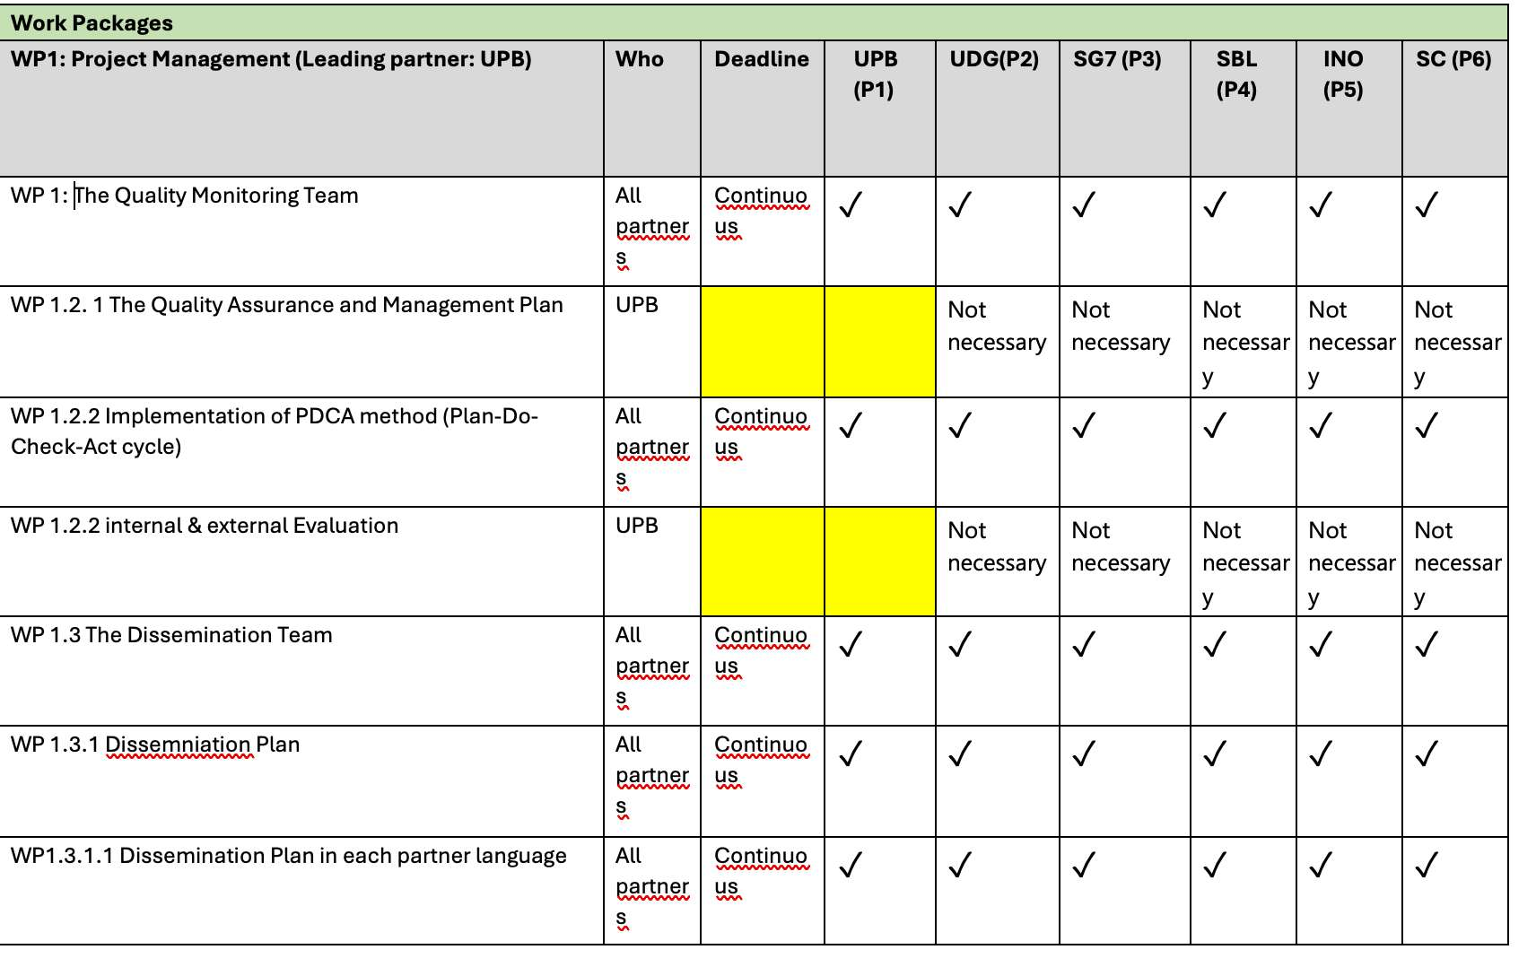
Workplan – W1

Slide 15
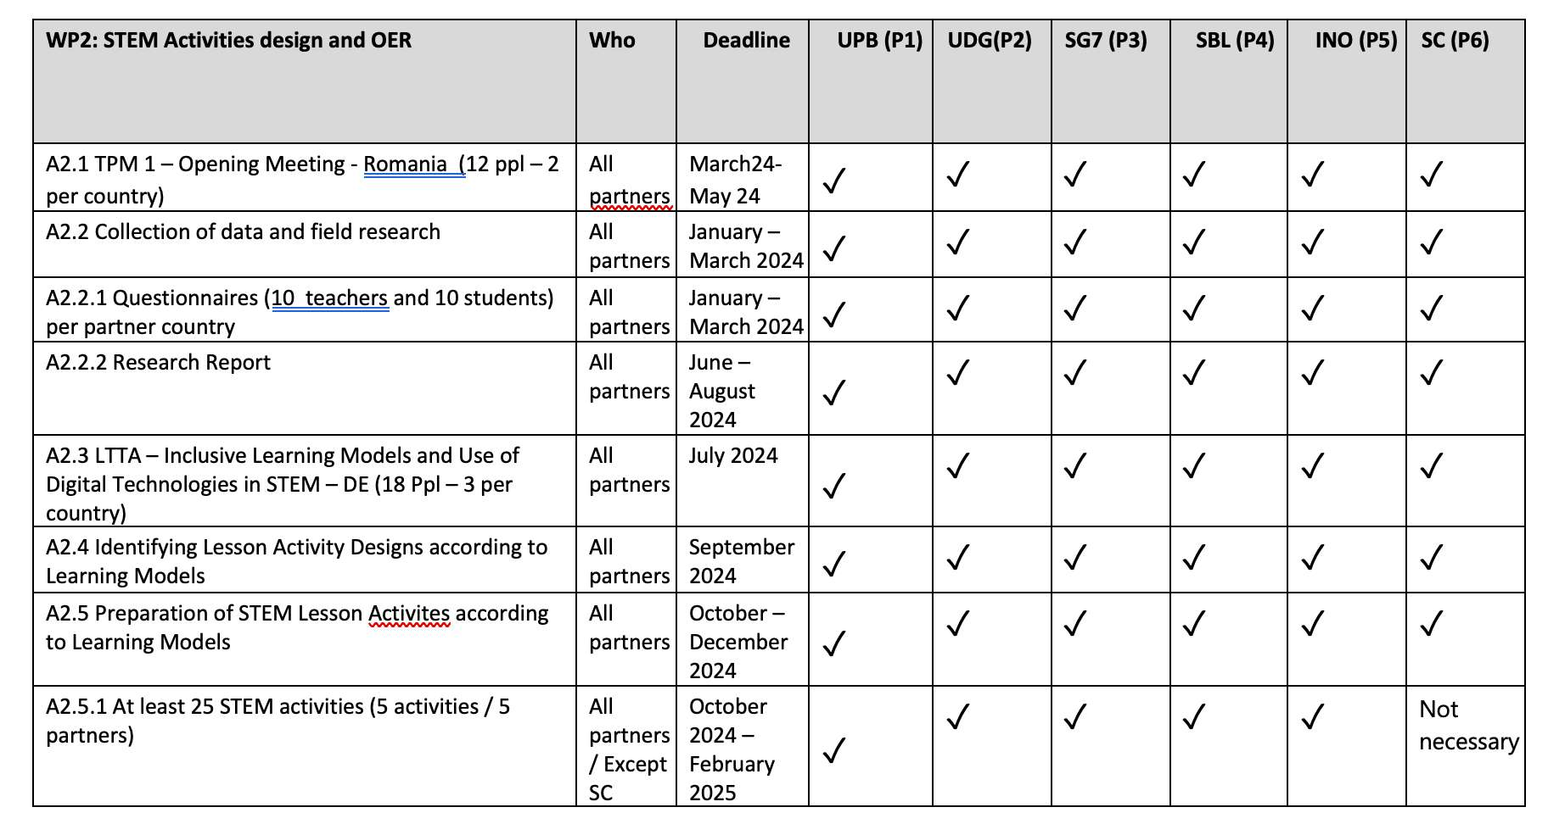
Workplan – W2

Slide 16
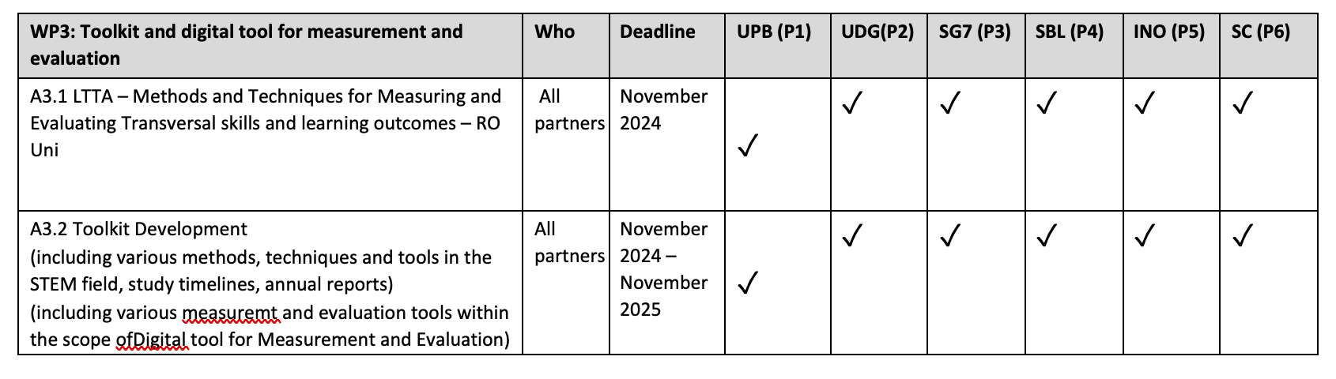
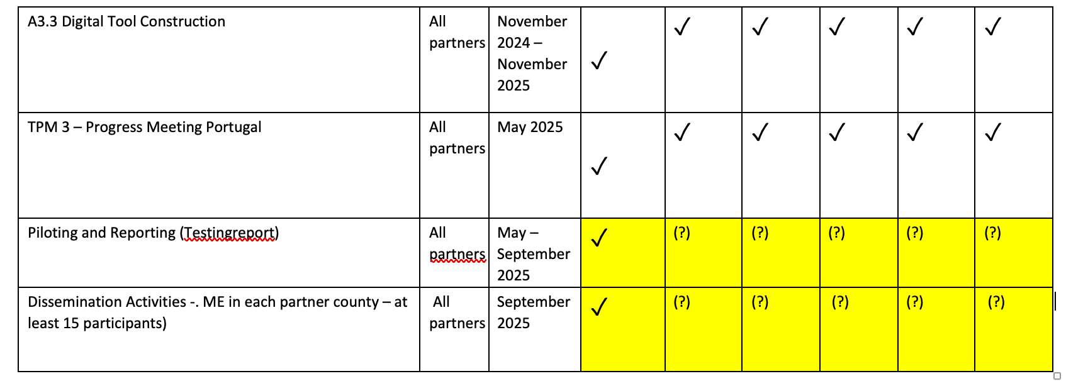
Workplan – W3

Slide 17
Workplan – W4

Slide 18
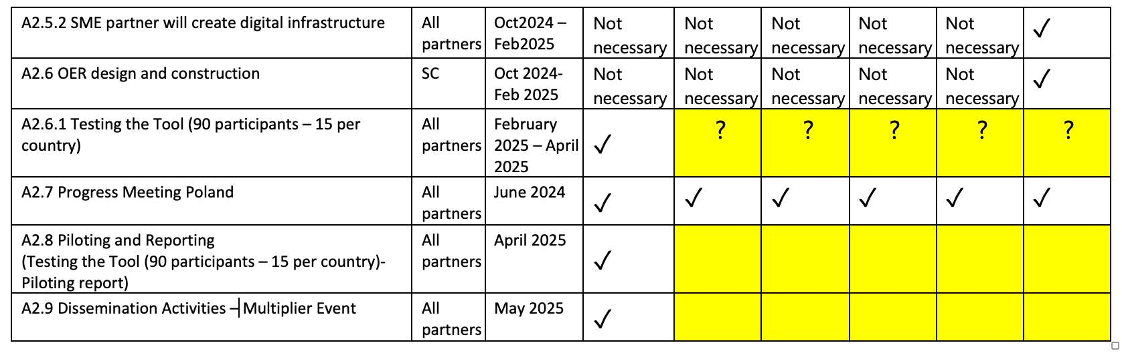
Workplan

Slide 19
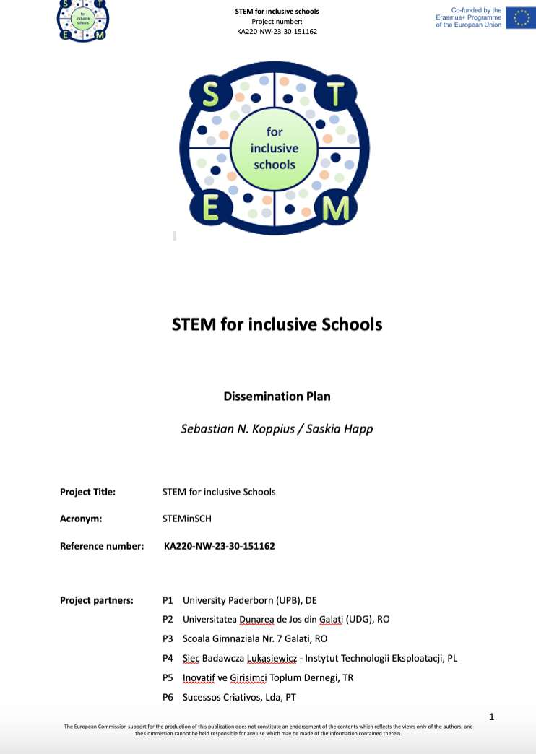
Dissemination Plan
https://docs.google.com/document/d/1y4RgOX9b37A0C3jy623W5lUp9b-cklmc/edit

Slide 20
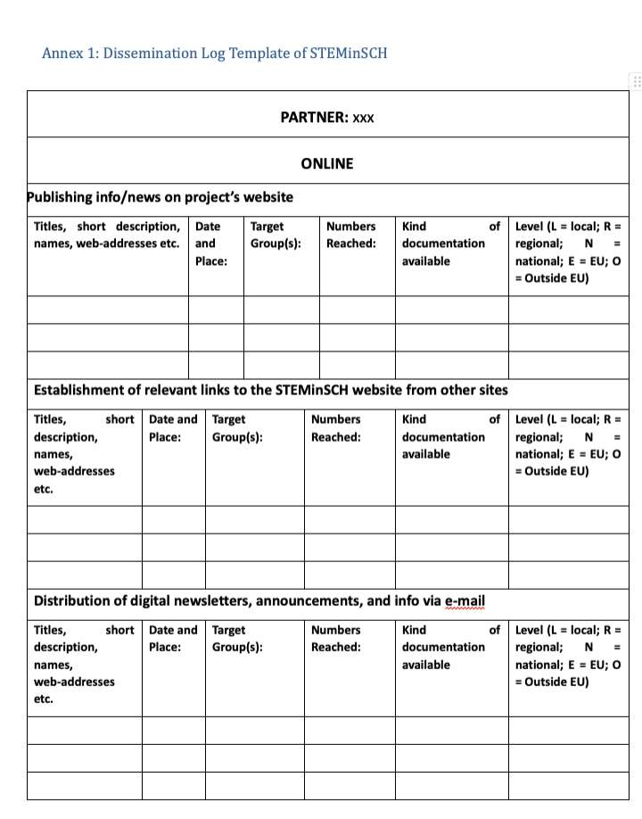
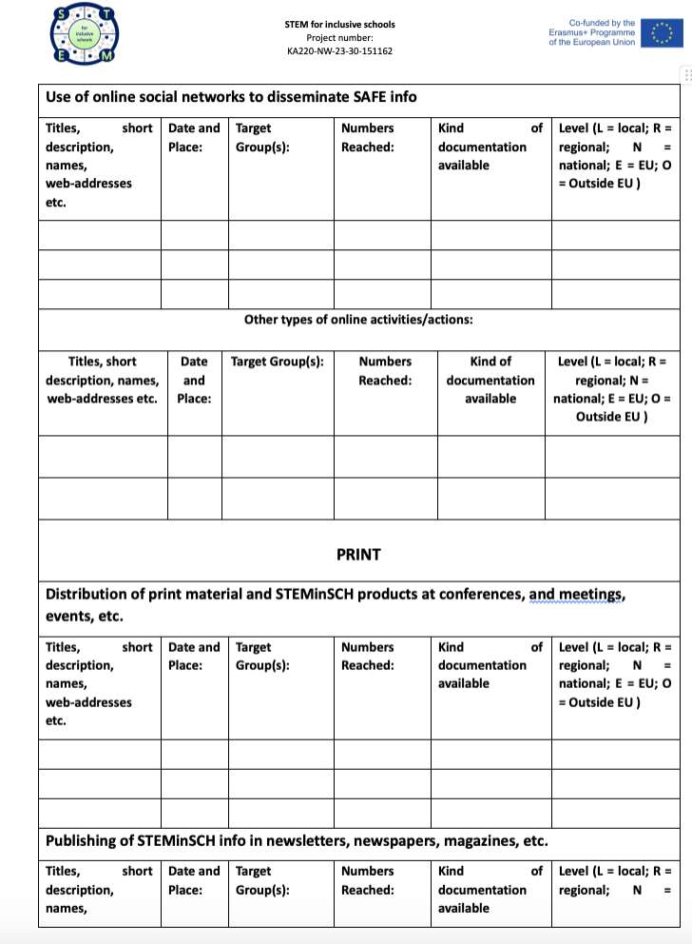
Dissemination Log

Slide 21
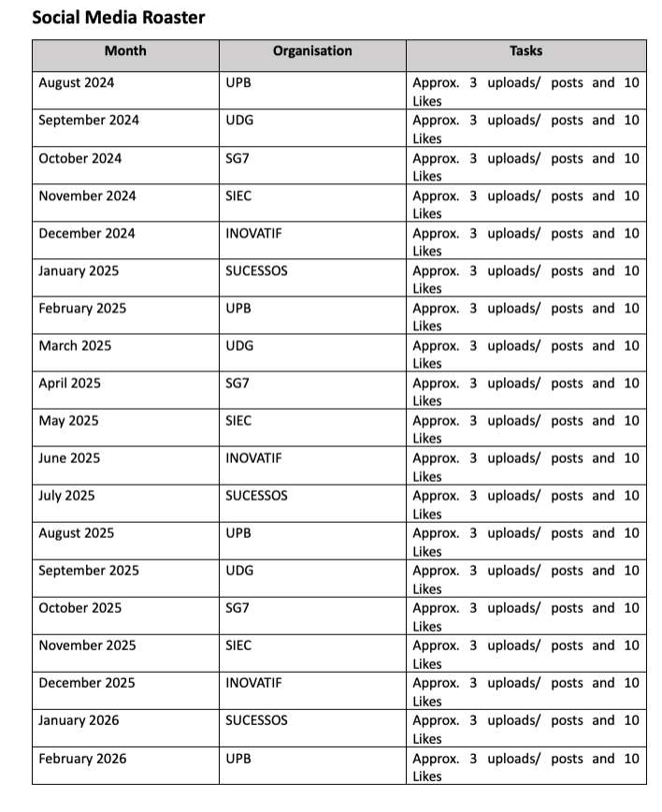
Social Media Roaster
https://drive.google.com/drive/folders/15iBU_vAuz1Urliiwq-X0_eRgB2edzhYF

Slide 22
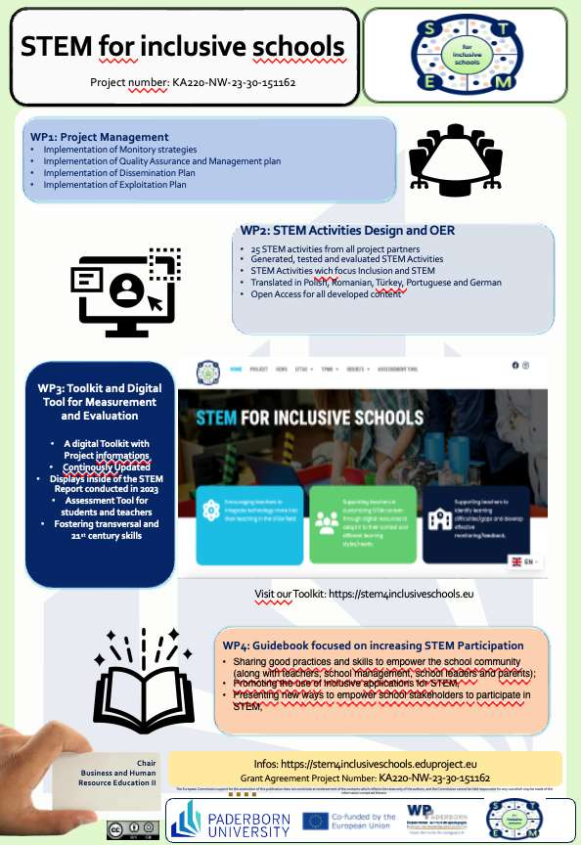
New Dissemination Poster
German version is also available

Slide 23
Questions / Discussions

Slide 24
STEM for inclusive schools
School Education
ERASMUS+
KA220-NW-23-30-151162
Cooperation partnerships in school education
Reference Number:
2023-1-DE03-KA220-SCH-000151162
Duration:
03.09.2023 to 02.03.2026
(30 months)
STEM for inclusive schools
Welcome to participants to the
3rd Transnational Project Meeting in Porto
6th – 8th of May 2025
Presentation of the leading partner:
University of Paderborn
Chair of Business and Human Resource Education II
Prof. Dr. Marc Beutner

Slide 25
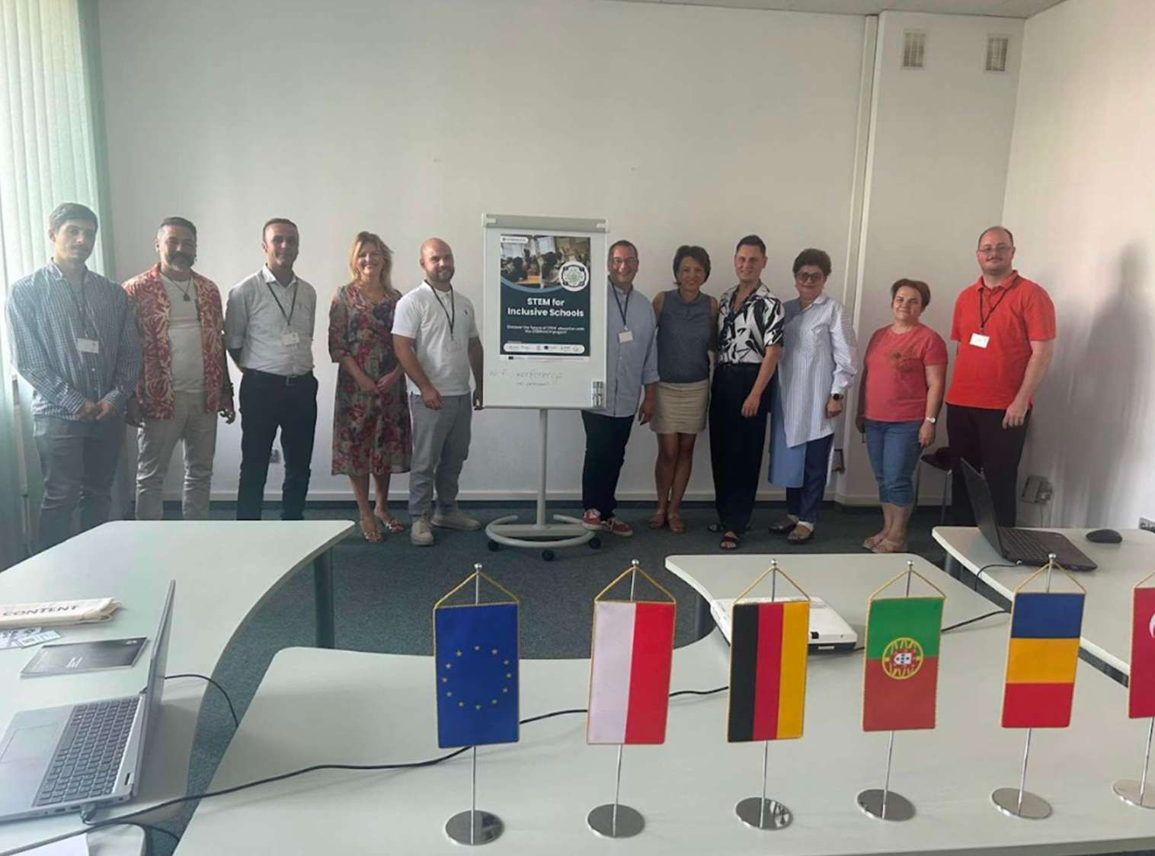
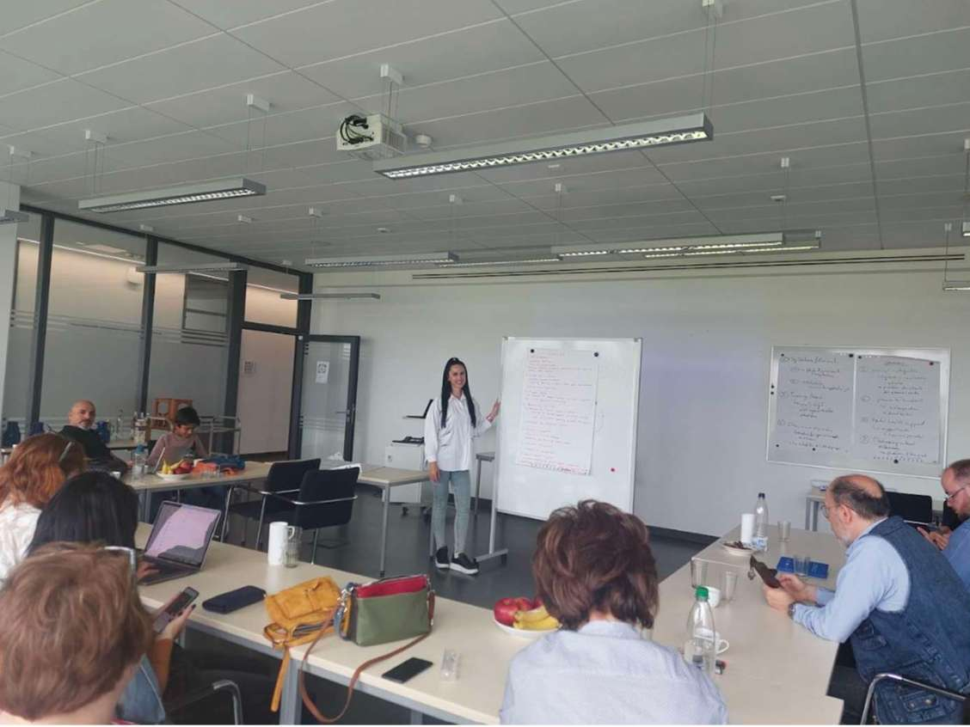
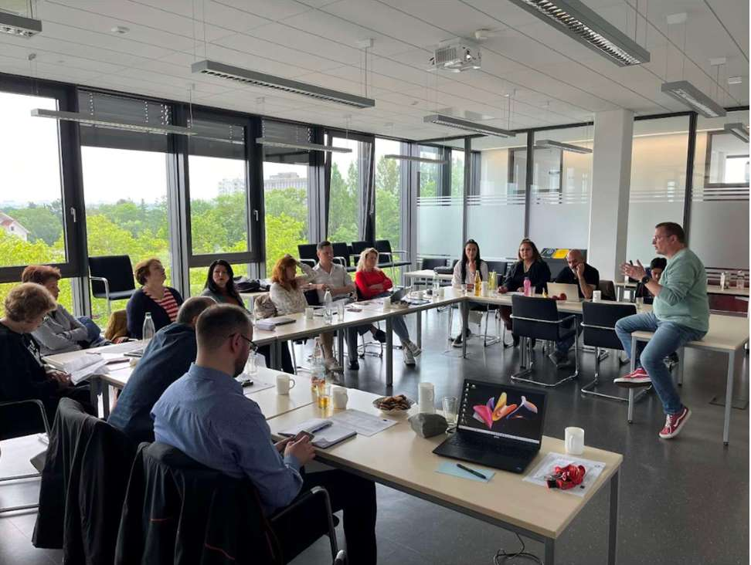
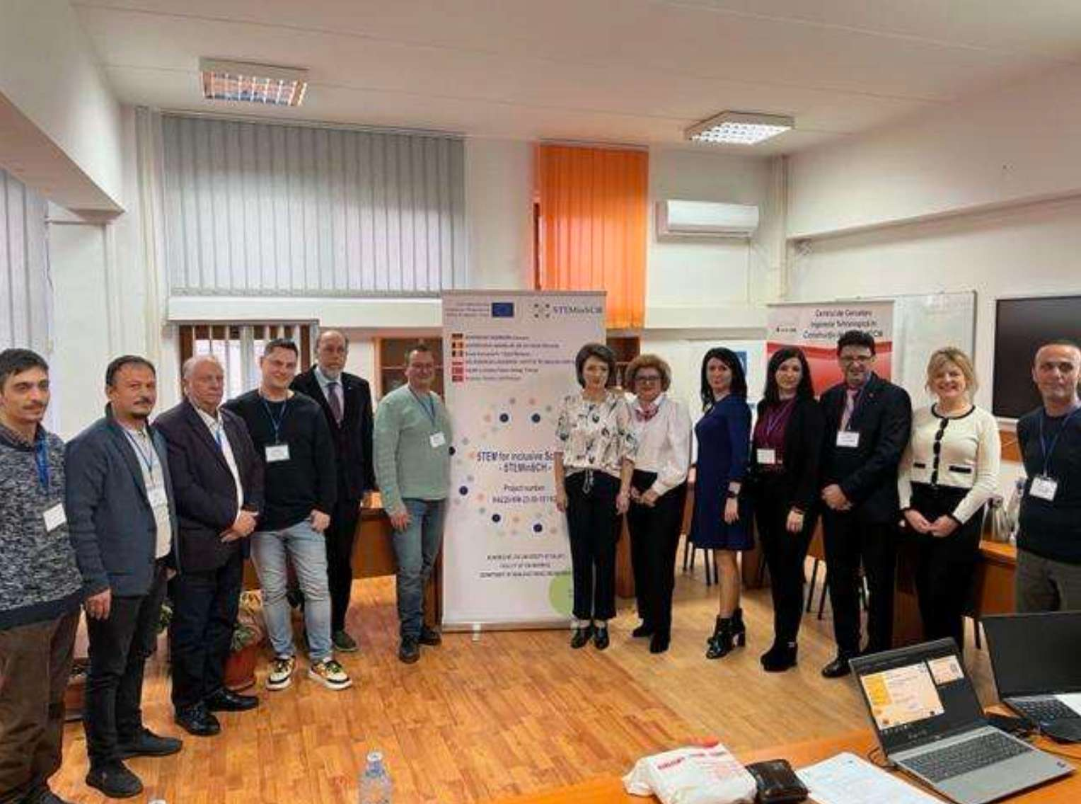
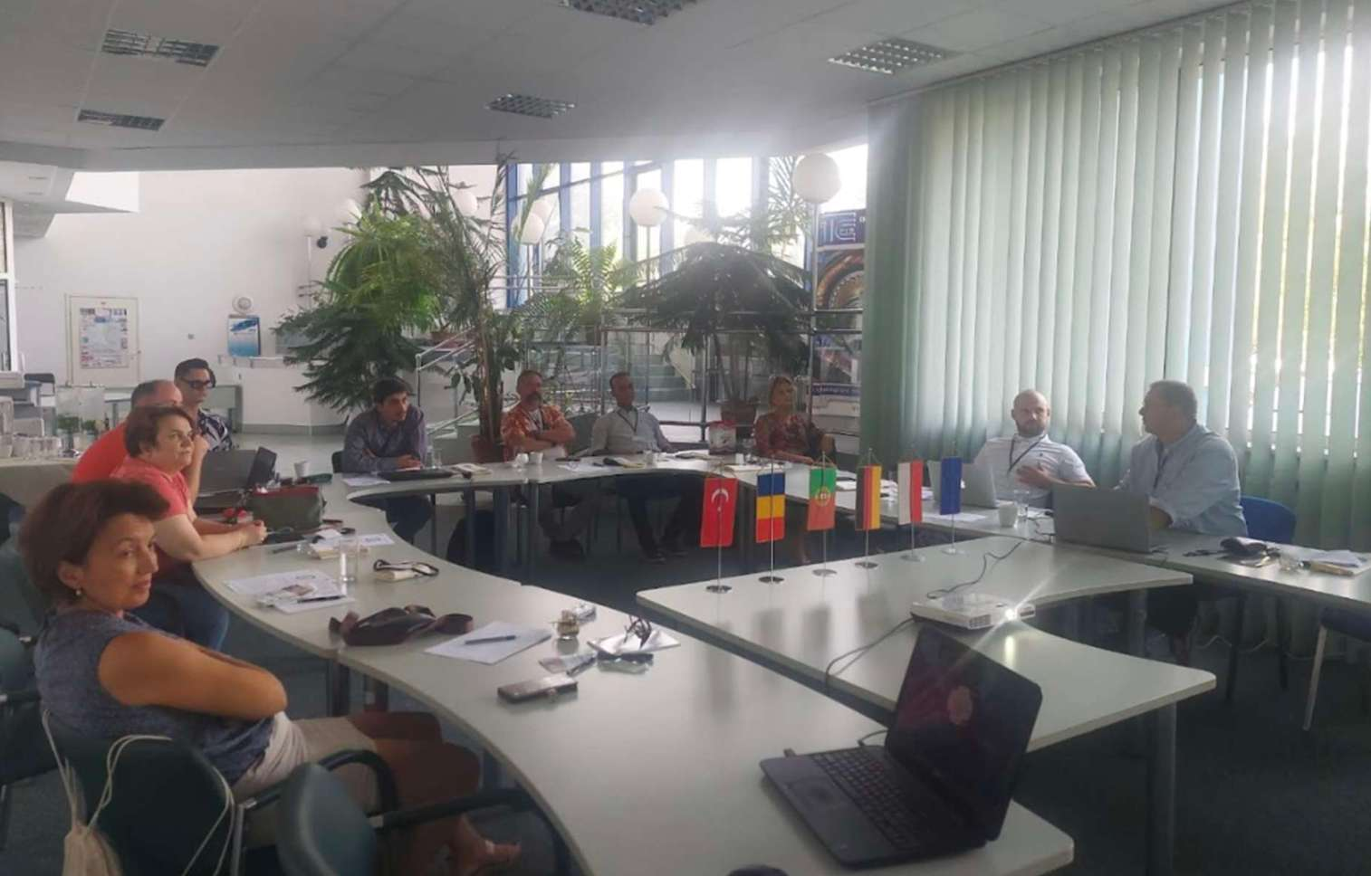
Looking back!

Slide 26
Project goals
1
Encouraging teachers to integrate technology into their STEM teaching
2
Supporting teachers in customizing STEM content
3
Supporting teachers to identify learning difficulties/gaps
4
To increase the knowledge that promote inclusion,
5
Offering ways to strengthen the school community for an inclusive school climate.

Slide 27
Workpackages of STEM for inclusive schools
WP 1 – PROJECT MANAGEMENT
WP 2 – STEM ACTIVITIES DESIGN AND OER
WP 3 – TOOLKIT AND DIGITAL TOOL FOR MEASUREMENT AND
EVALUATION
WP 4 – GUIDEBOOK FOCUSED ON INCREASING STEM PARTICIPATION

Slide 28
Workplan – W1

Slide 29
Workplan – W2

Slide 30
Workplan – W3

Slide 31
Workplan – W4

Slide 32
Workplan

Slide 33
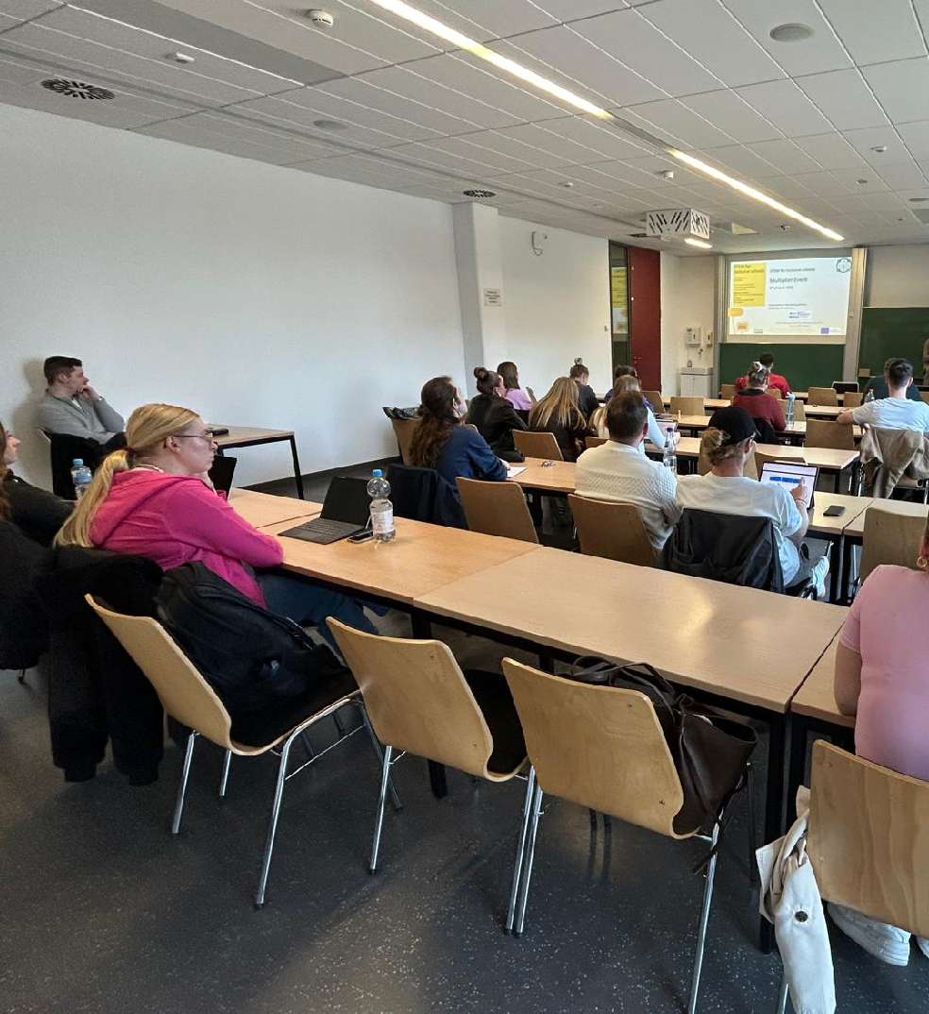
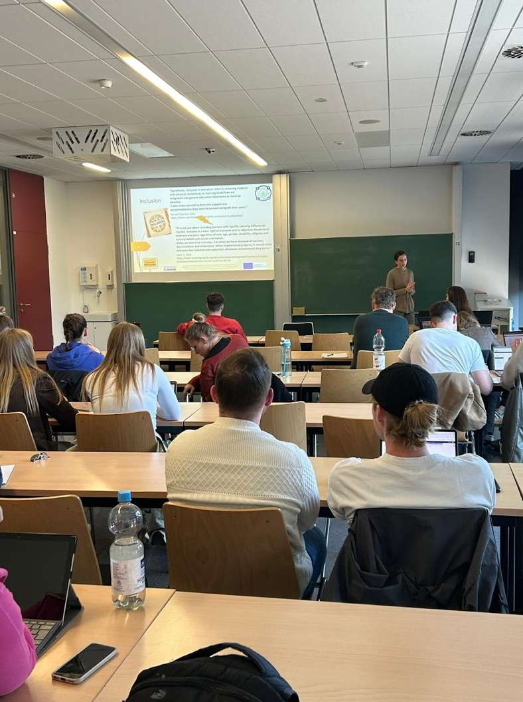
Insights of the Multipliever Event

Slide 34
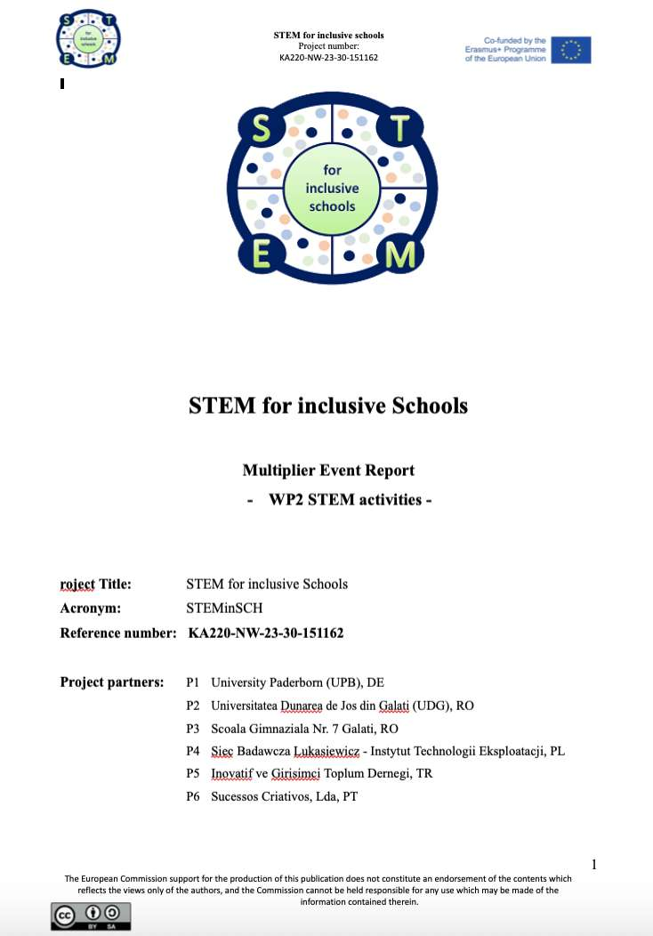
Insights of the Multiplier Event
https://docs.google.com/document/d/1KqJN4lzIlv3-gcKNcS-8FEt_gRiQa_mz/edit

Slide 35
Contact
Prof. Dr. Marc Beutner
Tel: +49 (0) 52 51 / 60 - 23 67
Fax: +49 (0) 52 51 / 60 - 35 63
E-Mail: marc.beutner@uni-paderborn.de
Universität Paderborn
Department Wirtschaftspädagogik Lehrstuhl Wirtschaftspädagogik II Warburger Str. 100
33098 Paderborn
http://www.upb.de/wipaed
Sebastian Koppius
E-Mail: sebastian.koppius@uni-paderborn.de
Saskia Happ
E-Mail: saskia.happ@uni-paderborn.de

Slide 36
STEM for inclusive schools
School Education
ERASMUS+
KA220-NW-23-30-151162
Cooperation partnerships in school education
Reference Number:
2023-1-DE03-KA220-SCH-000151162
Duration:
03.09.2023 to 02.03.2026
(30 months)
STEM for inclusive schools
Welcome to the
3rd Transnational Project Meeting in Porto
6th – 8th of May 2025
Presentation of the coordinating partner:
Paderborn University
Chair of Business and Human Resource Education II
Prof. Dr. Marc Beutner

Slide 37


Welcome to the
3rd Transnational Project Meeting in Porto
- Validation Meeting -

Slide 38
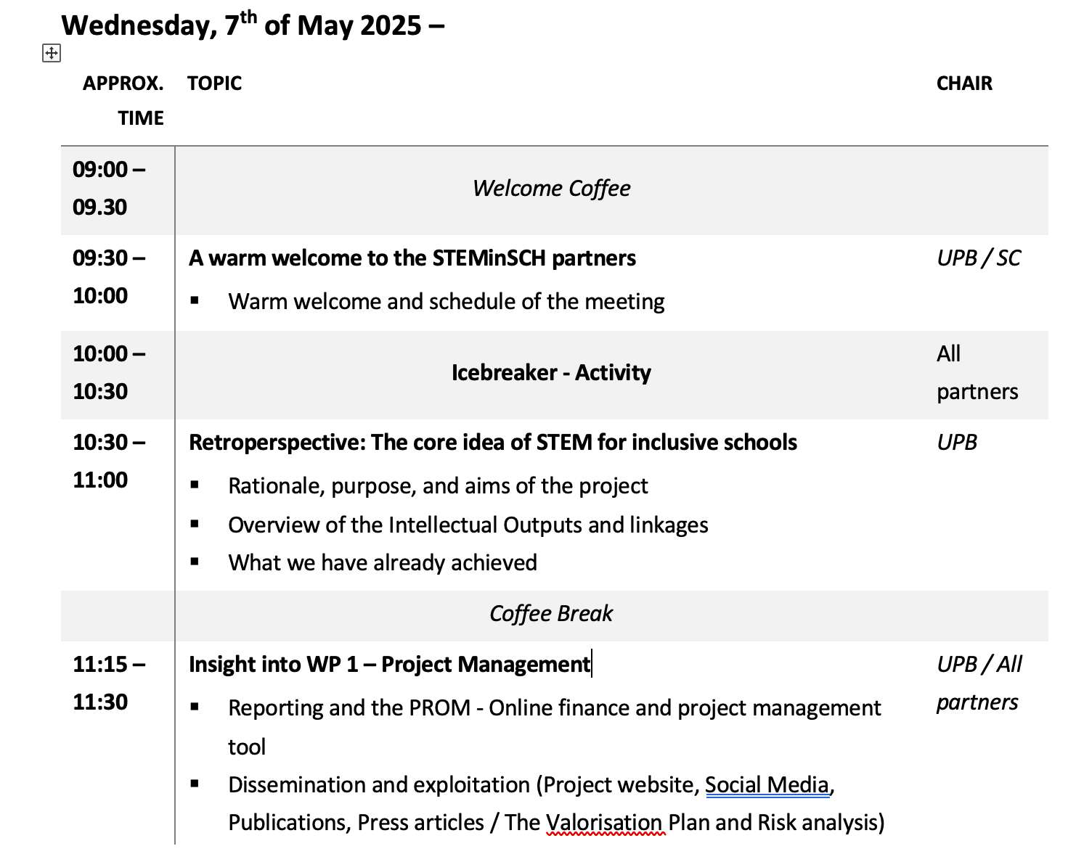
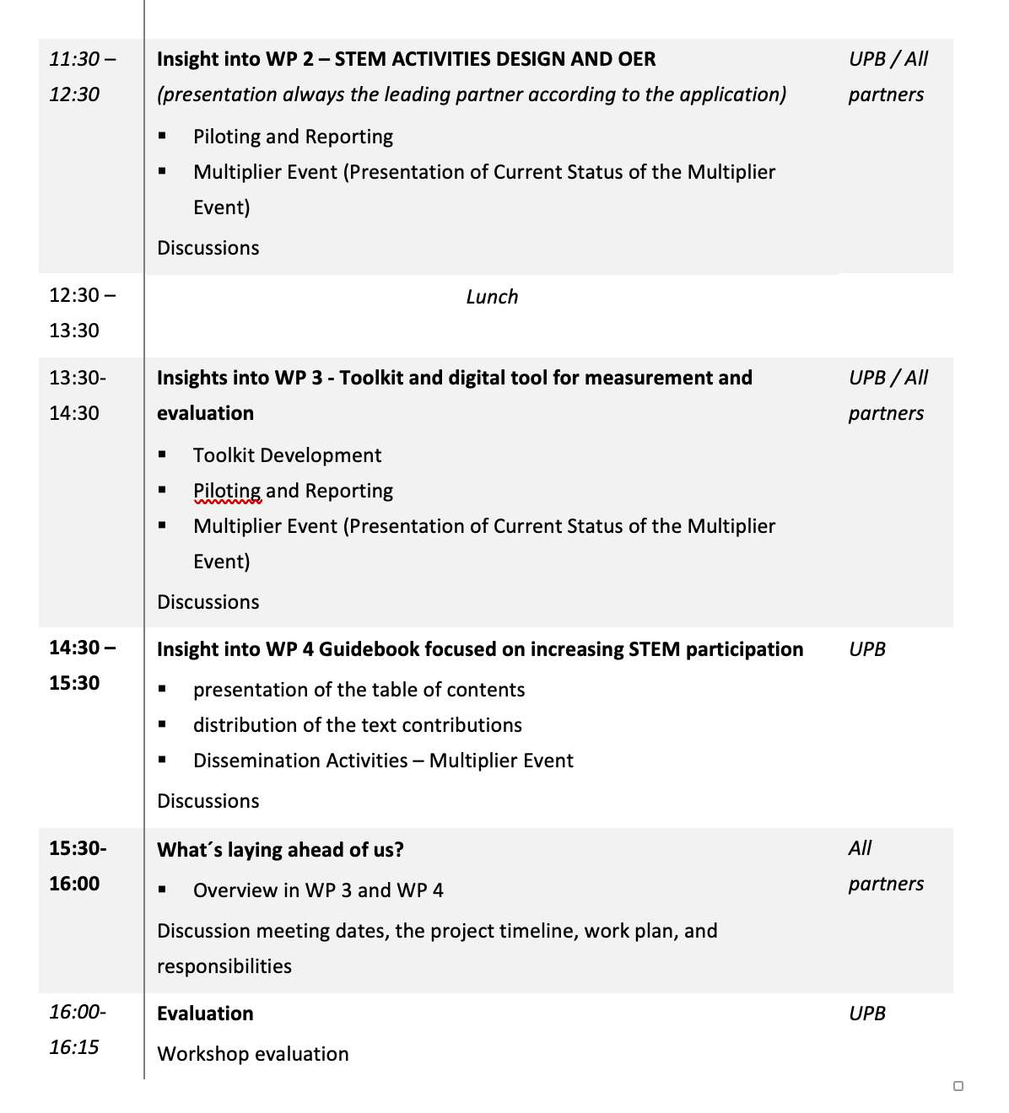
Welcome to the
3rd Transnational Project Meeting in Porto
- Meeting Agenda –

Slide 39
- Meeting Agenda –

Slide 40
- Meeting Agenda –

Slide 41
Contact
Prof. Dr. Marc Beutner
Tel: +49 (0) 52 51 / 60 - 23 67
Fax: +49 (0) 52 51 / 60 - 35 63
E-Mail: marc.beutner@uni-paderborn.de
Universität Paderborn
Department Wirtschaftspädagogik Lehrstuhl Wirtschaftspädagogik II Warburger Str. 100
33098 Paderborn
http://www.upb.de/wipaed
Sebastian Koppius
E-Mail: sebastian.koppius@uni-paderborn.de
Saskia Happ
E-Mail: sebastian.happ@uni-paderborn.de

Slide 42
STEM for inclusive schools
School Education
ERASMUS+
KA220-NW-23-30-151162
Cooperation partnerships in school education
Reference Number:
2023-1-DE03-KA220-SCH-000151162
Duration:
03.09.2023 to 02.03.2026
(30 months)
STEM for inclusive schools
Welcome to participants to the
3rd Transnational Project Meeting in Porto
6th – 8th of May 2025
Presentation of the leading partner:
University of Paderborn
Chair of Business and Human Resource Education II
Prof. Dr. Marc Beutner

Slide 43
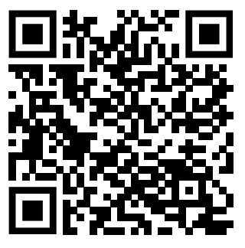

Meeting Evaluation
https://umfragen.uni-paderborn.de/index.php/886891?lang=en

Slide 44
Contact
Prof. Dr. Marc Beutner
Tel: +49 (0) 52 51 / 60 - 23 67
Fax: +49 (0) 52 51 / 60 - 35 63
E-Mail: marc.beutner@uni-paderborn.de
Universität Paderborn
Department Wirtschaftspädagogik Lehrstuhl Wirtschaftspädagogik II Warburger Str. 100
33098 Paderborn
http://www.upb.de/wipaed
Sebastian Koppius
E-Mail: sebastian.koppius@uni-paderborn.de
Saskia Happ
E-Mail: sebastian.happ@uni-paderborn.de

Slide 45
STEM for inclusive schools
School Education
ERASMUS+
KA220-NW-23-30-151162
Cooperation partnerships in school education
Reference Number:
2023-1-DE03-KA220-SCH-000151162
Duration:
03.09.2023 to 02.03.2026
(30 months)
STEM for inclusive schools
Welcome to participants to the
3rd Transnational Project Meeting in Porto
6th – 8th of May 2025
Presentation of the leading partner:
University of Paderborn
Chair of Business and Human Resource Education II
Prof. Dr. Marc Beutner

Slide 46
Workplan – W1

Slide 47
Workplan – W2

Slide 48
Workplan – W3

Slide 49
Workplan – W4

Slide 50
Workplan

Slide 51
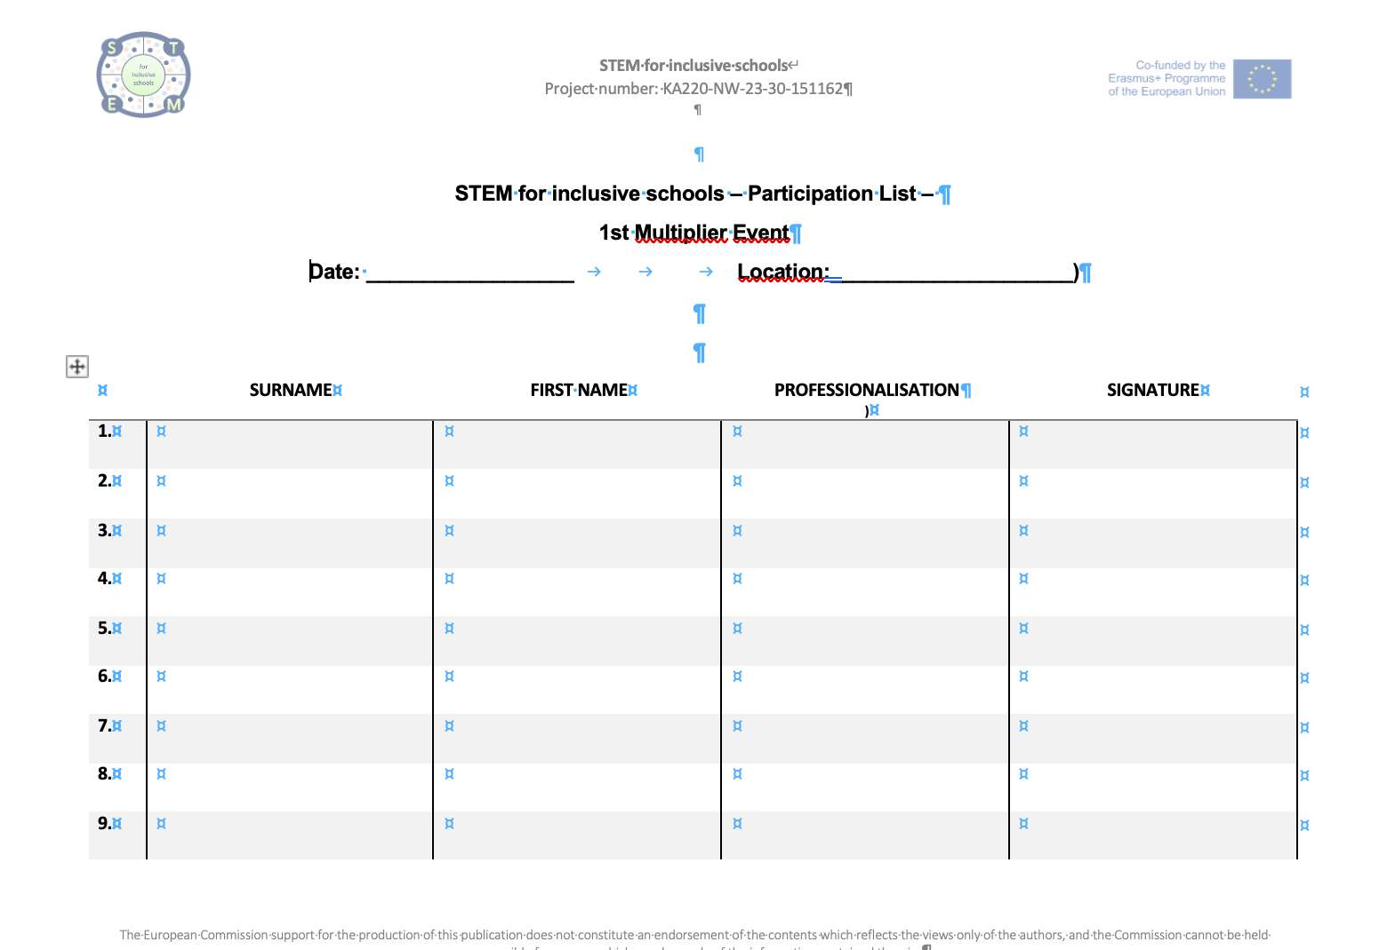
Please document the participants. Photos are very welcome.

Slide 52
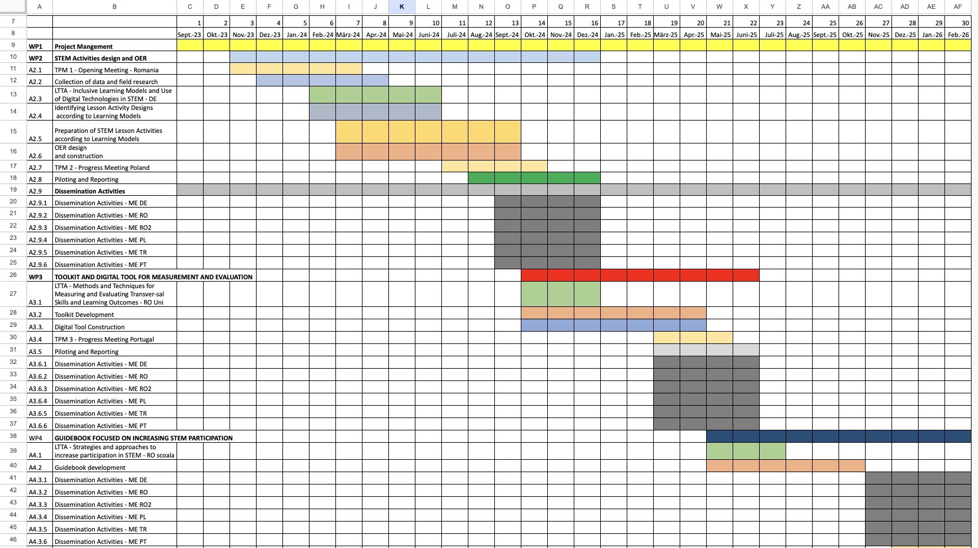
Multiplier Event Timetable
ME1
September 2024 – December 2024
ME2
March 2025 – July 2025
ME3
November 2025 - February 2026

Slide 53
4 Transnational Partner Meetings - TPMs
TPM 1 – Kick-off - Romania
Between
Nov 2023 and March 2024
Suggested date:
16th to 18th of Jan 2024
Suggested date:
11st. to 13rd of Jan 2024
TPM 2 – Progress I - Poland
Between
July 2024 and Oct 2024
Suggested date:
13th to 15th of Aug 2024
Suggested date:
13th to 15th of Aug 2024
TPM 3 – Progress II - Portugal
Between
March 2025 and May 2025
Suggested date:
22th to 24th of Apr 2025
Suggested date:
3rd to 5th of September 2024
TPM 4 – Final - Germany
Between
Dec 2025 and Feb 2026
Suggested date:
16th to 18th of Dec 2025
Suggested date:
16th to 18th of Dec 2025

Slide 54
3 Learning Teaching Training Activities - LTTAs
LTTA 1 – Inclusive Learning Models and Use of Digital Technologies in STEM – Germany
Between
Feb 2024 and June 2024
Suggested date:
8th to 12th of April 2024
Suggested date:
8th to 12th of April 2024
LTTA 2 – Methods and Techniques for
Measuring and Evaluating Transversal Skills and Learning Outcomes – Romania xUni
Between
Oct 2024 and Dec 2024
Suggested date:
8th to 12th of April 2024
Suggested date:
8th to 12th of April 2024
LTTA 3 – LTTA - Strategies and approaches to increase participation in STEM – Romania Soala
Between
May 2025 and Jul 2025
Suggested date:
8th to 12th of April 2024
Suggested date:
22th to 26th of September 2025

Slide 55

Open Tasks / Any Comments

Slide 56
Contact
Prof. Dr. Marc Beutner
Tel: +49 (0) 52 51 / 60 - 23 67
Fax: +49 (0) 52 51 / 60 - 35 63
E-Mail: marc.beutner@uni-paderborn.de
Universität Paderborn
Department Wirtschaftspädagogik Lehrstuhl Wirtschaftspädagogik II Warburger Str. 100
33098 Paderborn
http://www.upb.de/wipaed
Sebastian Koppius
E-Mail: sebastian.koppius@uni-paderborn.de
Saskia Happ
E-Mail: saskia.happ@uni-paderborn.de

Slide 57
STEM for inclusive schools
School Education
ERASMUS+
KA220-NW-23-30-151162
Cooperation partnerships in school education
Reference Number:
2023-1-DE03-KA220-SCH-000151162
Duration:
03.09.2023 to 02.03.2026
(30 months)
STEM for inclusive schools
Welcome to participants to the
3rd Transnational Project Meeting in Porto
6th – 8th of May 2025
Presentation of the coordinating partner:
University of Paderborn
Chair of Business and Human Resource Education II
Prof. Dr. Marc Beutner

Slide 58
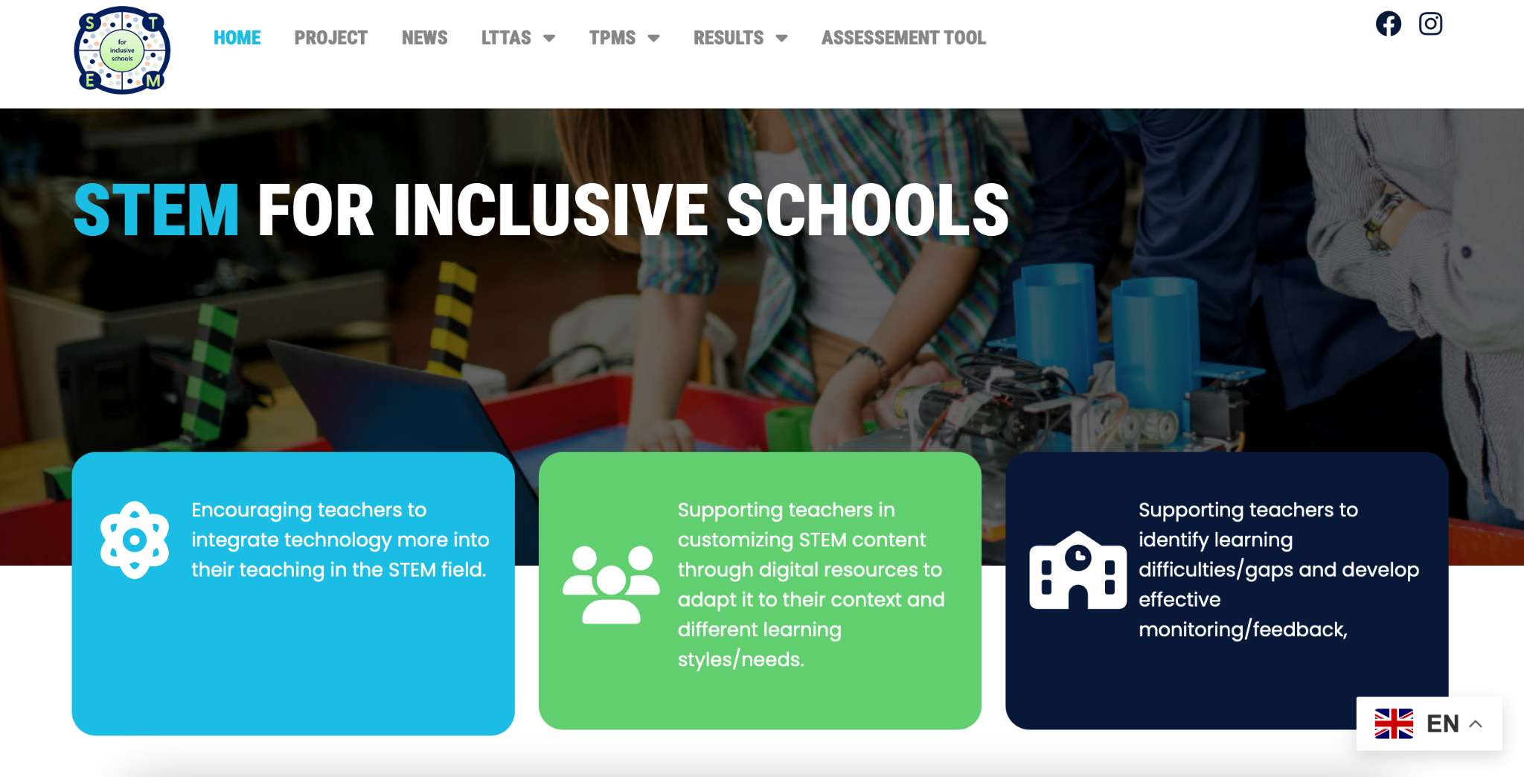

Act 3.3 Digital Tool Construction
https://stem4inclusiveschools.eu

Slide 59
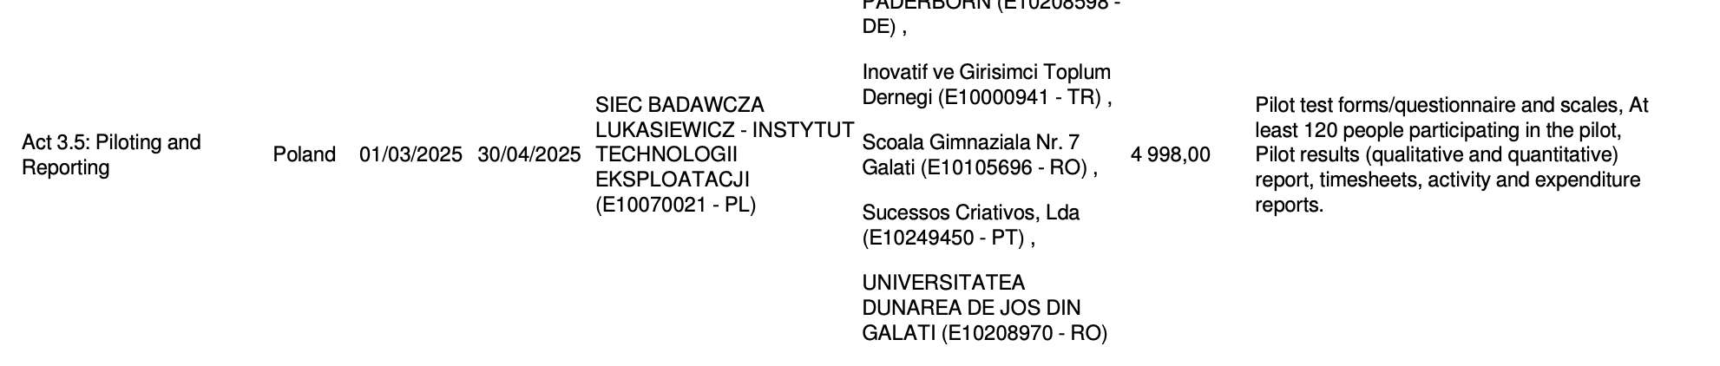
Act 3.5 Piloting and Reporting

Slide 60
Contact
Prof. Dr. Marc Beutner
Tel: +49 (0) 52 51 / 60 - 23 67
Fax: +49 (0) 52 51 / 60 - 35 63
E-Mail: marc.beutner@uni-paderborn.de
Universität Paderborn
Department Wirtschaftspädagogik Lehrstuhl Wirtschaftspädagogik II Warburger Str. 100
33098 Paderborn
http://www.upb.de/wipaed
Sebastian Koppius
E-Mail: sebastian.koppius@uni-paderborn.de
Saskia Happ
E-Mail: saskia.happ@uni-paderborn.de

